Slide 1





Vietnam Beer Market
Vietnam Beer Market and Tet 2026 Consumer Trends
2026 January

Slide 2
Research Overview & Methodology
Comprehensive Investigation into Vietnam Beer Market
Market Context
This report examines the beer market in 2026, with a strong outlook for Tet 2026 purchases, focusing on key players, market trends, consumer usage and attitudes, brand perceptions, and beer type preferences.
Research Objectives
Assess impact of zero-alcohol laws on consumption patterns
Evaluate brand preferences and perceptions for Tet 2026
Understand purchase decision drivers across segments
Identify emerging trends in health-conscious consumption
Map regional and generational differences
Fieldwork Period & Timeline
Fieldwork: December 2-15, 2025
Analysis & Reporting: December 16-30, 2025
Vietnam Beer Market and Tet 2026 Consumer Trends | InsightAsia Vietnam Primary Research | December 2025

Slide 3
Research Overview & Methodology
Research Methodology
Quantitative survey
Qualitative Research
Sample | 1,200 respondents
Age | 18-45 years
Criteria | Beer drinkers (monthly+)
Method | Online survey
Quotas | Gender (72% Male – 28% Female)
Consumer IDIs | 14 in-depth interviews
Profile | Regular drinkers, occasional drinkers, Gen Z explorers, premium seekers (aged 22-42)
Duration | 30-45 minutes per interview
Geographic Coverage
Key city coverage
Ho Chi Minh City (n=420)
Hanoi (n=380)
Da Nang (n=240)
Can Tho (n=160)
Vietnam Beer Market and Tet 2026 Consumer Trends | InsightAsia Vietnam Primary Research | December 2025

Slide 4
Market Landscape & Context
The "Cautious Celebration" Era: Vietnam's beer market enters Tet 2026 facing a perfect storm of regulatory tightening, economic pressure, and shifting consumer values.
Zero-alcohol driving laws and anticipated tax increases have fundamentally reshaped consumption patterns, pushing beer drinking from restaurants and bars into homes. While Tet remains a "must-celebrate" occasion, consumers are approaching it with more pragmatism, buying fewer bottles but sometimes trading up to premium or craft options for gifting, while mainstream brands dominate family gatherings. Despite brand marketing push, consumers fundamentally reject non-alcoholic beer (82% say "without alcohol, it's not beer"), highlighting the gap between corporate strategy and consumer reality.
-5.8%
Market Contraction
Expected Tet 2026 volume decline YoY due to tax increase anticipation and continued regulatory pressure
67%
Home Consumption Dominance
Of Tet beer consumption now occurs at home, up from 45% in 2019, driven by zero-alcohol laws
42%
Selective Premiumization
Purchase both mainstream (for family) and premium/craft (for gifting) during Tet. Premium segment (incl. craft/imports) grows to 35.5% despite volume decline.
82%
Non-Alcoholic Rejection
Say "without alcohol, it's not beer" — fundamental consumer rejection despite heavy brand push. Only 4.2% actual purchase penetration.
Vietnam Beer Market and Tet 2026 Consumer Trends | InsightAsia Vietnam Primary Research | December 2025

Slide 5

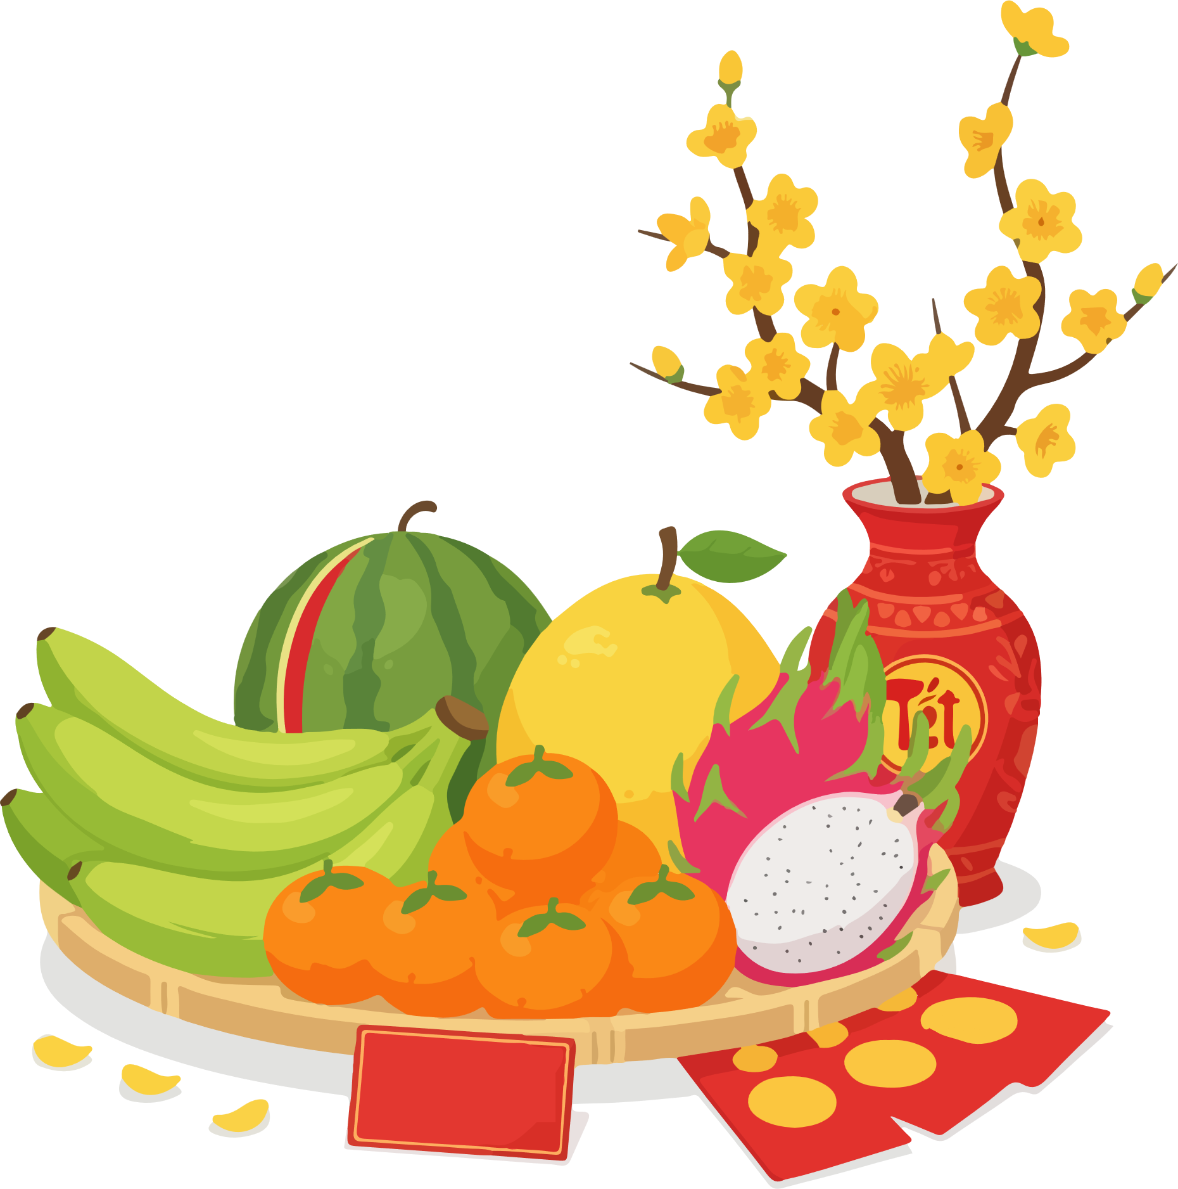

Four Defining Trends Shaping Tet 2026
78%
Off-Trade Shift
Tet beer purchased from modern retail & e-commerce
64%
Gifting Priority
Consider beer quality & packaging critical for Tet gifts
35%
Digital First
Research or purchase Tet beer online (urban markets)
52%
Moderation Mindset
Gen Z/Millennials actively trying to drink less
Vietnam Beer Market and Tet 2026 Consumer Trends | InsightAsia Vietnam Primary Research | December 2025

Slide 6
Market Context & Regulatory Environment
Regulatory Pressures Reshaping the Market
Zero-Alcohol Driving Law Impact
Tax Increase 2026 Anticipated Impact
On-premise consumption decline | -55%
Home consumption share | 67%
Consumers avoiding drinking when driving | 82%
Impact on restaurant/bar visits | Very high
Excise tax increase (2026) | 65% → 80%
Expected retail price increase | +18-22%
Consumers aware of price increase | 47%
Planning to reduce consumption | 38%
I used to go out to beer gardens 3-4 times a week, but now with the strict laws, I only drink at home. If I go out, I take Grab. It's not the same feeling, but it's safer and I save money.
— Male, 32, Office Worker, Ho Chi Minh City
Vietnam Beer Market and Tet 2026 Consumer Trends | InsightAsia Vietnam Primary Research | December 2025

Slide 7
Market Context & Regulatory Environment
Economic & Market Performance Indicators
Total Beer Production (mil. L)
Market Share by Different Segments
100%
(est.)
(forecast)
Per Capita Consumption (L/year)
2023 | 2024 | 2025 (est.) | 2026 (forecast)
Off-trade channel
Premium
Craft & Premium Import
(est.)
(forecast)
My friends and I now do house parties instead of going to bars. We buy beer from the supermarket,
it's much cheaper, and we can drink without worrying about getting stopped by police on the way home.
— Female, 27, Marketing Executive, Da Nang
Q: How have your beer consumption patterns changed in the past year?| Are you aware of the upcoming tax increase on beer? | How do zero-alcohol driving laws affect your drinking behavior?
Base: All respondents (n=1,200) | Vietnam Beer Market and Tet 2026 Consumer Trends | InsightAsia Vietnam Primary Research | December 2025

Slide 8
Current Consumption Patterns & Frequency
Beer Consumption Frequency
2-3 times per week | 34%
Once per week | 28%
2-3 times per month | 22%
Once per month | 11%
Daily | 5%
Key Consumption Occasions
Weekend relaxing/social gatherings | 72%
Family meals / celebrations | 64%
Special occasions | 58%
After work / stress relief | 52%
Watching sports / entertainment | 45%
Where Beer is Consumed
At home | 67%
Friends’ Home | 48%
Beer Gardens/ Bia Hoi | 38%
Restaurants | 32%
Convenience Stores | 18%
Bars/ Pubs | 15%
Weekly+ drinkers represent 62%
The majority consume beer at least once per week, showing strong baseline demand despite market headwinds
Social occasions remain important
Despite regulatory pressure, 72% still drink for weekend social gatherings, indicating beer's continued cultural significance
Home-centric consumption
67% now drink primarily at home (vs. 45% in 2019), driven by zero-alcohol laws and cost pressure.
On-premise decline
Only 15% visit bars/pubs and 38% visit beer gardens, sharply decline vs. pre-2020.
Q: How often do you typically consume beer? | Where do you typically consume beer? | On what occasions do you typically drink beer?
Base: All respondents (n=1,200) | Vietnam Beer Market and Tet 2026 Consumer Trends | InsightAsia Vietnam Primary Research | December 2025

Slide 9
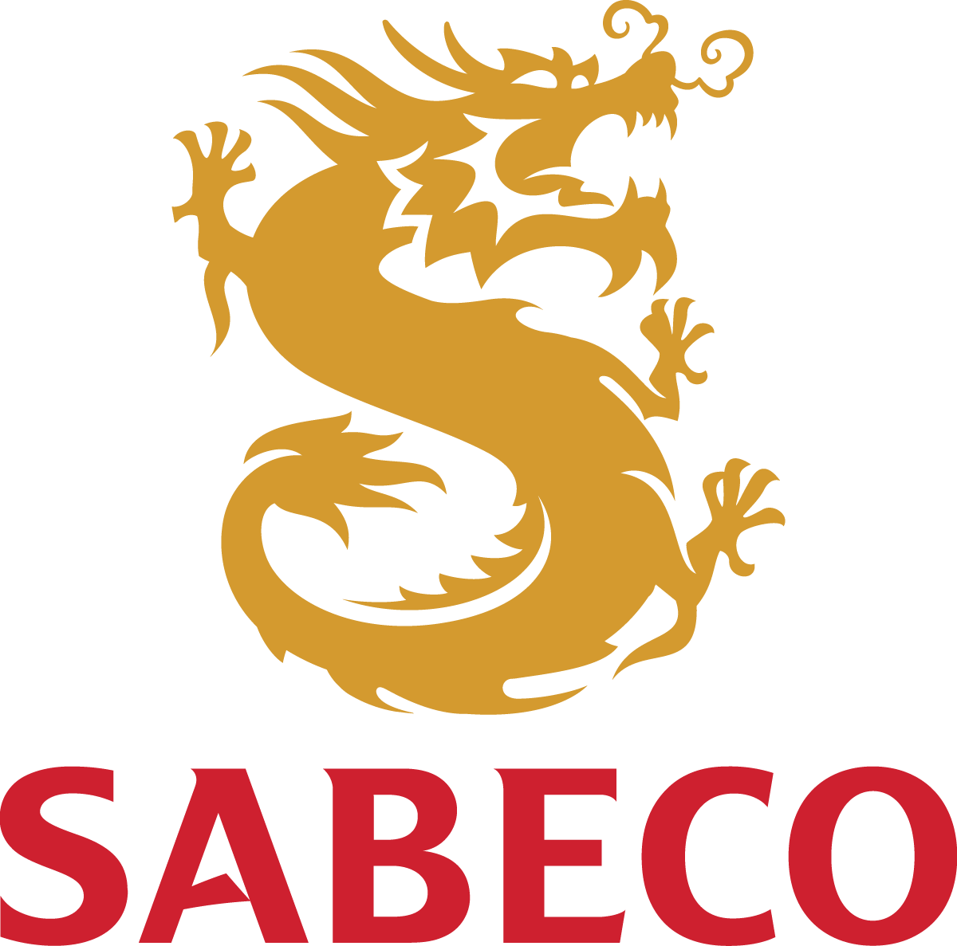

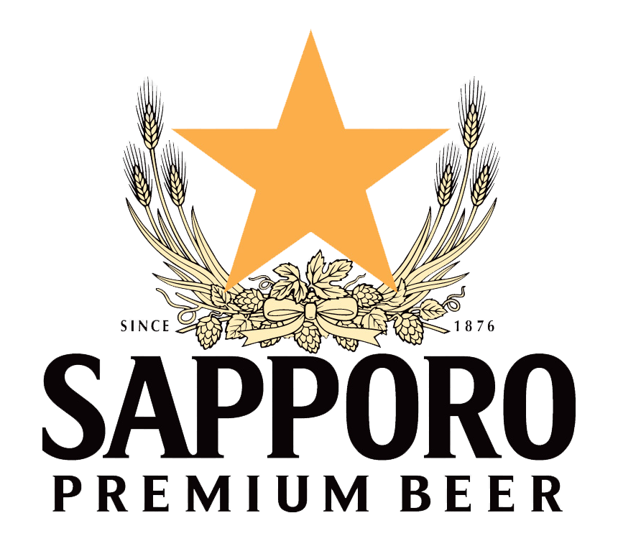
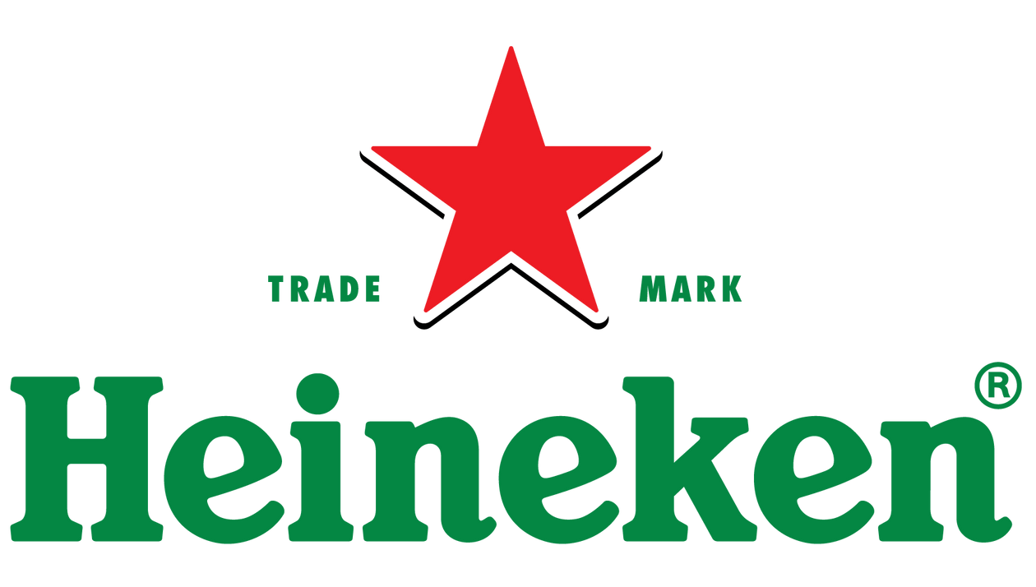


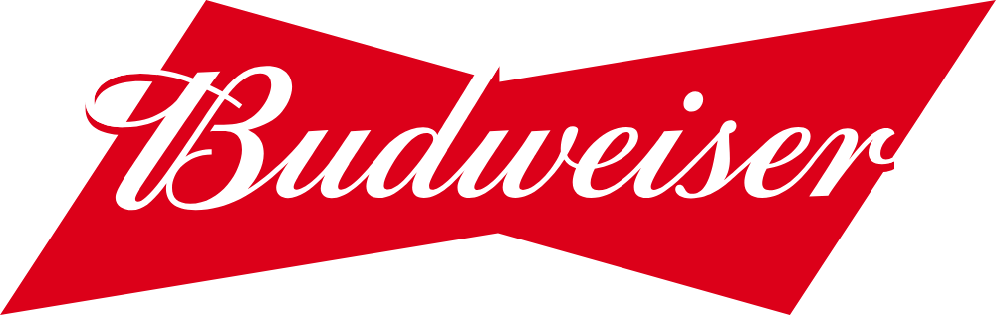
Brand Awareness & Consumption
Local dominance persists: Saigon maintains highest awareness (84%) and consideration (72%) despite premium segment growth
Awareness vs. Usage gap: All brands show 15-20% gap between awareness and actual consumption, indicating trial barriers or price sensitivity
Mainstream | Premium | Premium | Mainstream | Mainstream | Premium | Premium
Q: Which beer brands can you name? | Which brands have you consumed in the past 6 months?
Base: All respondents (n=1,200) | Vietnam Beer Market and Tet 2026 Consumer Trends | InsightAsia Vietnam Primary Research | December 2025

Slide 10
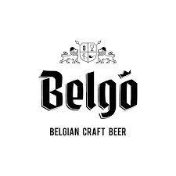
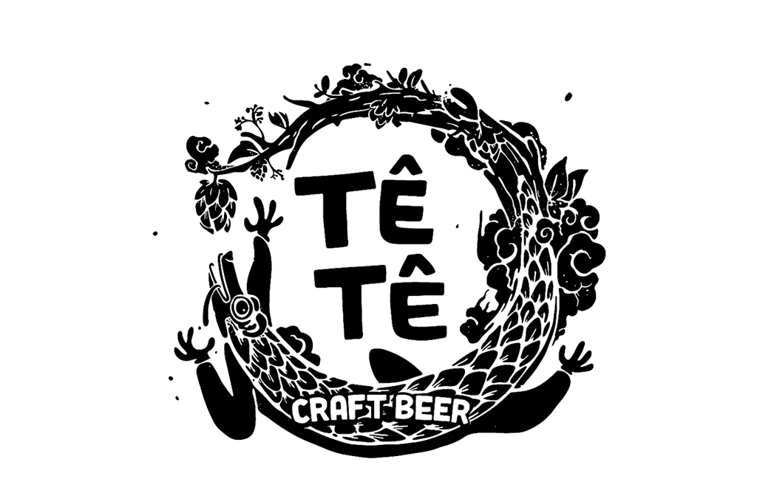

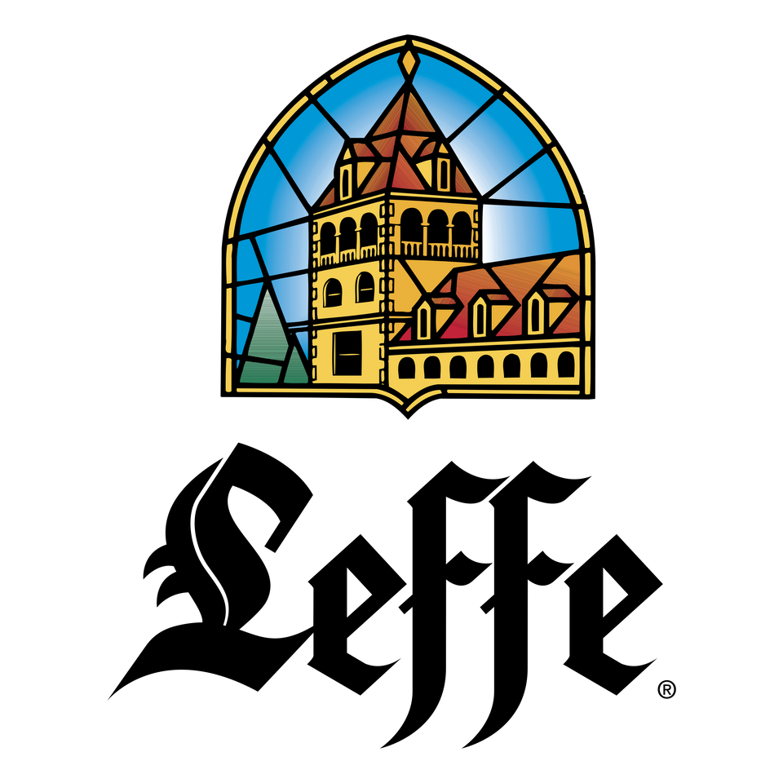

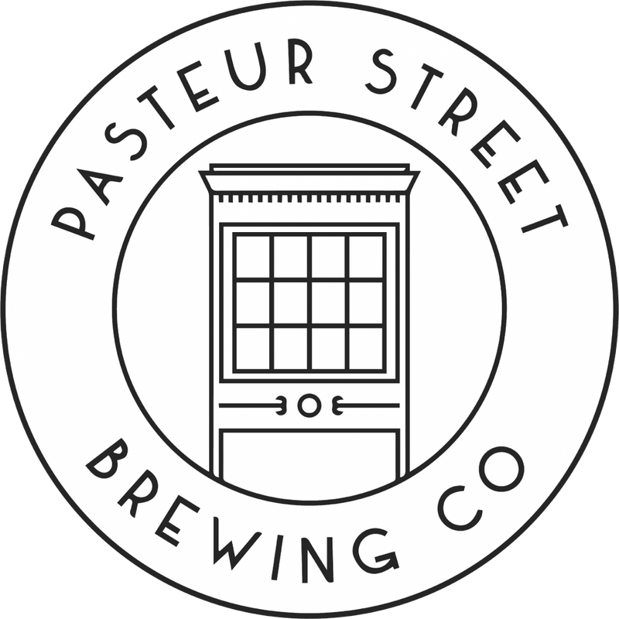
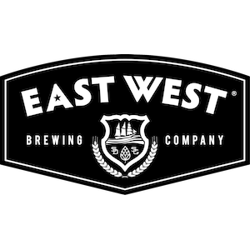
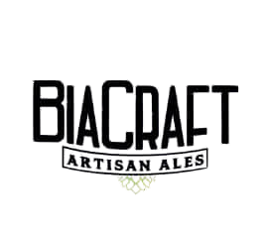
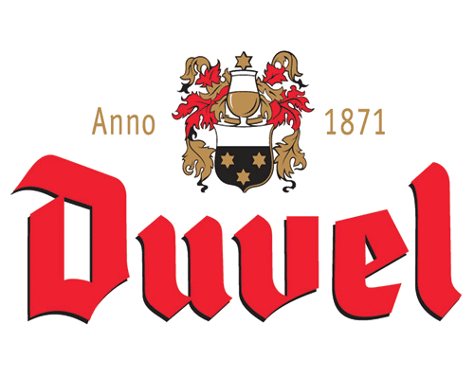
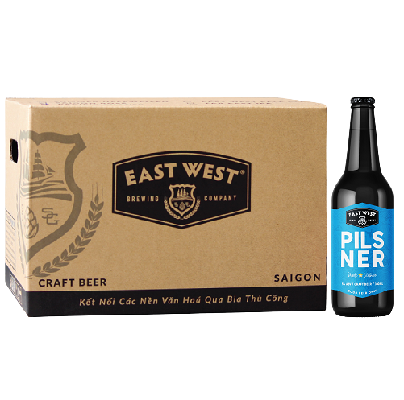
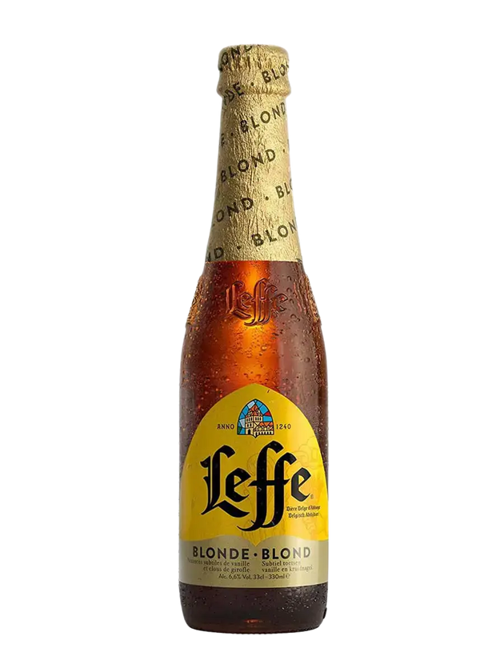
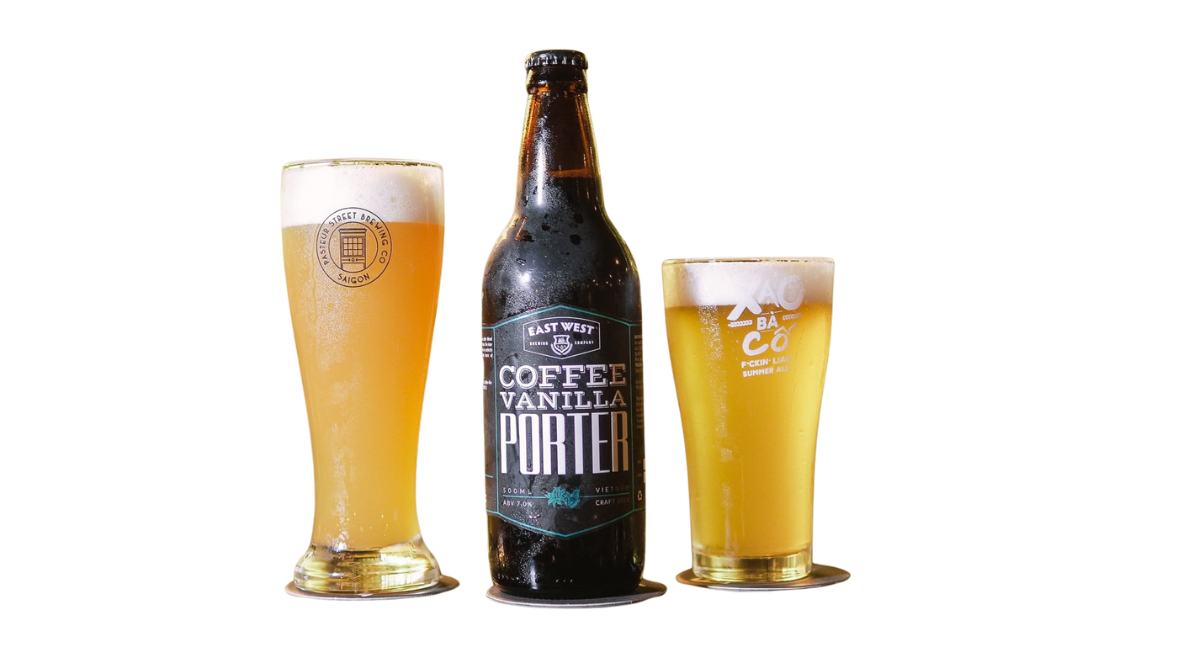
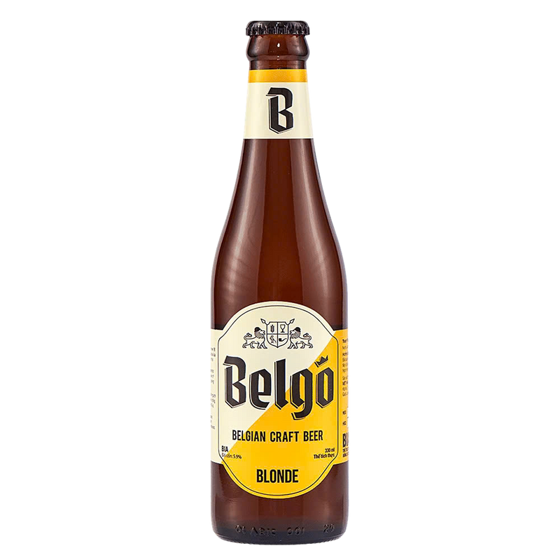
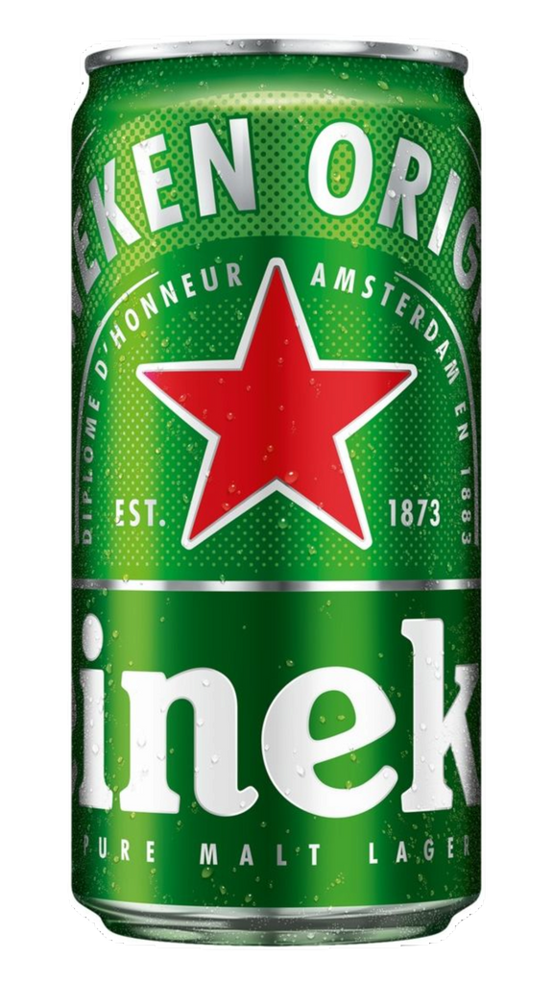
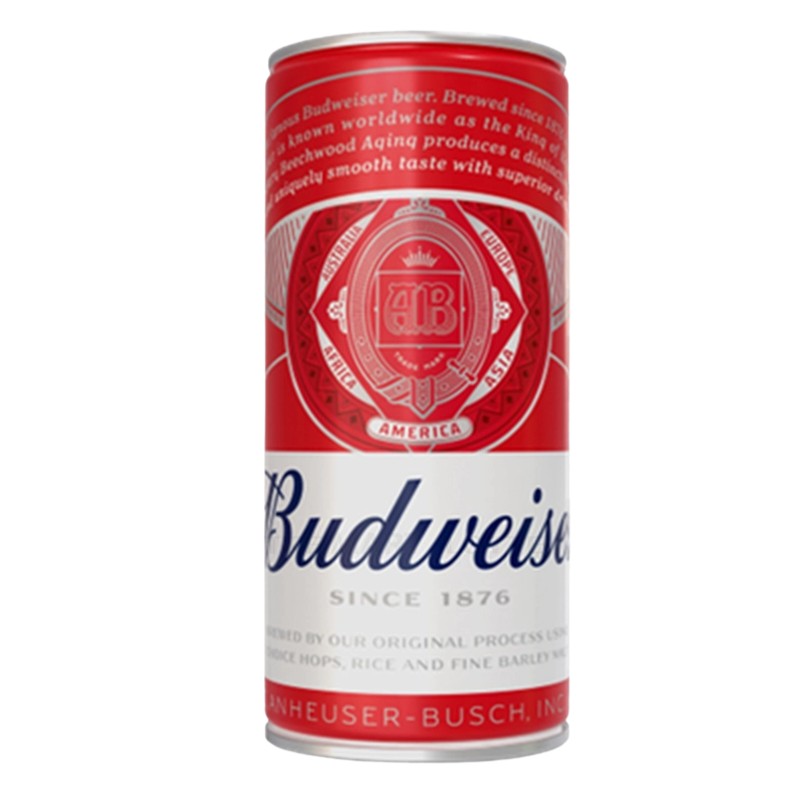
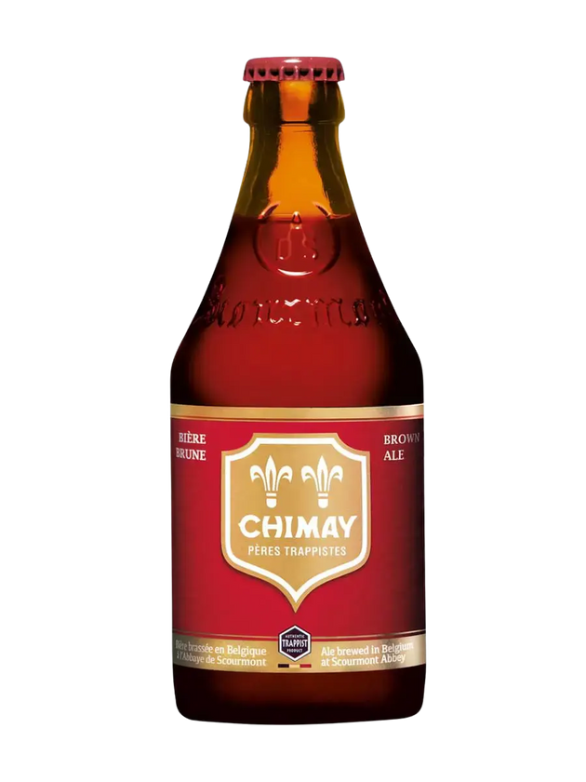
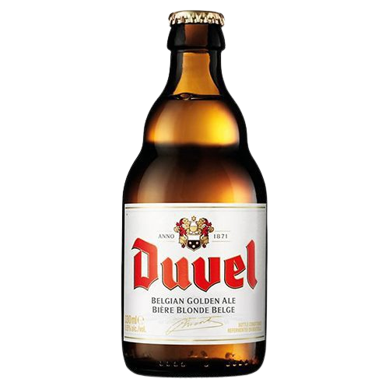
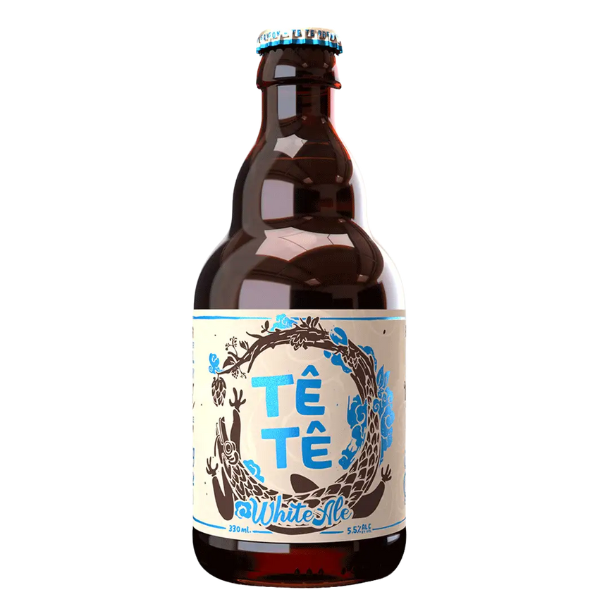
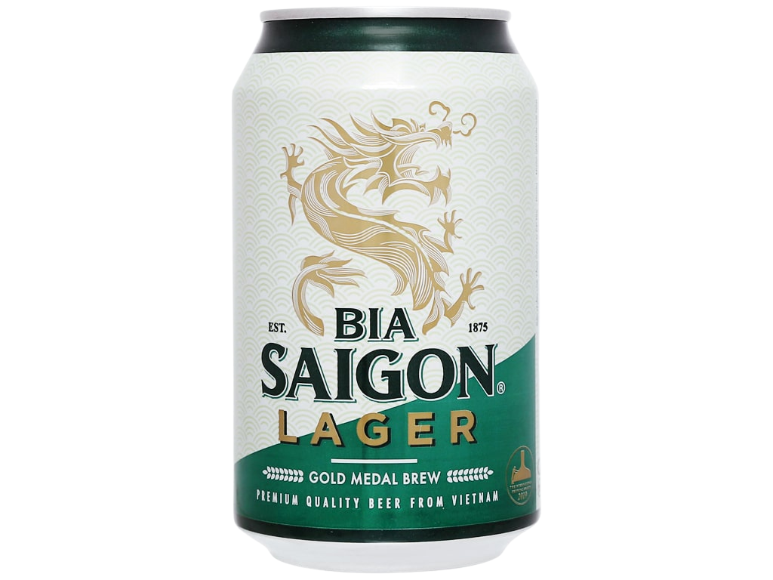
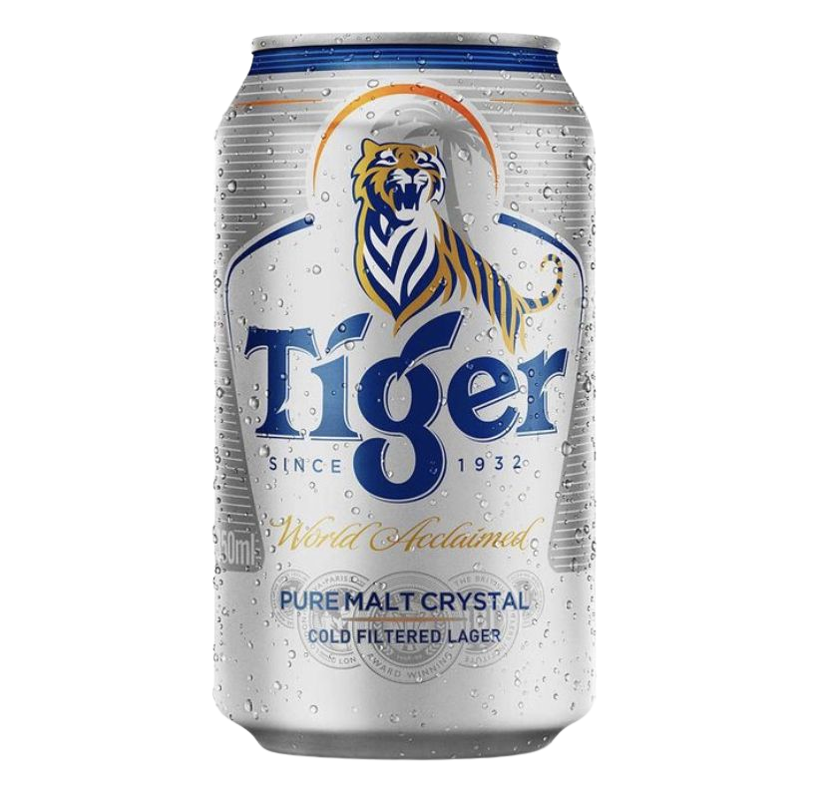
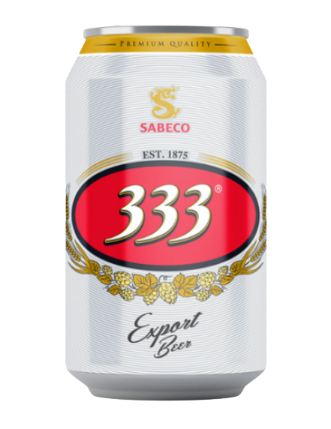
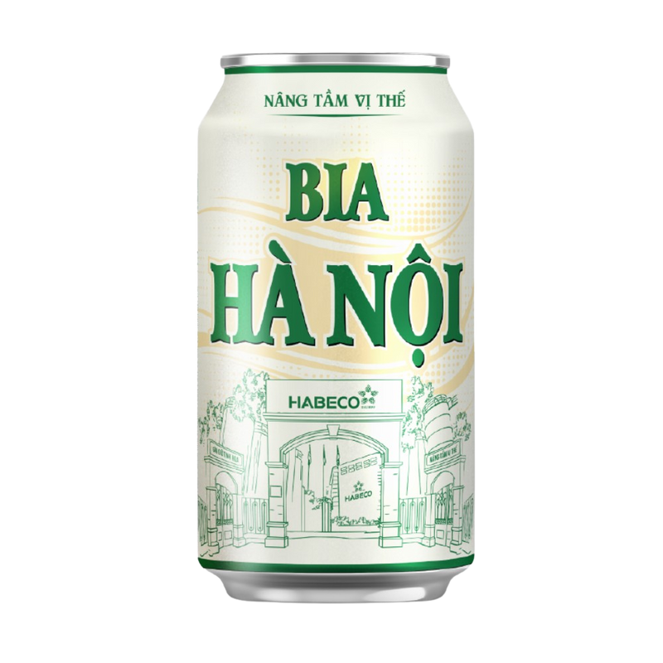
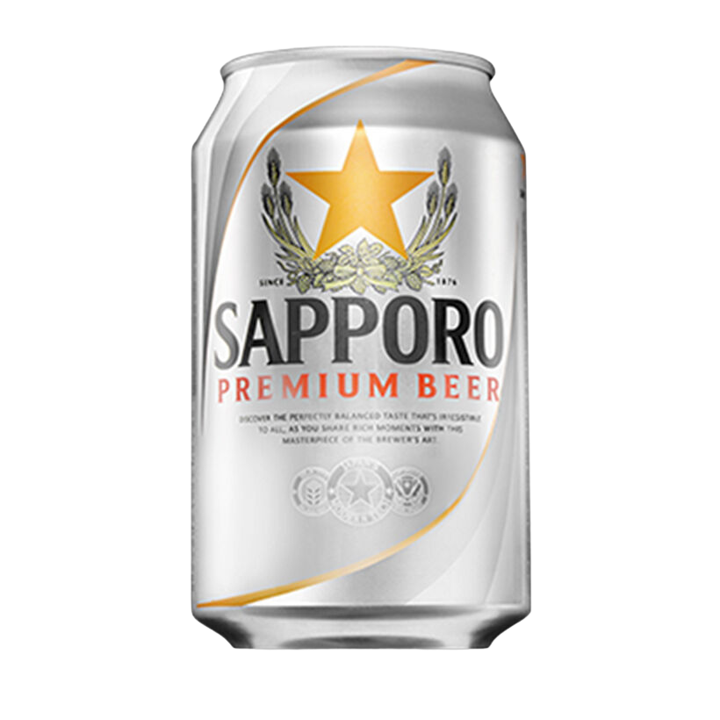
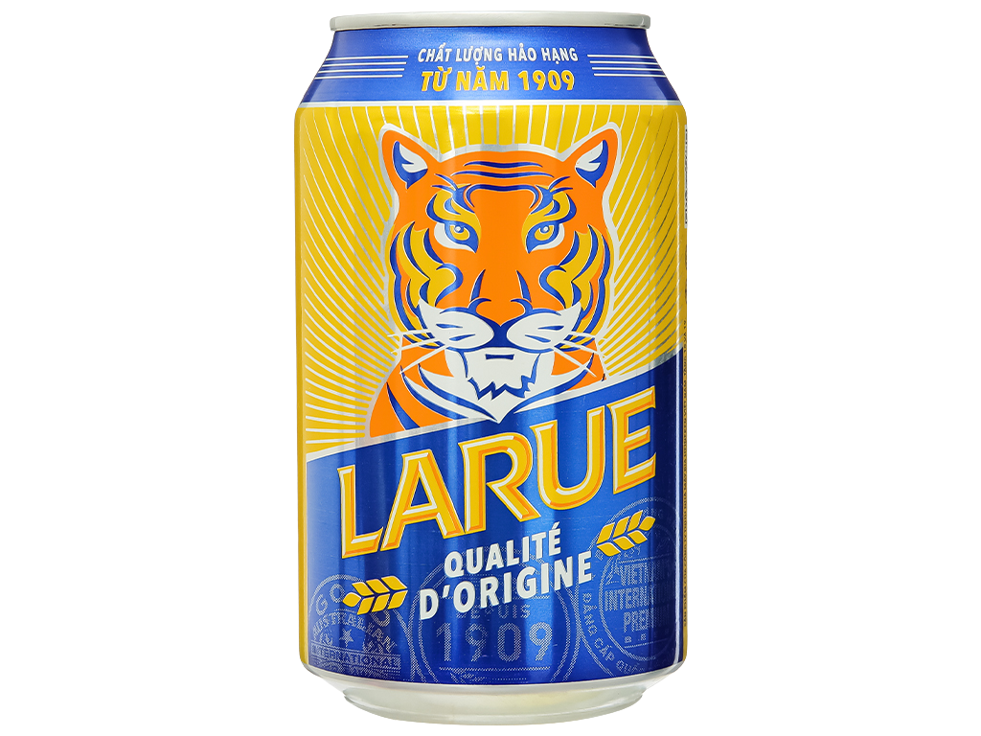
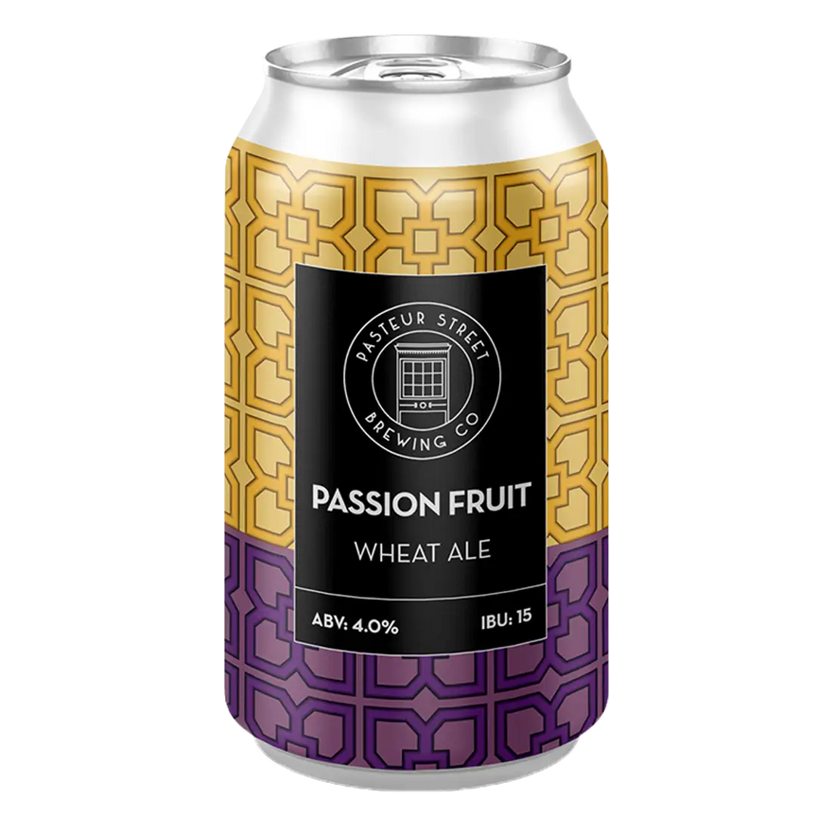
Brand Awareness & Market Structure
Tet 2026 Purchase Consideration
Mainstream & Mass Premium Brands
Premium Imported & Craft Brands (Niche but Growing)
Base: All respondents (n=1,200)
Craft/Premium Import base: Urban affluent respondents (n=280)
Mainstream | Premium | Premium | Mainstream | Mainstream | Premium | Premium | Mainstream | Belgian Import | Belgian Import | Belgian Import | Local Craft | Local Craft | Local Craft | Belgian Style | Local Craft
Premium trio strong: Tiger (56%) Heineken (51%), and Budweiser (28%) show solid Tet consideration, particularly for gifting occasions
Regional strength matters: Hanoi Beer (62% awareness, 42% Tet consideration) remains strong in North; 333 dominates South/Mekong
Multi-brand shopping: 68% plan to purchase 2+ brands for Tet, allocating mainstream for family, premium for gifting
Q: Which brands are you considering purchasing for Tet 2026?
Vietnam Beer Market and Tet 2026 Consumer Trends | InsightAsia Vietnam Primary Research | December 2025

Slide 11
Tet 2026 Purchase Consideration
Detailed Brand Attribute Perceptions
 | Premium | Premium | Mainstream | Mainstream | Mainstream | Premium | Premium | Mainstream | Belgian Import | Local Craft
Premium Image | 88% | 72% | 38% | 28% | 24% | 78% | 82% | 22% | 86% | 78%
Local/ Vietnamese | 22% | 48% | 92% | 88% | 94% | 18% | 14% | 72% | 8% | 62%
Tet Gifting | 82% | 68% | 54% | 46% | 42% | 72% | 76% | 34% | 81% | 74%
Special Occasions | 84% | 72% | 48% | 38% | 34% | 76% | 78% | 28% | 84% | 76%
Family Gatherings | 42% | 58% | 84% | 78% | 86% | 38% | 34% | 68% | 18% | 38%
Modern/ Innovative | 78% | 74% | 42% | 32% | 26% | 72% | 68% | 22% | 72% | 88%
Traditional/ Authentic | 38% | 42% | 88% | 82% | 91% | 28% | 24% | 74% | 48% | 34%
Quality/ Trust | 81% | 76% | 78% | 74% | 76% | 74% | 79% | 64% | 82% | 84%
Good Value | 34% | 48% | 82% | 86% | 84% | 32% | 28% | 78% | 16% | 22%
Strong Taste | 58% | 62% | 56% | 64% | 58% | 54% | 48% | 62% | 68% | 64%
Smooth/ Easy | 68% | 71% | 74% | 68% | 72% | 64% | 76% | 66% | 58% | 72%
Q: For each brand, please indicate which attributes apply
Base: Brand aware respondents (Mainstream brands n=180-980, Premium mass brands n=120-580) and urban affluent oversample for craft/premium imports (n=120-180) | Vietnam Beer Market and Tet 2026 Consumer Trends | InsightAsia Vietnam Primary Research | December 2025

Slide 12
Brand Awareness & Perceptions
Brand Positioning Map: Correspondence Analysis
Premium–Local divide International premiums lead on prestige (Heineken, Sapporo, Leffe) but score low on local identity, while local brands (Saigon, Hanoi) strongly own Vietnamese heritage but lack premium credentials.
Tiger’s bridge role Balances premium strength with approachability, enabling versatility across occasions and driving strong Tet consideration.
Value–Quality trade-off Mainstream brands win on value, while premium brands lead on perceived quality.
Craft white space Pasteur Street uniquely combines modernity, local identity, and quality, signaling a “modern Vietnamese premium” opportunity.
Occasion split Mainstream dominates family occasions; premium brands dominate gifting, reflecting strategic brand allocation by use case.
Q: For each brand, please indicate which attributes apply (Correspondence analysis based on brand-attribute association matrix)
Vietnam Beer Market and Tet 2026 Consumer Trends | InsightAsia Vietnam Primary Research | December 2025

Slide 13


Tet-Specific Purchase Behavior
Tet 2026 Beer Planning Overview
3.8M VND
Average Tet beer spending per household
3-4 weeks
Advanced planning time before Tet
Tet Budget Allocation
Spending
Planning
10% Reserve or Extra
Flexibility for unexpected guests or last-minute needs during Tet period
52% Family Consumption
Mainstream brands (Saigon, 333, Hanoi Beer) for family meals and gatherings, prioritizing value and quantity
64%
Purchase beer specially for Tet gifting (among beer purchasers)
2.4
Average number of brands purchased
38% Gifting
Premium brands (Heineken, Tiger, Budweiser, Sapporo) for business partners, relatives, and special recipients
Purpose
# of Beer Brands
Q: How do you allocate your Tet beer budget across different needs?
Base: All respondents (n=1,200)| Vietnam Beer Market and Tet 2026 Consumer Trends | InsightAsia Vietnam Primary Research | December 2025

Slide 14

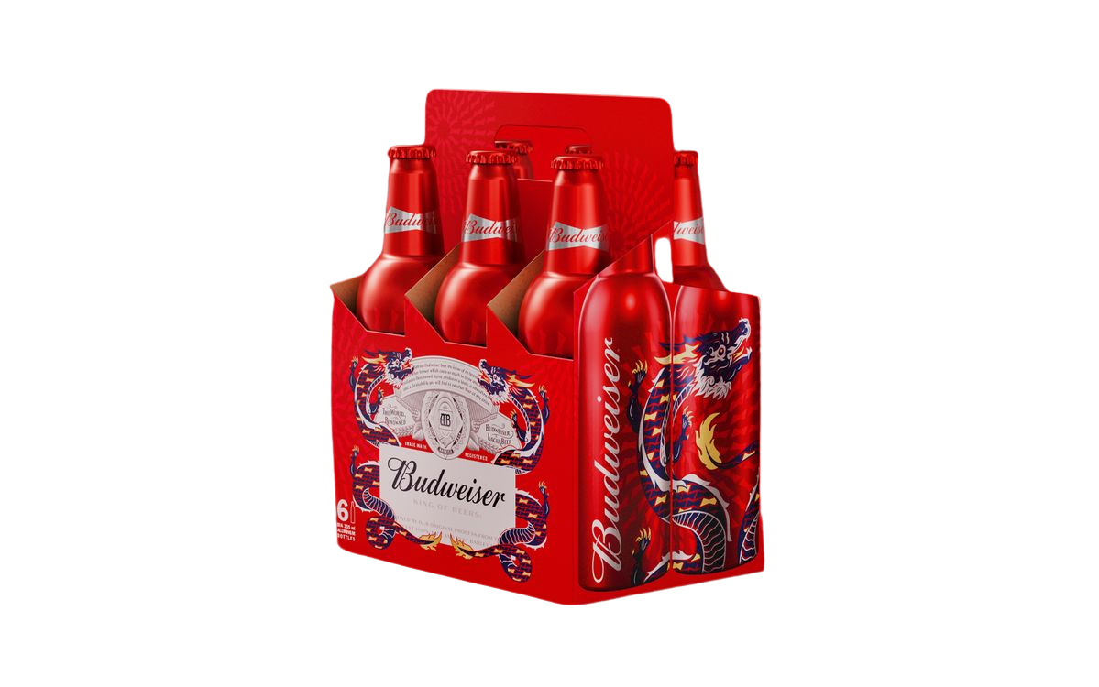
Tet-Specific Purchase Behavior
Tet Purchase Strategies
I buy two types of beer for Tet, Saigon for my family and close relatives. It's familiar, everyone likes it, and the price is reasonable. But for my boss and important clients, I choose Heineken gift boxes, as the premium packaging signals respect.
— Male, 35, Sales Manager, Ho Chi Minh City
Key Purchase Drivers for Tet
Gifting Decision Dynamics
Base: All respondents (n=1,200)
Base: Those buying beer for gifting (n=768)
Packaging / gift presentation | 68%
Brand reputation / prestige | 62%
Price / promotional offers | 58%
Familiarity / family tradition | 54%
Taste / quality | 51%
Variety / trying new options | 32%
Availability / convenience | 28%
Business partners / boss Premium international Heineken, Sapporo | 72%
Close friends / colleagues Premium or mid-tier Tiger, Budweiser | 64%
Extended family / relatives Mainstream with good packaging Saigon Special | 58%
Neighbors / casual acquaintances Standard mainstream 333, Hanoi | 48%
This Tet, I'm more careful with my budget. Instead of only buying premium beer for gifts, I mix—Tiger for important people and Saigon Special for relatives; the Tet packaging looks good and saves money.
— Female, 41, Small Business Owner, Hanoi
Packaging matters for Tet gifting. That's why brands with special Tet editions — like the
red and gold designs — are more appealing.
It shows I put thought into the gift.
— Female, 29, Marketing Executive, Da Nang
Q: What factors most influence your beer purchasing decisions during Tet? | How do you decide which beer to buy as gifts for different recipients?
Base: All respondents (n=1,200)| Vietnam Beer Market and Tet 2026 Consumer Trends | InsightAsia Vietnam Primary Research | December 2025

Slide 15
Distribution Channel Dynamics
Channel Share Evolution: Tet 2025 vs. Tet 2026 Forecast
Channel Share Evolution
Tet-specific decline
Modern Retail Gains Ground
E-commerce Plateau
Supermarkets/hypermarkets grow to 38% (+4pp) driven by one-stop shopping convenience and promotional bundles. Convenience stores also gain (+2pp) from impulse purchases and extended hours. | E-commerce declines to 12% (-2pp) for Tet despite year-round growth. Tactile product inspection matters for gifting decisions, and delivery reliability concerns during Tet rush.
Traditional shops decline to 24% (-4pp) as consumers seek wider selection and promotional offers unavailable in small format. Still relevant in rural areas and for immediate needs. | Supermarkets for bulk family purchases (76%), e-commerce for convenience (82%), specialty shops for premium gifting (8%). Multi-channel shopping is the norm (68% use 2+ channels).
Traditional Shops Under Pressure
Channel Specialization Emerges
Q: Which channel do you intend to buy beer from for Tet 2026? Which channel did you buy beer from for Tet 2025?
Vietnam Beer Market and Tet 2026 Consumer Trends | InsightAsia Vietnam Primary Research | December 2025

Slide 16
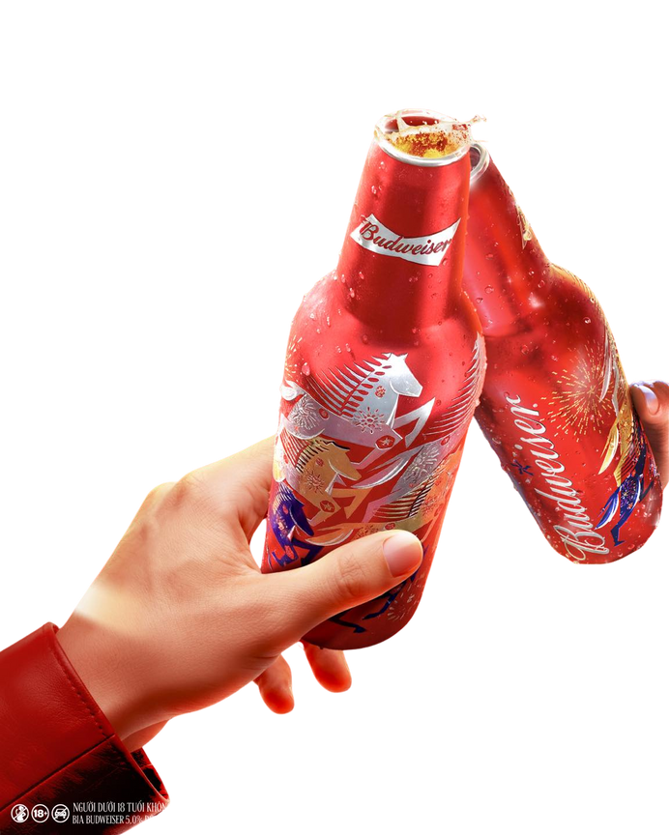
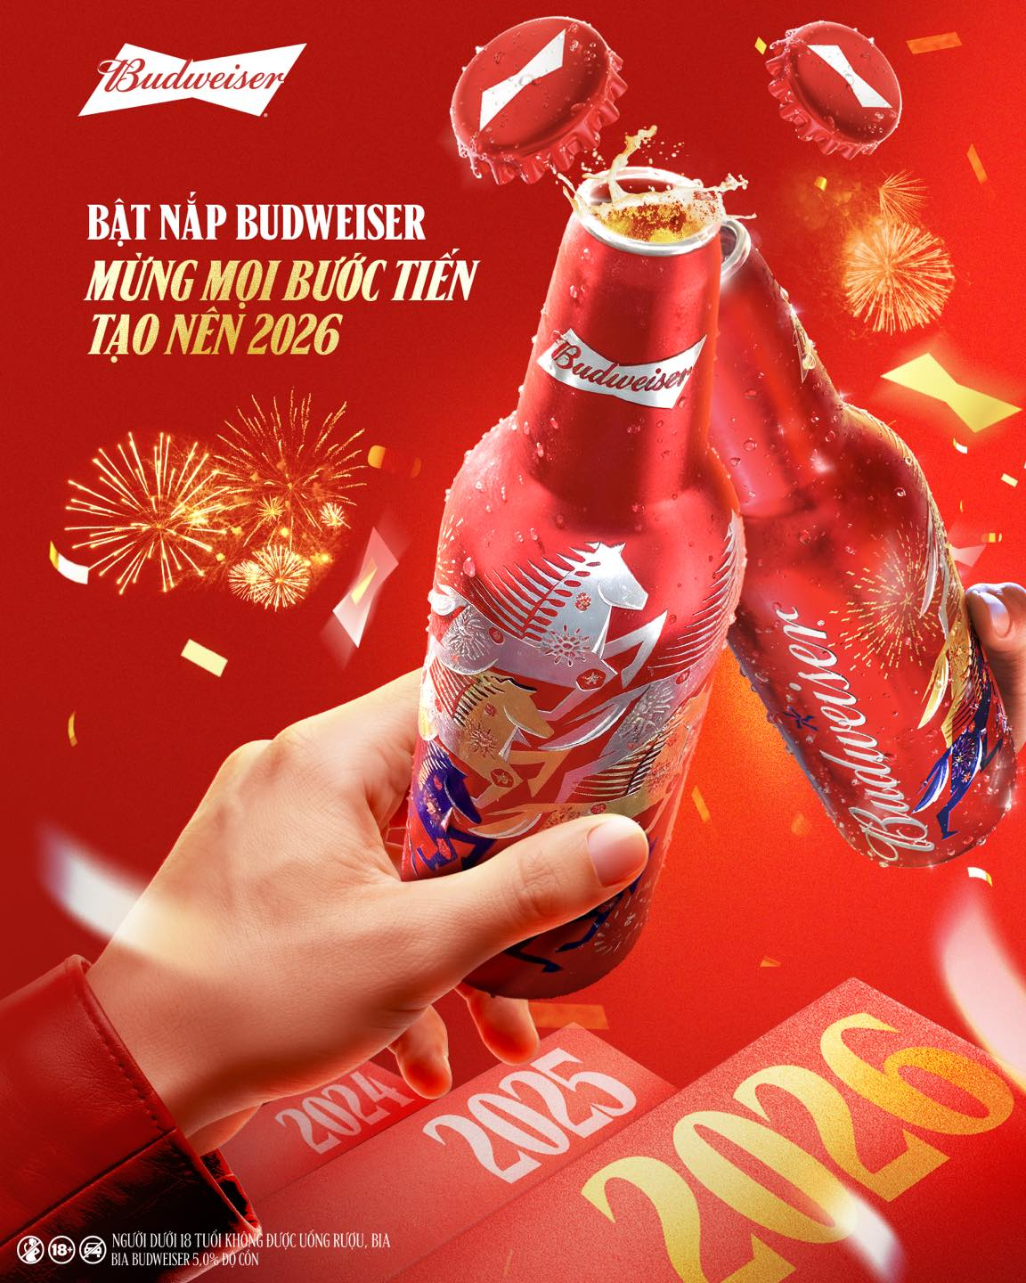
Channel Preference Drivers & Barriers
Reason To Choose
Base: Respondents who use each channel (n varies by channel)
Supermarkets/ Hypermarkets
E-Commerce
Want Wide selection / variety | 76%
Promotional offers / bundles | 68%
Can buy everything in one place | 62%
Home delivery convenience | 82%
Better prices / exclusive deals | 71%
Avoid crowded stores during Tet | 64%
Reason To Lapse E-Commerce
Base: Those who switched from e-commerce to other channels (n=168)
Want to see/touch product before buying (for gifting) | 58%
Delivery delays during Tet period | 52%
Concerns about product authenticity | 46%
Limited Tet gift packaging options online | 42%
Q: Why do you prefer to purchase beer from [channel] during Tet? | Why did E-commerce decline for Tet 2026?
Vietnam Beer Market and Tet 2026 Consumer Trends | InsightAsia Vietnam Primary Research | December 2025

Slide 17
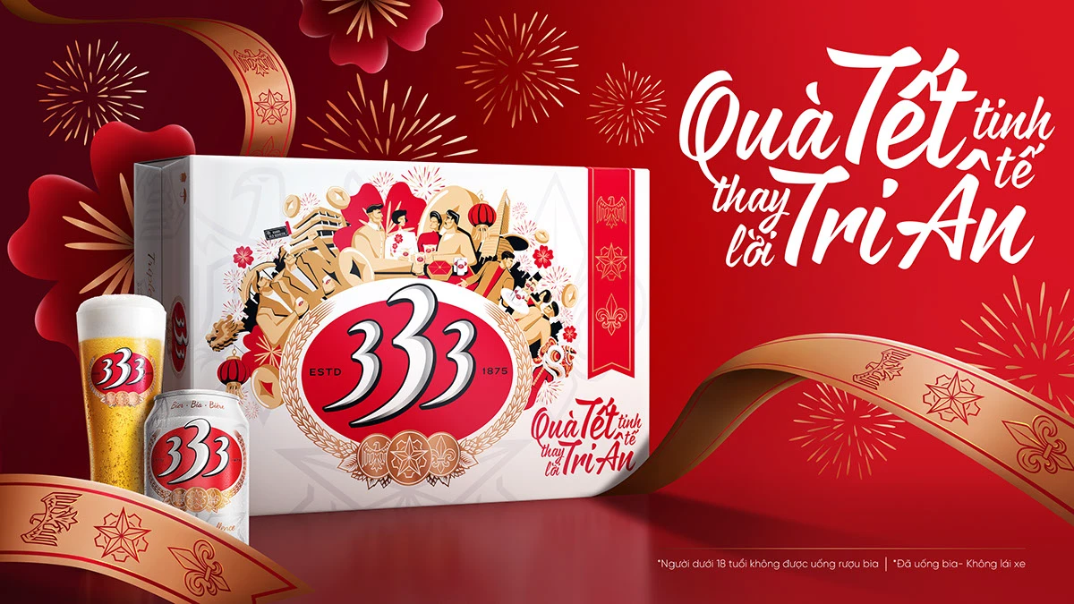
Purchase Decision Drivers
Decision Driver Priority (Overall Market)
2
1
3
Taste & Quality
Consistent preference regardless of price sensitivity; quality threshold maintained
68%
Price & Value
Most important factor across all segments; heightened by tax increase anticipation
72%
Packaging & Presentation
Critical for Tet gifting; drives premium segment growth despite budget pressure
64%
Q: What are your top 3 factors when selecting beer?
Base: All respondents (n=1,200), segmented by stated priorities and behavior patterns | Vietnam Beer Market and Tet 2026 Consumer Trends | InsightAsia Vietnam Primary Research | December 2025

Slide 18



Purchase Decision Drivers
Decision Driver Priority by Purpose and Consumer Segment
For Family Gatherings |  | For Tet Gifting |  | For Personal Enjoyment
Price / good value | 84% | Brand prestige / reputation | 82% | Taste / flavor preference | 88%
Familiarity / family tradition | 76% | Brand prestige / reputation | 79% | Quality / craftsmanship | 64%
Taste everyone likes | 71% | Premium / international image | 68% | Uniqueness / trying new options | 52%
Value Seekers
42% of market
Quality Conscious
36% of market
Premium Seekers
22% of market
Price | 92% | Taste | 91% | Brand prestige | 86%
Promotion | 84% | Brand Reputation | 82% | Packaging | 84%
Familiarity | 76% | Premium Seekers | 78% | Uniqueness | 74%
Very High Price Sensitivity |  | Moderate Price Sensitivity |  | Low Price Sensitivity
Q: What drives your beer selection for different occasions? (% rating important) | What are your top 3 factors when selecting beer?
Base: All respondents (n=1,200), segmented by stated priorities and behavior patterns | Vietnam Beer Market and Tet 2026 Consumer Trends | InsightAsia Vietnam Primary Research | December 2025

Slide 19
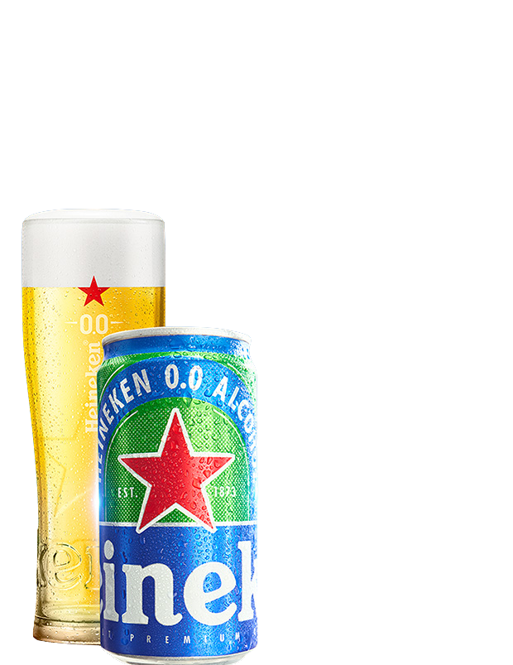
Health Trends: Reality Check on Non-Alcoholic Beer
Consumer Rejection: Overview Statistics and Underlying Reasons
Why Vietnamese Consumers Reject Non-Alcoholic Beer
4.2% | Purchased non-alcoholic beer in past 6 months
Without alcohol, it's not beer / defeats the purpose | 82%
Beer is for getting relaxed/tipsy, not for "pretending" | 76%
Taste is not the same / inferior quality | 71%
Too expensive for what it offers | 64%
Would rather drink soft drinks or water if avoiding alcohol | 58%
Feels awkward in social situations | 52%
Only useful for designated drivers (situational, not preference) | 48%
82% | Say "without alcohol, it's not real beer"
76% | Believe non-alcoholic beer "defeats the purpose" of drinking
2.1% | Tet 2026 purchase intention for non-alcoholic options
Non-alcoholic beer? What's the point? If I'm drinking beer, I want to feel something — get a little buzzed with my friends. Otherwise,
I'd just drink Coca-Cola or Heineken Silver (lower alcohol), not fake beer. It's like eating vegetarian pork — it's not the real thing.
— Male, 32, Construction Manager, Ho Chi Minh City
Q: What are your views on non-alcoholic or low-alcohol beer?
Base: All respondents (n=1,200)| Vietnam Beer Market and Tet 2026 Consumer Trends | InsightAsia Vietnam Primary Research | December 2025

Slide 20

Health Trends: Reality Check on Non-Alcoholic Beer
Limited Situational Acceptance
When I'm the designated driver (only practical reason) | 48%
When I have health issues and doctor orders to stop (reluctantly) | 32%
During pregnancy (women only, temporary) | 18%
None — would never consider it | 38%
As a woman, even I don't see the appeal of non-alcoholic beer. If I'm at a family gathering and don't want to drink, I'll have soft drinks or juice. Why would I pay premium price for something that's trying to be beer but isn’t?
It makes no sense.
— Female, 34, Marketing Manager, Ho Chi Minh City
Brands keep pushing this 0.0% beer, but nobody I know buys it. We drink beer to relax, to enjoy the feeling. Without alcohol, it's just expensive water that tastes weird. If I need to drive, I simply don't drink — I don't need to pretend with fake beer.
— Male, 38, Sales Director, Hanoi
Q: In what situations, if any, would you consider non-alcoholic beer?
Base: All respondents (n=1,200)| Vietnam Beer Market and Tet 2026 Consumer Trends | InsightAsia Vietnam Primary Research | December 2025

Slide 21
Strategic Insights: Non-Alcoholic Beer
Brand investment mismatch Despite heavy marketing spend on non-alcoholic options, actual purchase penetration is only 4.2% and Tet consideration just 2.1%, a massive gap between brand push and consumer pull. |  | Cultural barrier is fundamental 82% reject the core concept (‘without alcohol, it’s not beer’). This is not about taste or price, but about beer’s fundamental role in Vietnamese culture: alcohol enables social bonding.
Female segment is NOT a savior Contrary to brand assumptions, even female consumers (who drink less) don't favor non-alcoholic beer — they'd rather drink soft drinks, juice, or simply not participate in drinking occasions. |  | Designated driver use case is weak Only 48% would consider it for driving situations, and even then, many said they'd prefer soft drinks or simply not drink at all rather than "fake beer“.
Generation Z is not different enough While Gen Z is slightly more health-conscious (52% trying to drink less), this means drinking less often or choosing lower-alcohol options (Heineken Silver, Tiger Crystal), not accepting 0.0% beer. |  | Market growth is illusory Non-alcoholic beer shows +12% growth, but from a tiny base (0.8% → 0.9%). In absolute terms, growth is negligible and driven by a small health-restricted niche, not mainstream adoption.
Recommendation
Brands should recalibrate expectations and marketing spend. Non-alcoholic beer will remain a tiny niche for health-restricted situations, not a growth engine. Focus instead on moderation messaging around regular beer (smaller pack sizes, lower-ABV variants that still taste like beer) rather than pushing a product category consumers fundamentally reject
Vietnam Beer Market and Tet 2026 Consumer Trends | InsightAsia Vietnam Primary Research | December 2025

Slide 22



Generational Shifts in Beer Consumption
Behavioral Differences Across Generations
Gen Z (18-27)
Millennials (28-43)
Gen X (44-45)
Attribute
Consumption Frequency | 1.8x/week | 2.4x/week | 2.1x/week
Avg. Tet Beer Spend | 2.8M VND | 4.2M VND | 3.6M VND
Premium Beer Preference | 58% | 52% | 32%
Brand Loyalty | 34% | 48% | 72%
Willing to Try New Brands | 68% | 54% | 28%
Health-Conscious (reducing alcohol) | 38% | 28% | 18%
Digital Purchase Research | 74% | 62% | 28%
E-commerce Purchase for Tet | 22% | 18% | 6%
Non-Alcoholic Consideration | 22% | 15% | 12%
Craft Beer Interest | 36% | 28% | 8%
Sustainability Matters | 48% | 32% | 14%
(n=348)
(n=612)
(n=240)
Base: All respondents (n=1,200)| Vietnam Beer Market and Tet 2026 Consumer Trends | InsightAsia Vietnam Primary Research | December 2025

Slide 23
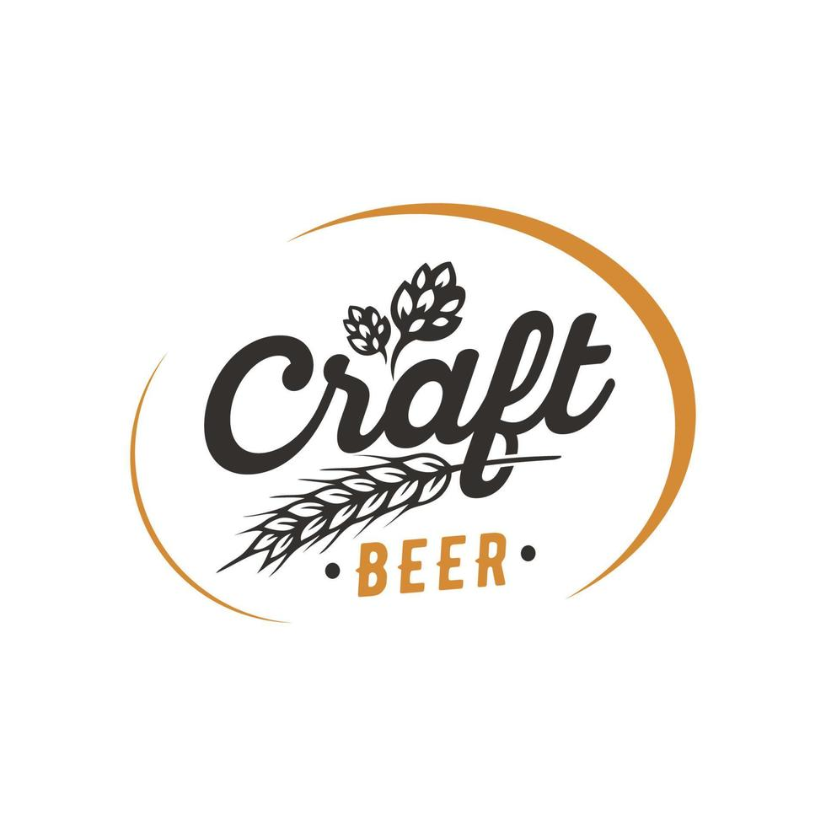
Generational Shifts in Beer Consumption
Brand Preference by Generation and Usage Overview by Generation
Gen Z: Experience Over Volume
Drink less often (1.8x/week) but pay more for premium/craft (58%).
Lower total spend (2.8M VND) due to smaller households and a quality-over-quantity mindset (2–3 premium vs. 10 mainstream).
Highly experimental (68%), moderately health-conscious (22% consider non-alcoholic), digitally native (74% research online), and sustainability-aware (48%).
Modern, premium image | Balanced modern/accessible | Tradition, familiarity
Millennials: Peak Consumption Years
Highest spending (4.2M VND Tet) and frequency (2.4x/week).
Balance tradition & modernity, buy both Saigon (58%) and Heineken (58%).
Digital-savvy but still value in-store experience. Family-focused purchasers.
Local heritage value | International, trendy | Uniqueness quality
Gen X: Traditional Loyalists
Extremely brand loyal (72%), prefer mainstream local brands (Saigon 78%, 333 62%). Lowest health-consciousness (18% reducing).
Rely on traditional retail channels. Price-sensitive but consistent purchasers.
Q: Which brands do you purchase or consider for Tet 2026?
Base: Brand aware respondents| Vietnam Beer Market and Tet 2026 Consumer Trends | InsightAsia Vietnam Primary Research | December 2025

Slide 24
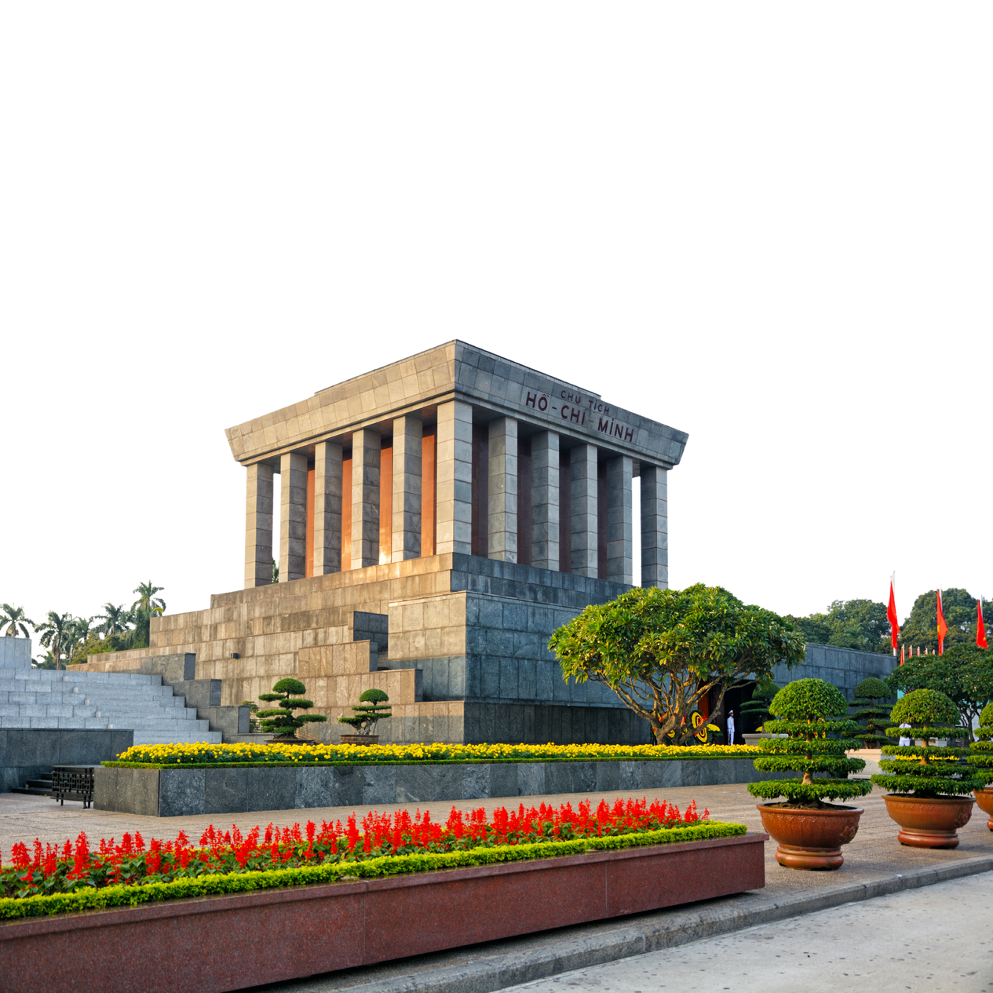
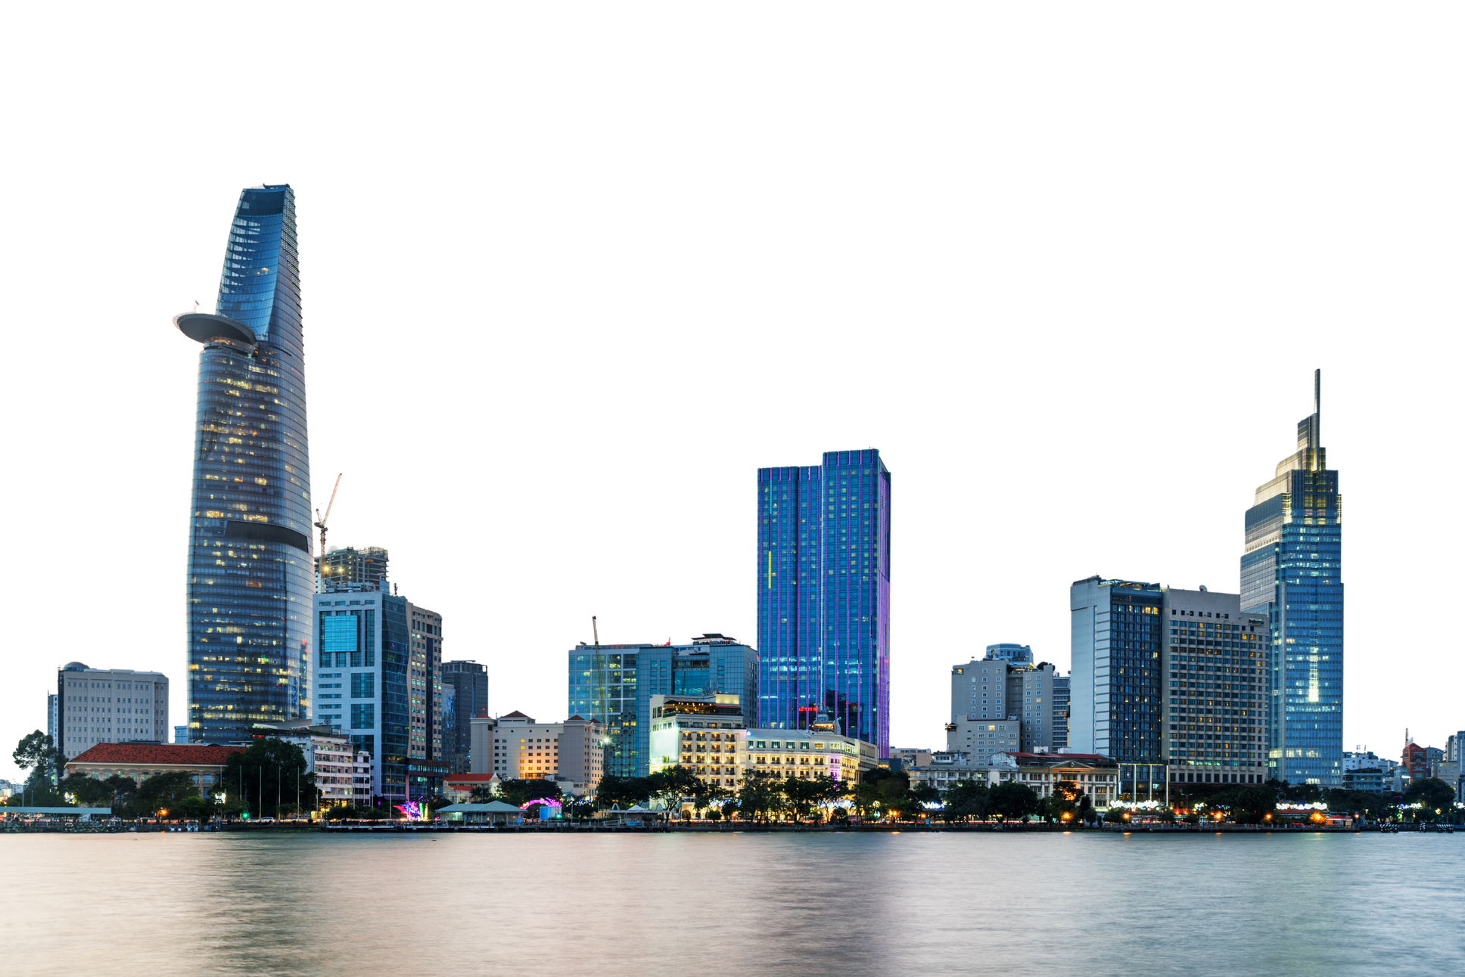

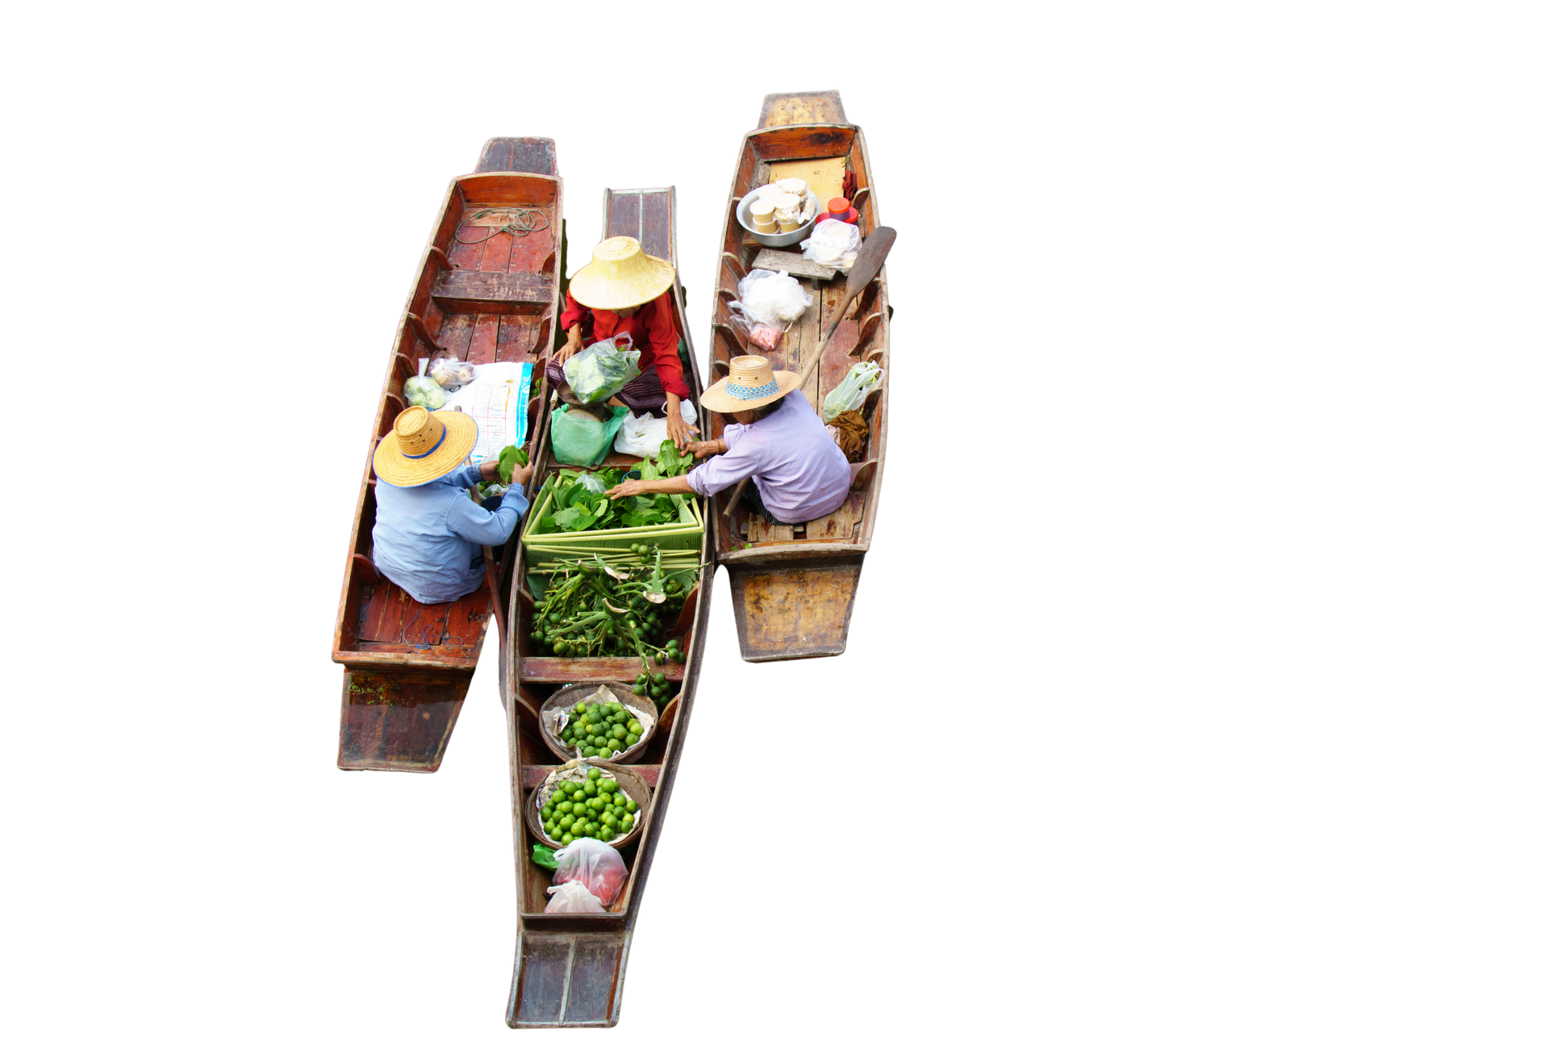
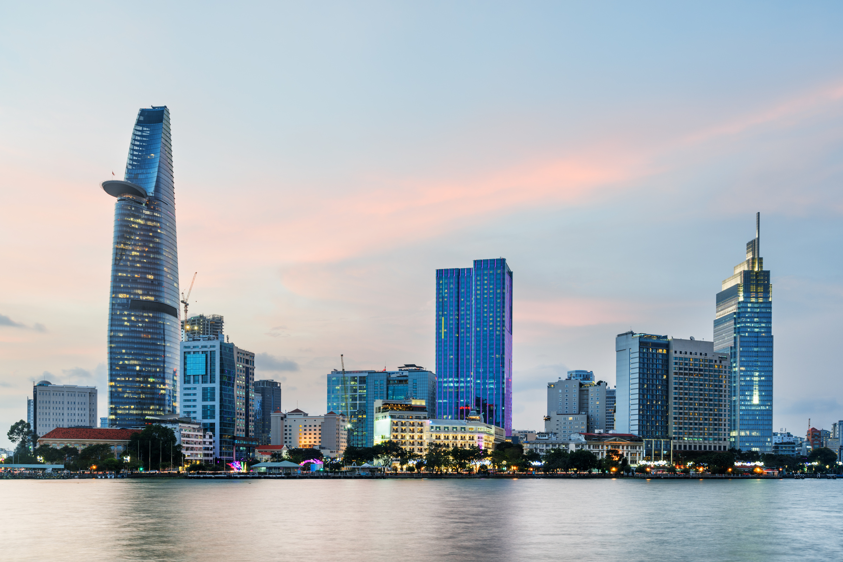


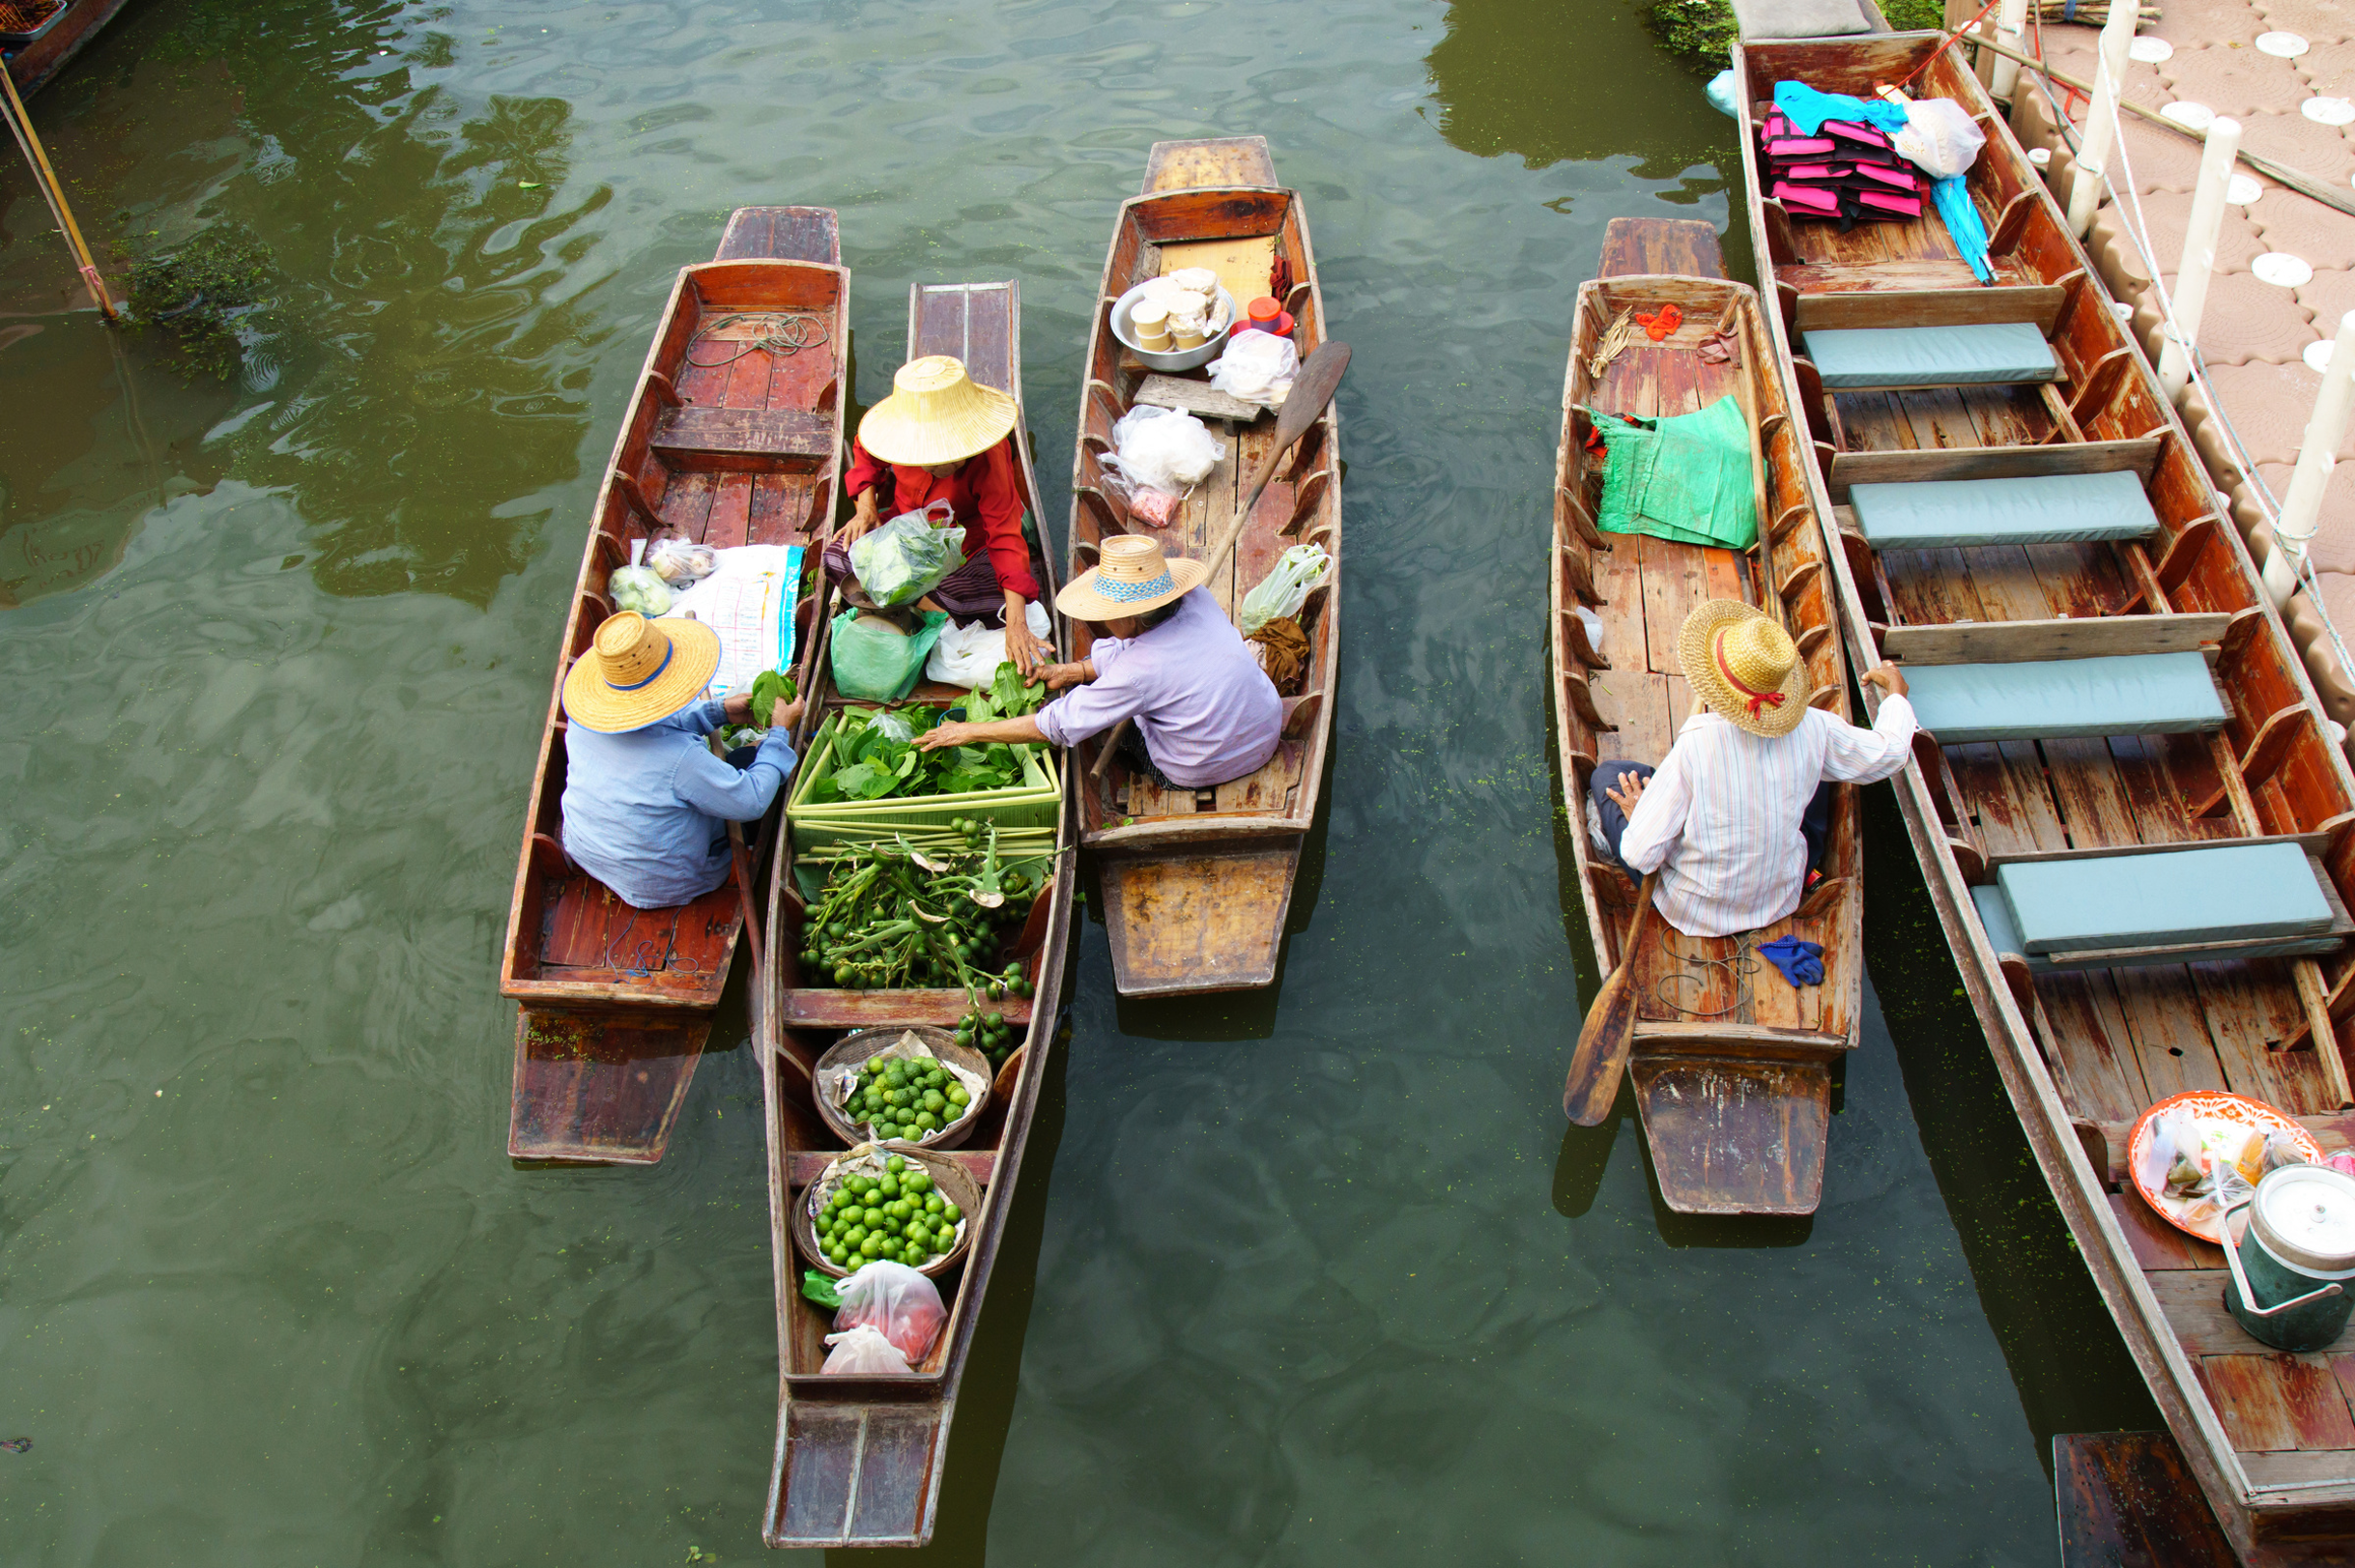

Regional Market Variations
Key Market Characteristics by Region
 | Ho Chi Minh City & South | Hanoi & North | Da Nang & Central | Mekong Delta
Base | (n=420) | (n=380) | (n=240) | (n=160)
Avg. Tet Beer Spend | 4.8M VND | 3.4M VND | 3.1M VND | 2.6M VND
Premium Preference | 56% | 44% | 38% | 28%
Digital Adoption | 78% | 68% | 58% | 42%
Brand Loyalty | 42% | 64% | 52% | 58%
Top Brands
Overview | Most affluent, open to premium/international positioning, and e-commerce strategies brands (56%). Highest digital adoption (78%). Opportunity for craft, premium | Strongest brand loyalty (64%), dominated by Hanoi Beer (78%). Quality-focused, traditional channel preference. Requires long-term brand building and relationship marketing. | Regional brands strong (Larue 62%, Huda 48%). Tourism influence drives premium during peak season. Lower spending during Tet but consistent year-round. | Most price-sensitive (2.6M VND spend), mainstream dominance (333 64%, Saigon 72%). Limited digital adoption (42%). Volume-driven, promotion-sensitive market.
Base: Respondents by region| Vietnam Beer Market and Tet 2026 Consumer Trends | InsightAsia Vietnam Primary Research | December 2025

Slide 25
Regional Market Variations
Brand Preference Share by Region (%)
Brand | HCMC & South | Hanoi & North | Da Nang & Central | Mekong Delta
Base | (n=420) | (n=380) | (n=240) | (n=160)
 | 68% | 42% | 48% | 72%
 | 58% | 24% | 32% | 64%
 | 18% | 78% | 22% | 14%
 | 62% | 54% | 42% | 32%
 | 58% | 52% | 56% | 38%
 | 22% | 18% | 62% | 28%
 | 12% | 14% | 48% | 8%
 | 38% | 32% | 24% | 18%
Q: Which brands do you typically purchase?
Base: Respondents by region| Vietnam Beer Market and Tet 2026 Consumer Trends | InsightAsia Vietnam Primary Research | December 2025

Slide 26
Consumer Segmentation: Three Core Segments
Three Key Consumer Segments
Value Seekers
42%
Quality Conscious
36%
Premium Seekers
22%
Profile | Age 35-45, family-oriented, suburban/rural, moderate-to-low income | Age 28-42, professionals, urban, mid-to-high income | Age 25-38, high income, urban (HCMC dominant), status-conscious
Main Brands | Saigon, 333, Hanoi Beer, Larue | Tiger, Heineken, Saigon Special, Budweiser | Heineken, Sapporo, Leffe, Chimay, Pasteur St., Budweiser
Regional Skew | Mekong, Rural, Northern provinces | HCMC, Hanoi, Da Nang balanced | HCMC dominant (67% of segment)
Generational Skew | Gen X dominant (58%) | Millennials dominant (64%) | Millennials + Gen Z (72%)
Targeting Strategy | Largest but most mature segment. Growth limited by economic constraints. Defend with promotional intensity and value communication. Risk: trading down within mainstream portfolio rather than defecting to competitors. | Sweet spot for growth — willing to pay more but not irrational. Tiger's success demonstrates power of straddling premium and accessible. Opportunity to capture through quality storytelling and mid-premium positioning. | Smallest but highest value segment. Less affected by tax increases. Gifting-dominated (82% of spend). Craft and premium imports can win here with differentiation. HCMC concentration (67%) makes targeted activation efficient.
Based on cluster analysis of purchase behaviors, brand preferences, spending levels, and stated priorities
Vietnam Beer Market and Tet 2026 Consumer Trends | InsightAsia Vietnam Primary Research | December 2025

Slide 27
Consumer Segmentation: Three Core Segments
Segment Comparison Matrix
Value Seekers
42% of market
Quality Conscious
36% of market
Premium Seekers
22% of market
Tet Beer Spend | 2.2M VND | 4.2M VND | 6.4M VND
Price Sensitivity | Very High (92%) | Moderate (48%) | Low (18%)
Brand Loyalty | High (76%) | Moderate (48%) | Low (34%)
Growth Potential | Limited (stable base) | High (expanding mid-tier) | High (premiumization trend)
Brand Purchase | Buy mainstream for all occasions | Strategic brand mixing (mainstream + premium), Occasion-based brand selection | Open to craft and premium imports
Primary Channels | Traditional shops, Supermarkets | Modern retail, Online, Supermarkets Research-oriented before purchase (68%) | Specialty, E-commerce, Premium outlets
Key Motivator | Best value, family trusted Promotion-driven purchase behavior (84%) | Quality, authenticity, taste Taste and quality paramount (91% priority) | Status, prestige, exclusivity Brand prestige drives choice (86%) Packaging and presentation critical (84%) Digital-savvy, trend-aware (78%)
Tet Priority & Tet Purchase | Quantity for family needs Bulk purchase, multi-brand for different uses | Balance quality and budget Allocate budget by purpose (family vs. gifts) | Impressive gifts for key recipients Gifting-focused spending (82% of Tet budget) Use beer as status signal, curated selection
Targeting Strategy | Volume promotions, family packs, value messaging, traditional trade dominance, leverage brand heritage and familiarity | Quality storytelling, brand heritage, taste innovation, multi-channel presence, occasion-based messaging, balanced value-quality proposition | Premium positioning, limited editions, craft/import portfolio, experiential marketing, digital-first campaigns, exclusive partnerships
Based on cluster analysis of purchase behaviors, brand preferences, spending levels, and stated priorities
Vietnam Beer Market and Tet 2026 Consumer Trends | InsightAsia Vietnam Primary Research | December 2025

Slide 28
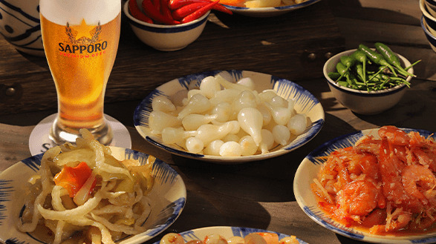
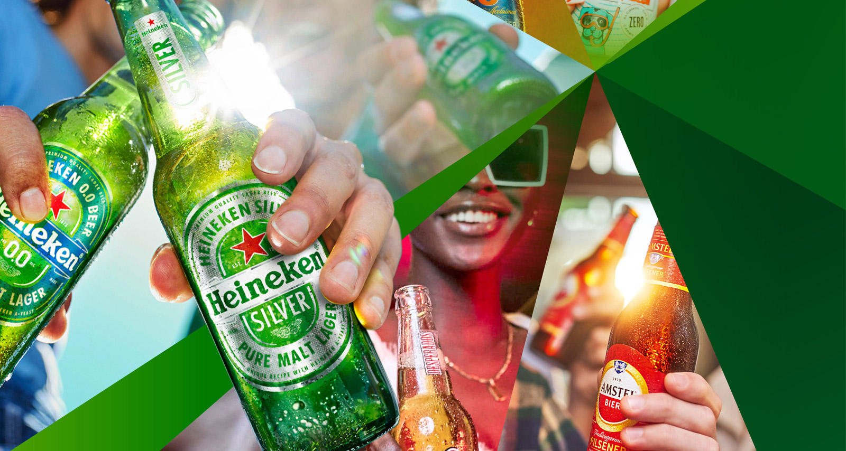
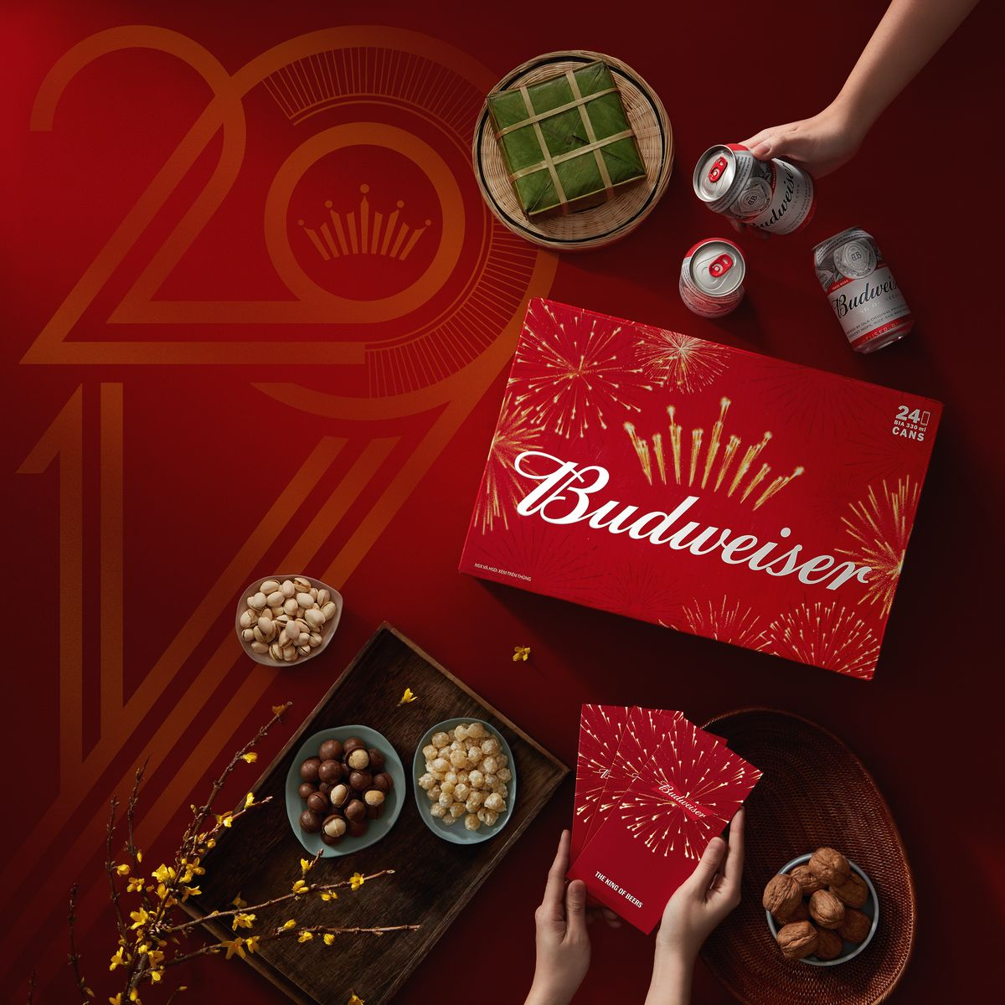
Strategic Implications for Tet 2026
Six Strategic Priorities for Brands
Master Dual-Brand Strategy
Recognize consumers buy 2+ brands: mainstream for family, premium for gifting
Position mainstream brands for "everyday Tet moments" (family meals, casual gatherings)
Position premium brands for "special Tet moments" (business gifts, important occasions)
Create clear occasion-based messaging to avoid brand confusion
2
Embrace the Home Consumption Reality
Design packaging for home storage and serving (family packs, resealable options)
Shift promotional spending from on-premise to off-trade channels
Create "at-home celebration" marketing narratives that normalize home drinking
Partner with food delivery platforms for meal + beer bundles
Invest in Tet Packaging Innovation
Packaging/presentation ranked #1 for gifting (68% importance)
Develop limited-edition Tet designs that evoke luck, prosperity, family
Create premium gift sets with added value (glasses, serving trays, gift bags)
Use red/gold color schemes and Year of Snake symbolism for Tet 2026
1
3
Vietnam Beer Market and Tet 2026 Consumer Trends | InsightAsia Vietnam Primary Research | December 2025

Slide 29
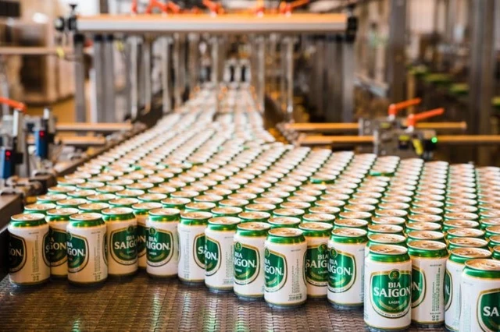
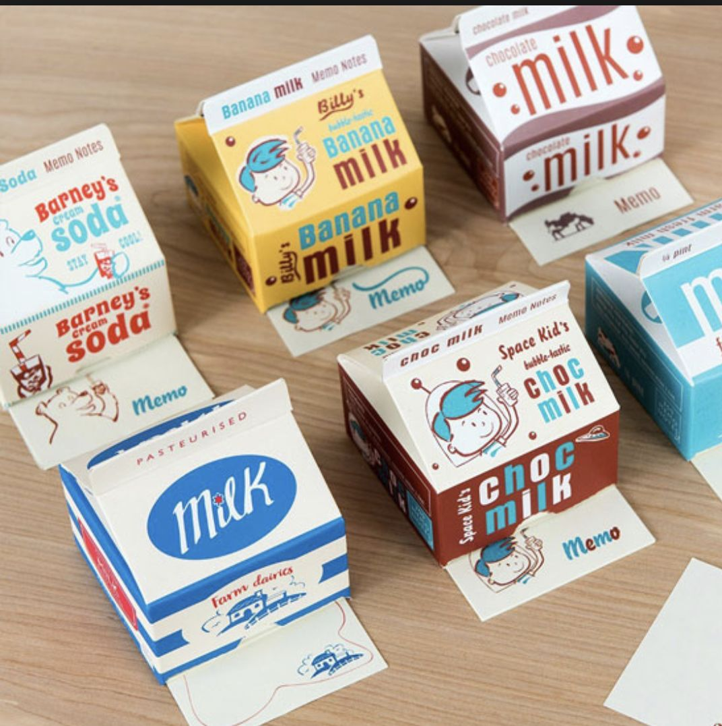
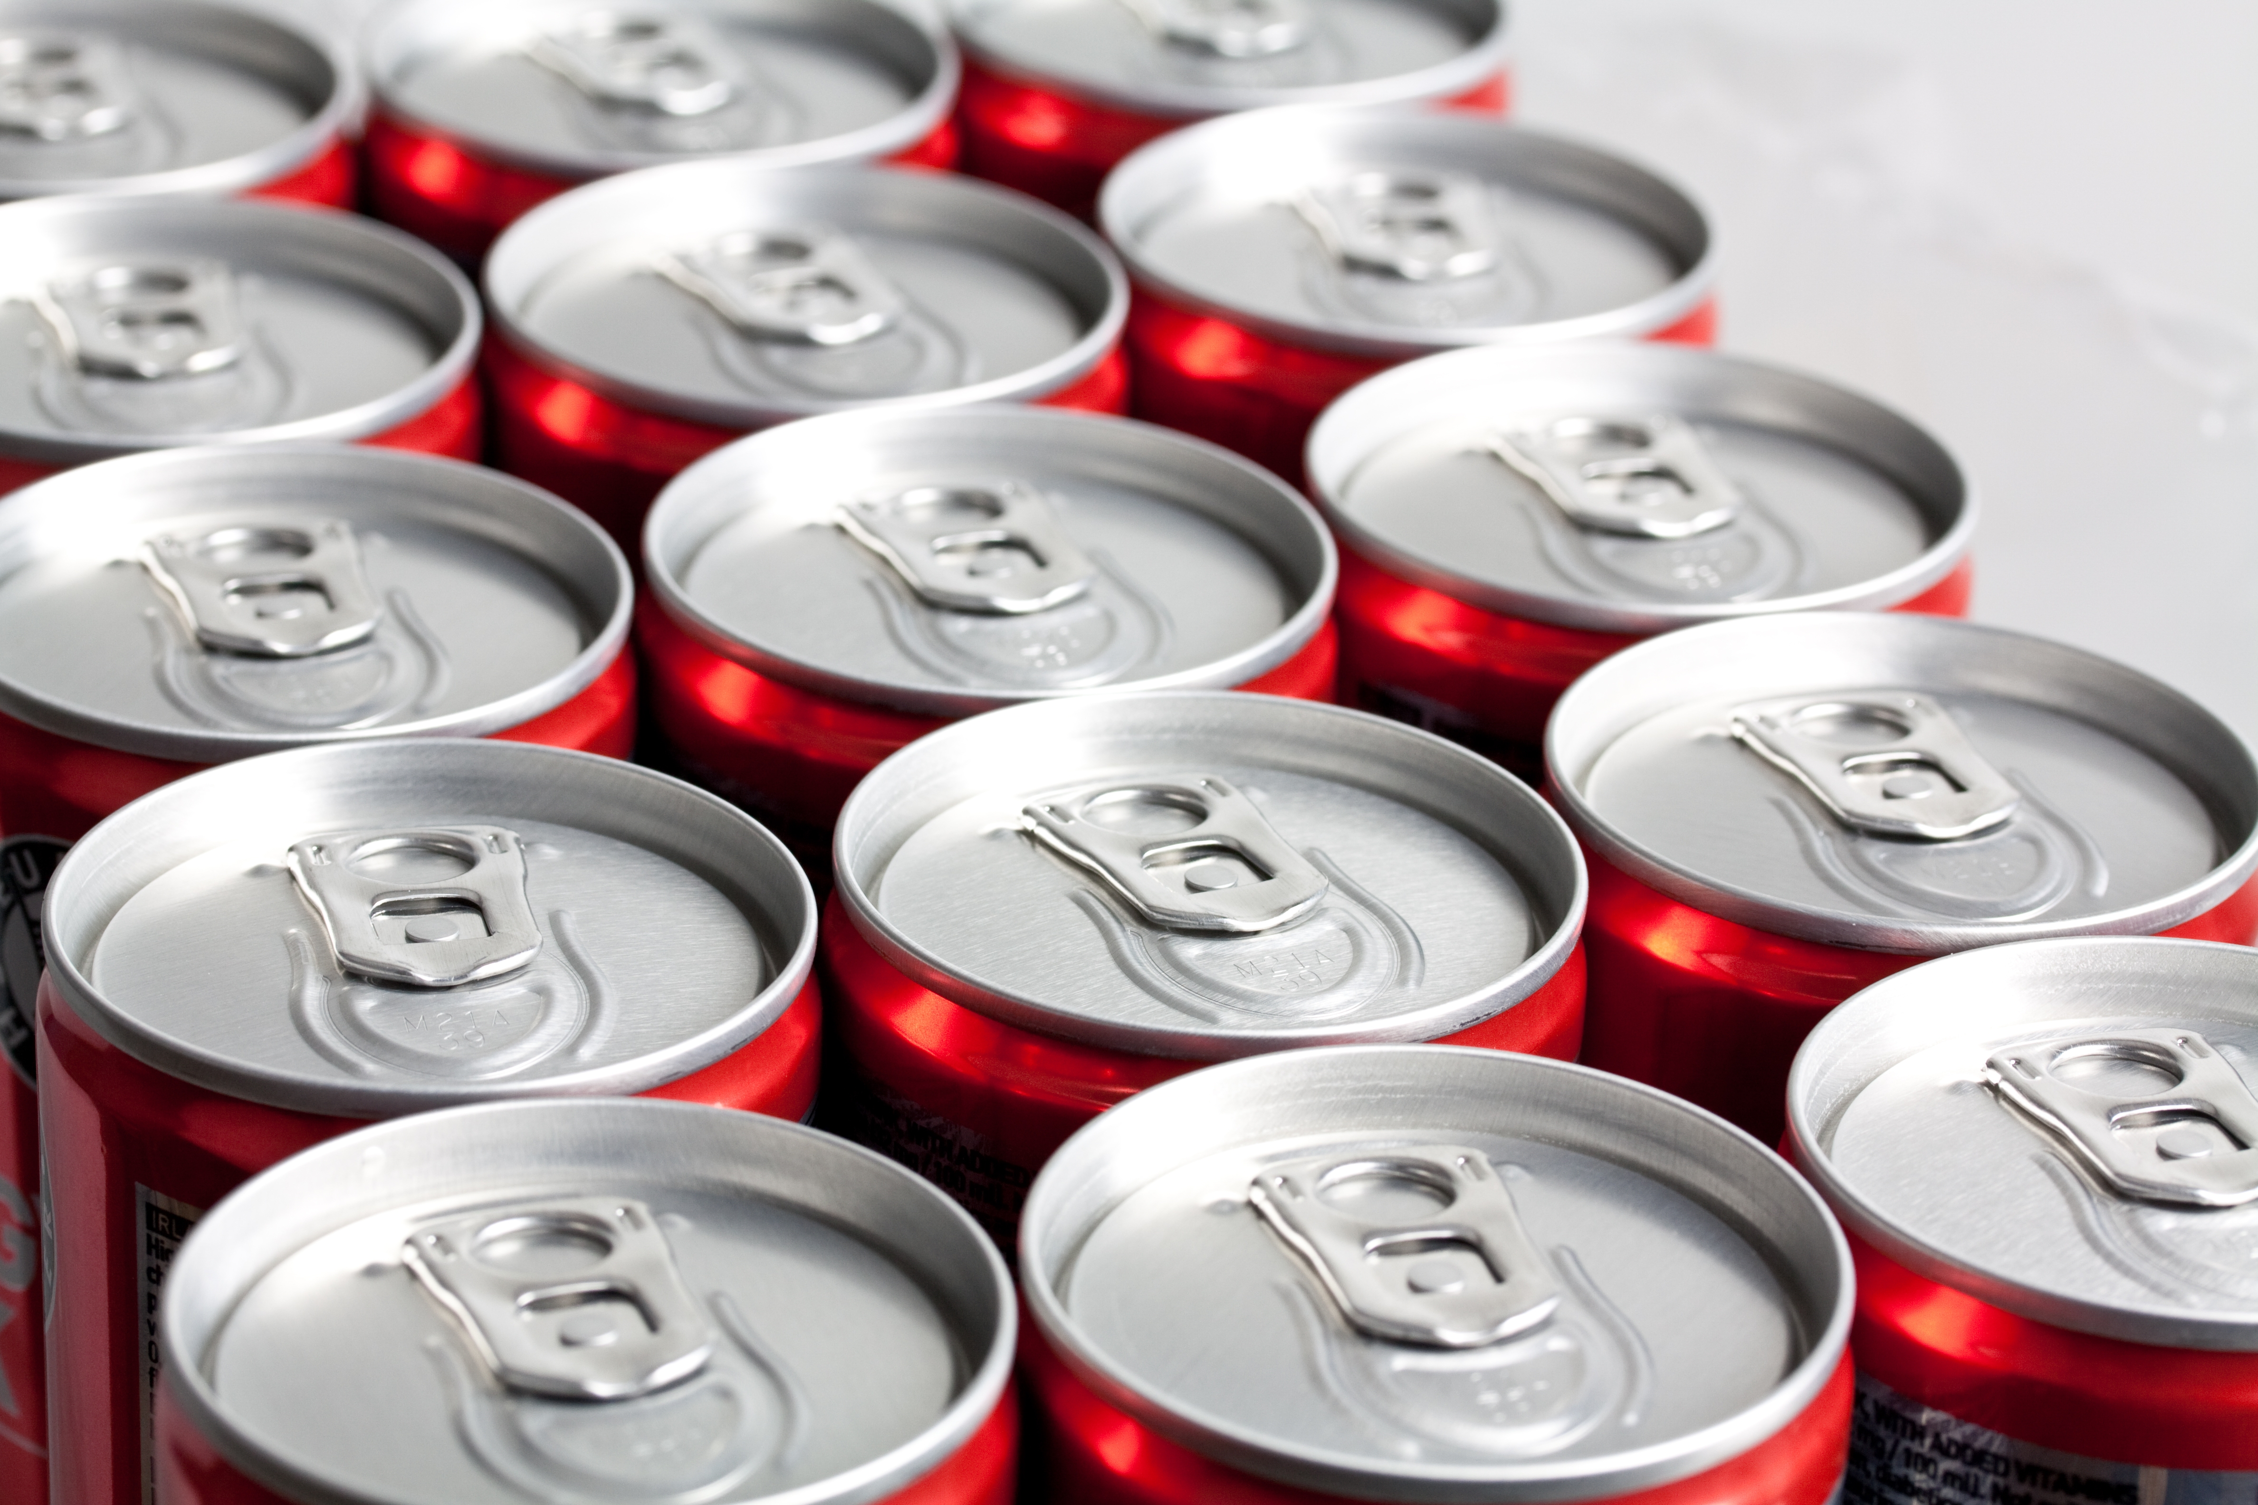
Strategic Implications for Tet 2026
Six Strategic Priorities for Brands
Embrace Premiumization & Craft Growth, Not Non-Alcoholic Illusion
Non-alcoholic beer faces fundamental rejection (82%: “without alcohol, it’s not beer”) despite brand push; only 4.2% penetration.
Real opportunity lies in craft & premium imports (4.1% share), driven by Premium Seekers (22%).
Target quality over quantity for health-conscious Gen Z/Millennials (38% reducing frequency, not alcohol).
Priorities lower-ABV variants that still taste like beer (Heineken Silver, Tiger Crystal) over 0.0%.
Invest in craft/premium for urban gifting, not non-alcoholic mass marketing.
5
Prepare for Tax-Driven Price Sensitivity
18-22% price increase expected in 2026 due to excise tax rise
Develop value-size options (smaller pack formats) to manage price perception
Increase promotional intensity during Tet period (bundles, BOGOF)
Communicate value proposition clearly to justify price points
Optimize Channel Strategy
Supermarkets growing to 38% (one-stop shopping convenience)
E-commerce declining for Tet (delivery concerns) but important year-round
Strengthen modern retail relationships with exclusive Tet promotions
Maintain traditional trade for rural/suburban reach (still 24%)
4
6
Vietnam Beer Market and Tet 2026 Consumer Trends | InsightAsia Vietnam Primary Research | December 2025

Slide 30

We Are
SMALL enough to care &
BIG enough to trust
30
We champion innovative research
Technical rigor and quality control, combined with research passion, creativity and smarter thinking
We bring real local knowledge
To provide ‘up to the minute’ understanding of the evolving competitive & consumer context

Slide 31

Our Clients Trust Us
Because We Understand
Asia.
Efficient and effective research design.
The need for practical and actionable solutions.
31
We Are your
THINKING
PARTNERS

Slide 32
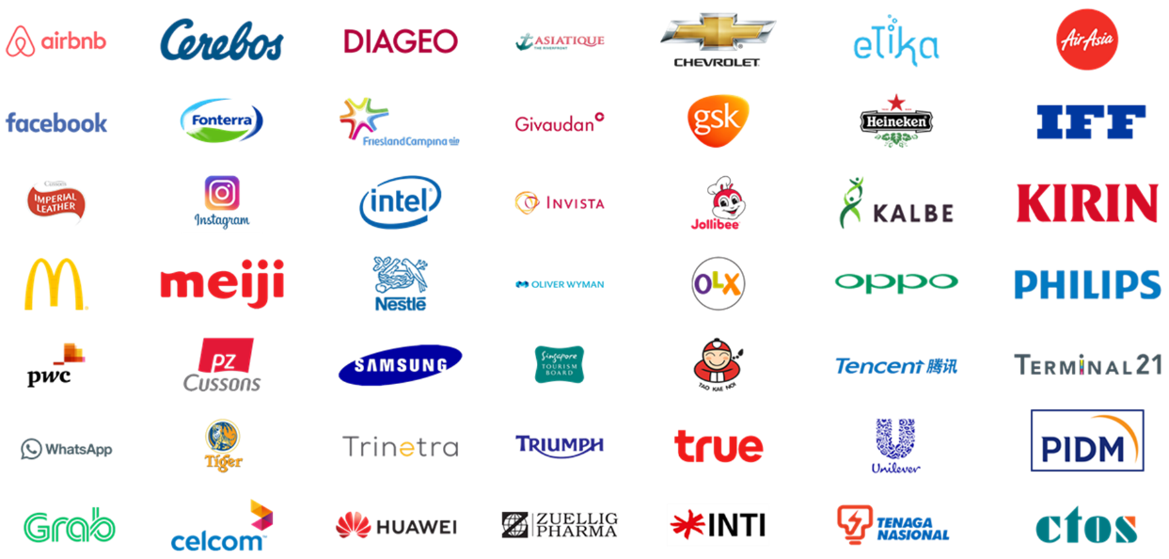




























Local & Regional Clients
Across Industries
...and more

Slide 33








(B2C) What we do
Survey: F2F/ Online
Focus Group
Home Usage Test
Central Location Test
Along shopping
Retail check/ audit
Ethnography
Mystery shopping

Slide 34

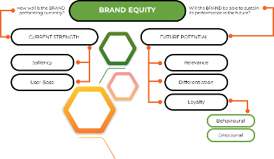
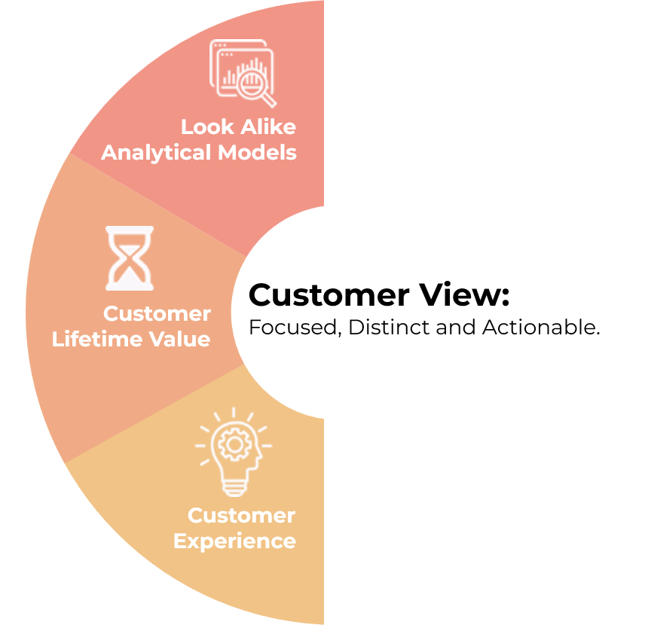
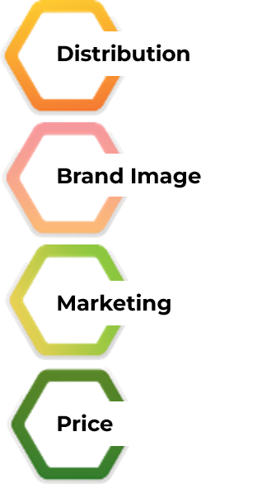
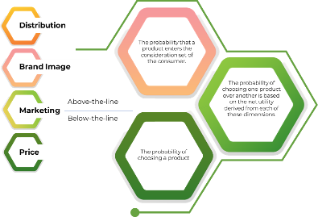

(B2B) What we do
Survey: F2F/ Online
In-depth Interview
Competitor Analysis
Market Analysis
ROMI Analysis
Ideation Workshop

Slide 35









Mr. Pham Anh Tuan
Research Director, Country Manager || VIETNAM
Tuan is a seasoned senior marketing research with over 15 years of expertise, specializing in B2B marketing research. His focus is on market exploration and penetration studies within various sectors, both locally and regionally. With a unique blend of IT and market research experience, Tuan leverages his technical skills to enhance data analysis and market insights, offering a comprehensive understanding of market dynamics.
Renowned for his sharp analytical skills and consultative approach, Tuan has made significant contributions to the understanding of consumer trends and market behaviors.
Tuan’s expert insights are occasionally featured in local newspapers such as Dan Tri , Tuoi Tre Online aaaaaa , and on Vietnam primary TV channels , where he shares his perspectives on evolving market landscapes.

