Slide 1
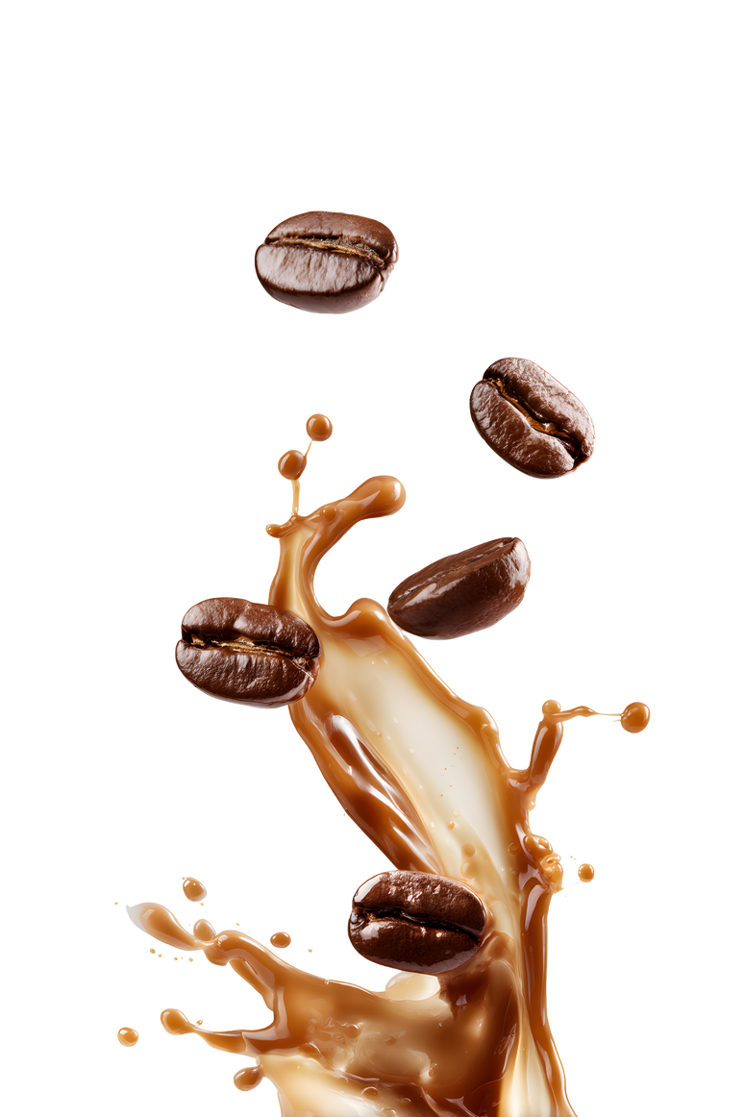
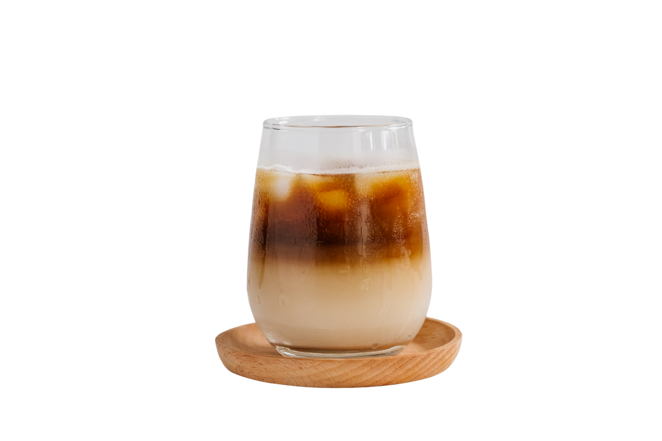
Vietnam Coffee Chain Market 2025
Consumer Behavior, Brand Performance & Competitive Dynamics
2026 January

Slide 2
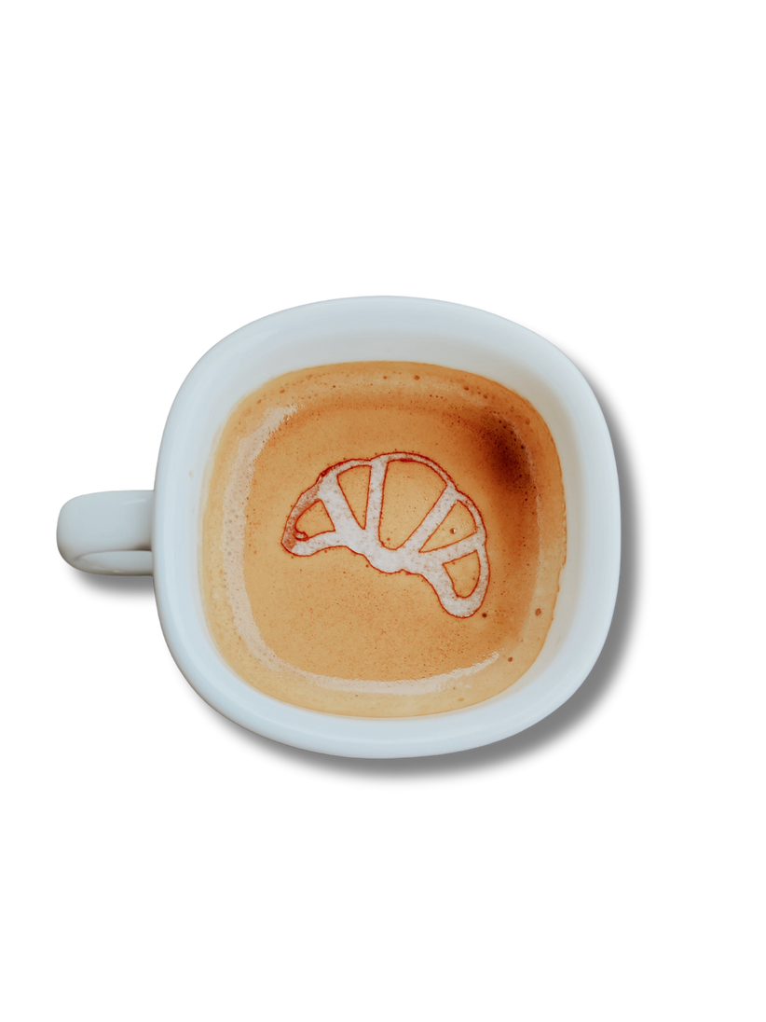
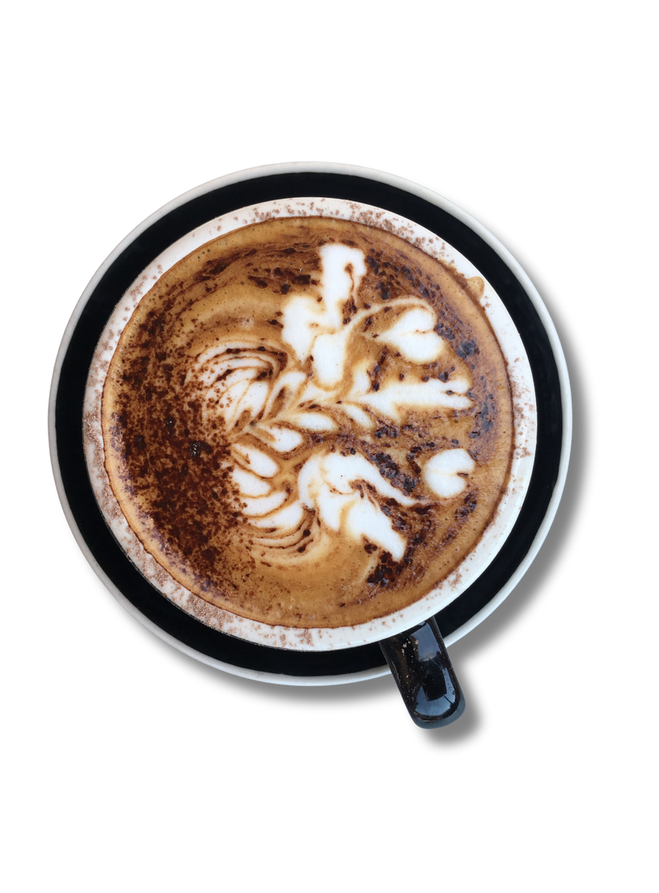
Executive Summary
Vietnam's coffee chain market continues robust growth in 2025, with intensifying competition driving innovation and premiumization despite economic headwinds.
Key Finding
Market Dynamics
~900
Highlands Coffee stores nationwide
Brand Dominance: Highlands Coffee maintains commanding lead with ~900 stores (up from 815 in early 2025), followed by Phúc Long (237 stores) and Starbucks (140 stores).
Market Consolidation: The Coffee House underwent major restructuring, reducing from 150 to 93 stores post-acquisition by Golden Gate Group.
Rising Stars: Katinat accelerates expansion with 115 stores, positioning as the Gen Z favorite with trendy, Instagrammable spaces.
International Focus: Trung Nguyên Legend prioritizes global expansion (targeting 1,000 international stores) while maintaining selective domestic presence.
73%
Visit coffee chains at least monthly
Consumer Behavior Shifts
62%
Willing to spend VND 41,000+ per visit
Frequency Paradox: Despite economic pressure, 30.4% visit coffee chains 1-2 times weekly (up from 2022), reflecting coffee as an affordable luxury.
Price Consciousness: Growing preference for VND 21,000-35,000 range (now 40% of consumers), yet premium segment remains resilient.
Digital Acceleration: Online coffee sales surged 133% YoY in H1 2025, with loyalty programs driving 35% of revenue at leading chains.
InsightAsia Vietnam | December 2025 | Based on primary research with 1,200 Vietnamese coffee chain users

Slide 3



Executive Summary
Vietnam's coffee chain market continues robust growth in 2025, with intensifying competition driving innovation and premiumization despite economic headwinds.
Strategic Implications
Success factors:
Location density
value-for-money combos
Digital integration
Experiential differentiation
Taste and product quality remain top drivers, but ambiance and convenience increasingly critical for Gen Z/Millennials
Sustainability emerging as key differentiator:
57% willing to choose eco-friendly options at comparable prices
InsightAsia Vietnam | December 2025 | Based on primary research with 1,200 Vietnamese coffee chain users

Slide 4
Research Overview & Methodology
Research Methodology
Quantitative survey
Qualitative Research
Sample | 1,200 respondents
Age | 18-45 years old
Criteria | Visited coffee chains at least once in past month
Method | Online survey
Fieldwork | November-December 2025
Consumer IDIs | 8 in-depth interviews: 4 regular users (2-3x weekly) 4 moderate users (2-4x monthly)
Expert Interviews | 3 IDIs: F&B industry consultant Coffee chain operations manager Food service analyst
Fieldwork | December 2025
Geographic Coverage
Tier 1 cities: Ho Chi Minh City (50% - 600 respondents), Hanoi (35% - 420 respondents), Da Nang (15% - 180 respondents)
Key Brand Studied
Note: Store counts as of December 2025 based on company reports and iPOS.vn tracking
Highlands Coffee: Market leader, ~900 stores
The Coffee House: Undergoing restructuring, 93 stores
Katinat: Gen Z favorite, 115 stores
Trung Nguyên Legend: Heritage brand, international focus
Phúc Long: Coffee & tea specialist, 237 stores
Starbucks: Premium international, 140 stores
InsightAsia Vietnam | December 2025 | Based on primary research with 1,200 Vietnamese coffee chain users

Slide 5
Coffee Chain Usage Behavior
Overall Coffee Chain Penetration
Have visited
coffee chains
in past 3 months
Visit at least monthly
Different chains
visited in past
month (avg)
92%
73%
3.2
Primary Occasions for Coffee Chain Visits
Q: "On which occasions do you typically visit coffee chains?" (Multiple responses allowed)
#1 | Meeting friends / socializing | 68%
#2 | Working / studying | 52%
#3 | Quick coffee break during work/errands | 47%
#4 | Dating / romantic occasions | 35%
#5 | Business meetings | 29%
#6 | Family outings | 22%
InsightAsia Vietnam | December 2025 | Based on primary research with 1,200 Vietnamese coffee chain users

Slide 6



Coffee Chain Usage Behavior
Beverage Preferences
Most Ordered Drinks:
Key insight
12% Non-coffee beverages
(E.g., tea, smoothies)
Coffee chains have successfully positioned as multifunctional spaces beyond just coffee consumption.
The "third place" concept (between home and work) resonates strongly, with 52% using chains as workspaces.
→ This validates investments in comfortable seating, reliable WiFi, and power outlets.
18% - Specialty/creative coffee (E.g., cold brew, coconut coffee)
42% Coffee with milk
(E.g., latte, cappuccino, cà phê sữa)
"I usually order a coconut coffee or cold brew when meeting friends. Traditional phin coffee is for home or street cafés."
28% Black coffee
(E.g., phin, americano)
— Female, 28, HCMC office worker
InsightAsia Vietnam | December 2025 | Base: All coffee chain users who visited in past month (n=1,200)

Slide 7
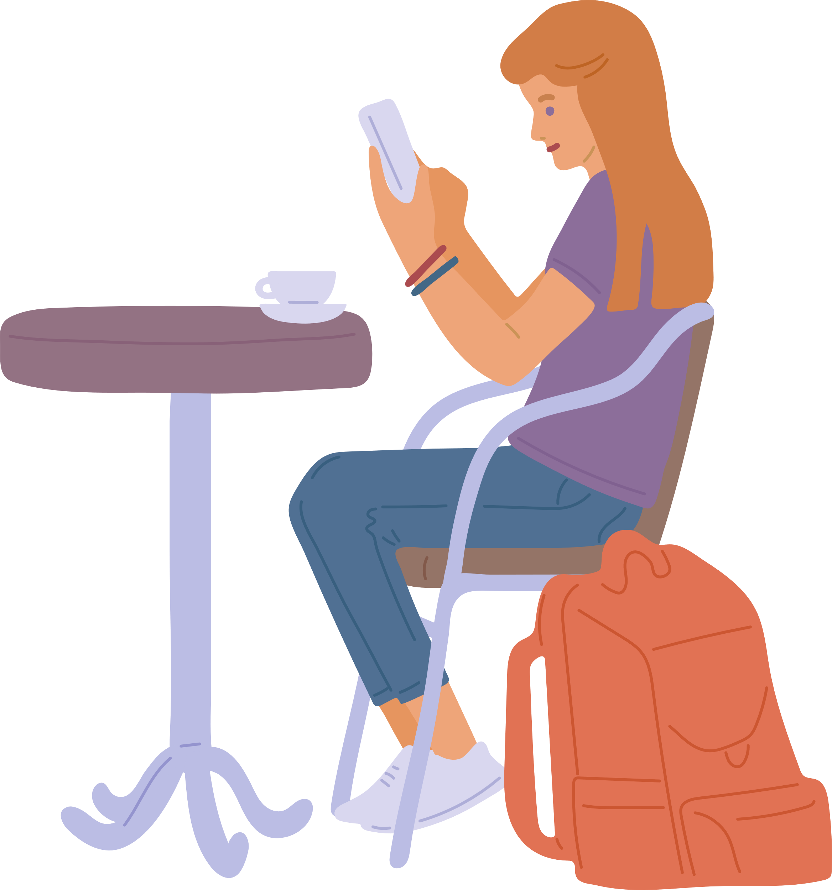





Visit Frequency & Occasion Patterns
Coffee Chain Visit Frequency
Q: "How often do you visit coffee chains?"
Visit Patterns by Demographics
1-2 times per month
By age group
18-24 years:
25-35 years:
35-45 years:
38% visit weekly+
Peak: Weekend afternoons/evenings
35% visit weekly+
Peak: Weekday mornings, lunch breaks
22% visit weekly+
Peak: Weekend mornings with family
1-2 times per week
3-4 times per month
By relationship status
3-4 times per week or more
Dating:
Single:
Married:
42% visit weekly+
Higher spend per visit (avg VND 95,000 for couple)
31% visit weekly+
Often visit for work/study
26% visit weekly+
Family outings or grab-and-go
Daily
InsightAsia Vietnam | December 2025 | Based on primary research with 1,200 Vietnamese coffee chain users
Note: 30.4% weekly+ frequency represents increase from 22.7% in 2022

Slide 8




Visit Frequency & Occasion Patterns
Time-of-Day Visit Patterns
Morning
(7am – 11am)
Afternoon
(2pm – 6pm)
Evening
(7pm – 10pm)
45%
32%
23%
Office workers
Breakfast
Students
Meetings
Work breaks
Socializing
Dating
Studying
InsightAsia Vietnam | December 2025 | Based on primary research with 1,200 Vietnamese coffee chain users

Slide 9
Visit Frequency & Occasion Patterns
Key insight
The "Affordable Luxury" Phenomenon
Despite economic pressure (inflation at 3.6%, conservative spending), coffee chain visits have increased. This paradox reveals coffee as an "affordable luxury" – a small indulgence that provides significant social/emotional value. Chains successfully position as accessible premium experiences, with most spending VND 30,000-50,000 (US$1.20-2.00) per visit.
"During COVID, we cut back a lot. Now we're back to going out for coffee regularly – it's something we won't sacrifice even when money is tight. It's our main social activity."
— Male, 32, Hanoi tech worker
InsightAsia Vietnam | December 2025 | Based on primary research with 1,200 Vietnamese coffee chain users

Slide 10
Consumer Spending Analysis
Spending per Coffee Chain Visit
Q: "How much do you typically spend per visit to a coffee chain (including drinks, food, for yourself)?"
Spending Changes vs. 2022-2023
Notable Shift: The "affordable" segment (VND 21-40k) has grown significantly from 28.5% to 40%, reflecting increased price sensitivity. Meanwhile, the ultra-premium segment (>VND 100k) dropped from 6% to 1.7%.
VND 41,000 - 70,000 (US$1.60 - 2.80)
Average Monthly Spend on Coffee Chains
VND 21,000 - 40,000 (US$0.85 - 1.60)
VND 285k
VND 425k
VND 165k
Overall average monthly spend (US$11.20)
Heavy users (weekly+) monthly spend
Light users
(monthly) spend
VND 71,000 - 100,000 (US$2.80 - 3.90)
Spending by City
Above VND 100,000 (US$3.90+)
HCMC
Hanoi
Da Nang
VND 315,000/month avg
Higher frequency, more premium chains
VND 275,000/month avg
Mix of traditional & modern chains
VND 245,000/month avg
Growing chain presence
Below VND 20,000 (US$0.85)
InsightAsia Vietnam | December 2025 | Base: All coffee chain users (n=1,200). Note: VND 21-40k segment grew from 28.5% (2022) to 40% (2025)

Slide 11




Consumer Spending Analysis
Willingness to Pay Premium
Q: "Would you be willing to pay 10-20% more for coffee chains that offer the following?" (% willing to pay premium)
67%
52%
48%
41%
For better
coffee quality
For
convenient
location
For better ambiance/space
For
eco-friendly practices
InsightAsia Vietnam | December 2025 | Base: All respondents (n=1,200), willing to pay 10-20% premium for stated attribute

Slide 12
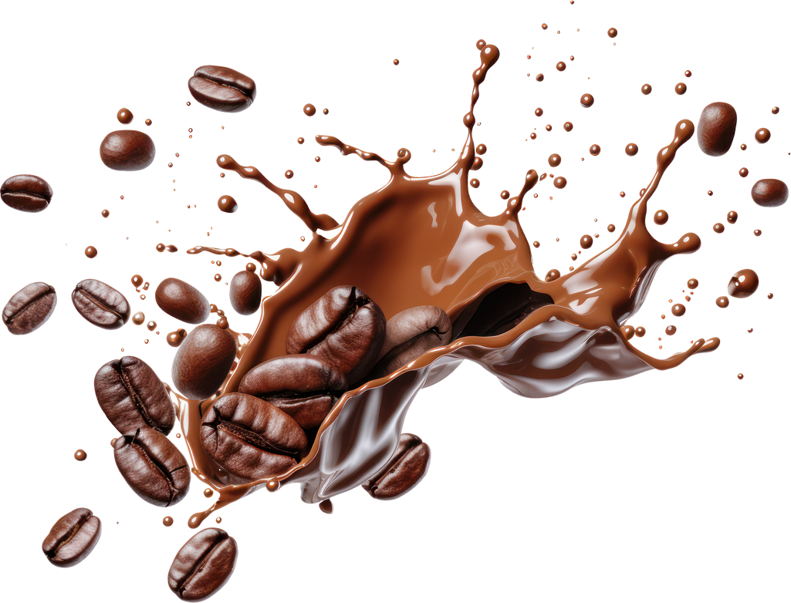
Consumer Spending Analysis
Key insight
Value-Seeking Behavior
Price sensitivity has intensified, but consumers remain willing to pay for quality and convenience. The sweet spot is VND 30-50k for a satisfying coffee experience.
Chains succeeding with combo offers, loyalty discounts, and "happy hour" promotions that provide perceived value while maintaining margins.
InsightAsia Vietnam | December 2025 | Based on primary research with 1,200 Vietnamese coffee chain users

Slide 13
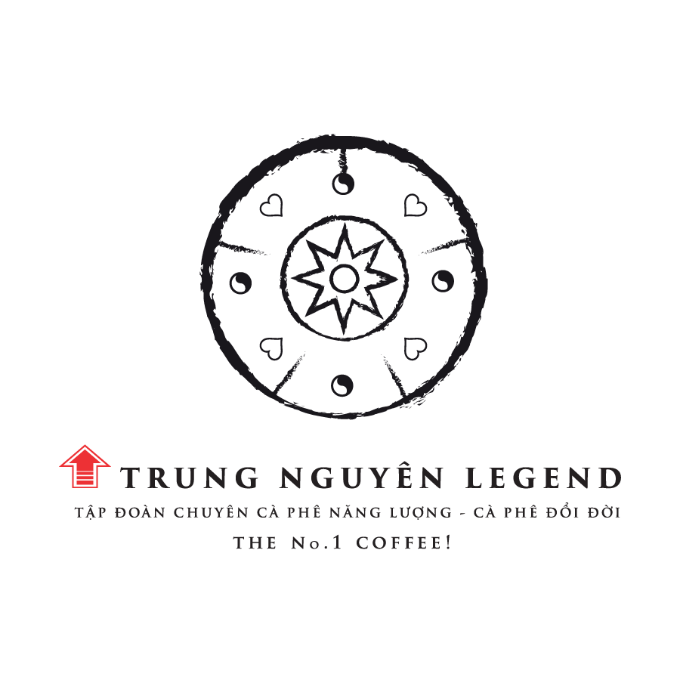

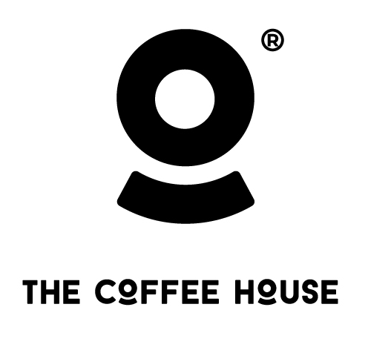
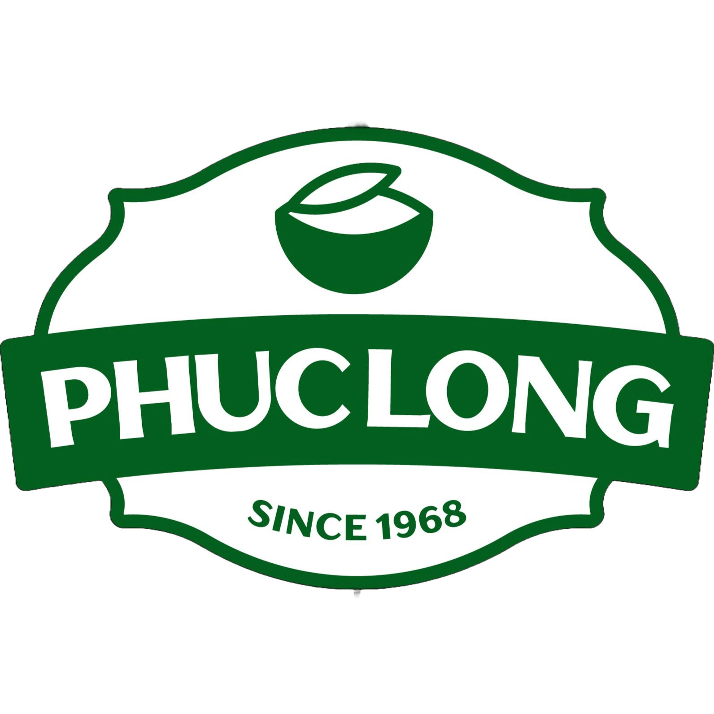


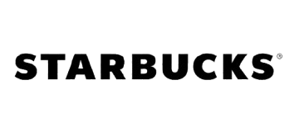
Brand Awareness & Trial Funnel
Brand Awareness & Usage Metrics
Top of mind
Total awareness
Ever tried
Monthly usage
Weekly usage
97%
74%
62%
91%
65%
58%
95%
62%
54%
Top of mind
Total awareness
Ever tried
Monthly usage
Weekly usage
95%
56%
65%
90%
62%
56%
87%
44%
42%
InsightAsia Vietnam | December 2025 | Based on primary research with 1,200 Vietnamese coffee chain users | Top-of-Mind: Q: "When thinking about coffee chains, which brand comes to mind first?" (Unaided recall) | Total Awareness: Q: "Which of these coffee chains have you heard of?" (Aided awareness, % aware) | Ever Tried: Q: "Which coffee chains have you ever visited?" (% ever visited) | Monthly/Weekly Usage: Q: "Which coffee chains have you visited in the past month/week?" (% current users)

Slide 14
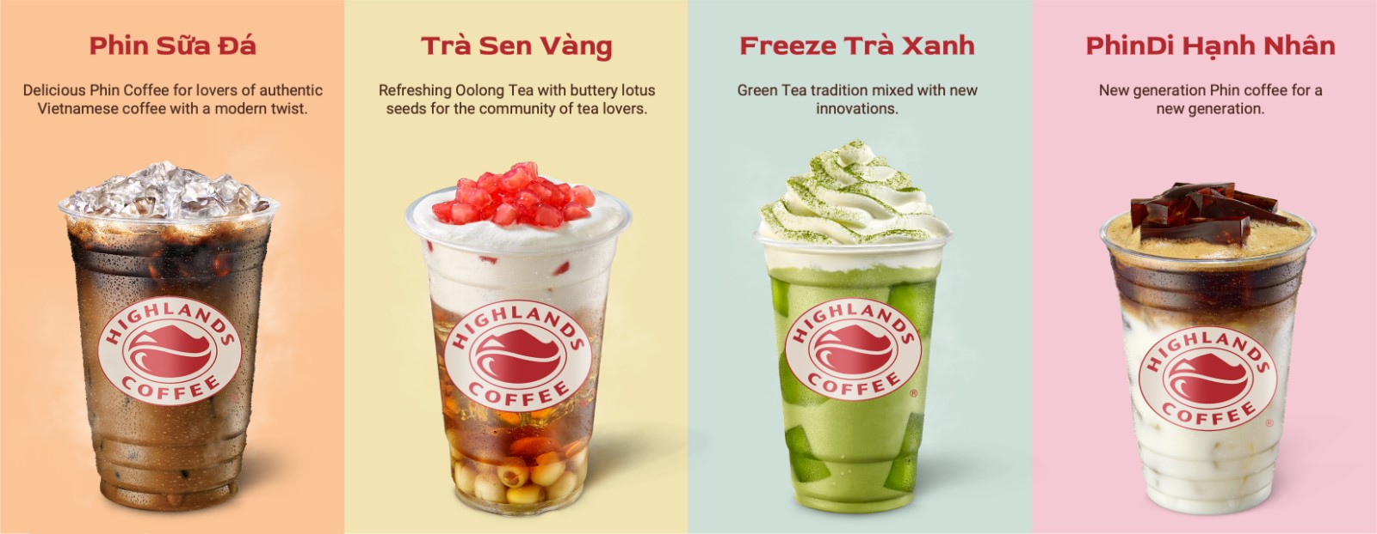
Brand Awareness & Trial Funnel
Conversion Funnel Analysis
Highlands Coffee demonstrates exceptional conversion throughout the funnel:
95% awareness → 92% trial = 97% conversion rate
92% trial → 68% monthly usage = 74% activation rate
Highest loyalty: 62% of monthly users visit weekly (42% of all aware users)
Awareness Leaders
 | Ubiquitous presence, ~900 stores creates natural awareness
 | Strong heritage brand, G7 instant coffee extends reach
 | Once strong, now declining due to store closures
Experience Challengers
 | 74% of trialists become monthly users
 | 62% conversion (strong among Gen Z)
 | 44% conversion (quality experience but price barrier)
InsightAsia Vietnam | December 2025 | Based on primary research with 1,200 Vietnamese coffee chain users | Top-of-Mind: Q: "When thinking about coffee chains, which brand comes to mind first?" (Unaided recall) | Total Awareness: Q: "Which of these coffee chains have you heard of?" (Aided awareness, % aware) | Ever Tried: Q: "Which coffee chains have you ever visited?" (% ever visited) | Monthly/Weekly Usage: Q: "Which coffee chains have you visited in the past month/week?" (% current users)

Slide 15
Brand Repertoire
Average number
of chains visited
in past month
Multi-brand
users (visit 2+
chains monthly)
Exclusively loyal
to one chain
"I go to Highlands most often because it's everywhere and consistent. But I'll visit Katinat when meeting friends because it's more Instagram-worthy, or Starbucks for important meetings."
— Female, 26,
HCMC marketing professional
3.2
68%
18%
Key insight
Polygamous Loyalty
Vietnamese consumers maintain repertoires of 3-4 chains, choosing based on occasion, location, and companions. True exclusivity is rare (18%). Success requires being in the consideration set for multiple occasions rather than achieving 100% loyalty. Highlands wins through "default choice" status, while specialty chains like Katinat win specific occasions.
InsightAsia Vietnam | December 2025 | Base: Users of each brand who visited in past 3 months

Slide 16
Brand Performance: Product Quality & Menu
Coffee Quality & Taste (% rating 4-5 out of 5)
Brand |  | Drink Quality | Consistency Across Stores | Menu Variety | Food & Snacks
 | Highlands Coffee | 84% | 79% | 76% | 70%
 | Trung Nguyên Legend | 88% | 82% | 64% | 58%
 | The Coffee House | 81% | 75% | 72% | 67%
 | Phúc Long | 78% | 70% | 69% | 61%
 | Katinat | 80% | 73% | 66% | 55%
 | Starbucks | 82% | 85% | 88% | 83%
InsightAsia Vietnam | December 2025 | Q: "Please rate each brand you've visited on the following attributes" (5-point scale: 1=Very Poor, 5=Excellent)
Base: Users who visited each brand in past 3 months

Slide 17
Brand Performance: Product Quality & Menu
Key Performance Highlights
 | Strong all-around performer (84%) Reliable quality across massive network. Good consistency (79%) despite scale. Growing food program (70%). |  | Tea-coffee balance, variable quality (78%) Known for tea expertise. Coffee quality acceptable but not exceptional. Consistency challenges across expanding network (70%).
 | Top for coffee quality (88%) Heritage expertise, premium beans, traditional Vietnamese coffee taste. Limited food offering but coffee excellence compensates. |  | Good drinks, limited food (80%/55%) Creative beverages resonate with youth. Consistency improving (73%). Food secondary to beverage focus.
 | Solid quality but declining consistency Quality still good (81%) but consistency suffering (75%) post-restructuring. Menu needs refreshment (72%). |  | Best consistency & menu variety Global standards ensure uniformity (85%). Unmatched menu breadth (88%) and food quality (83%). Premium positioning justified by product excellence.
InsightAsia Vietnam | December 2025 | Base: Users of each brand who visited in past 3 months

Slide 18
Brand Performance: Product Quality & Menu
Menu Innovation Perception
Q: "This brand frequently introduces new drinks and seasonal offerings" (% agree, 4-5 on 5-point scale)
 | 84% | Frequent new drinks, seasonal offerings |  | 74% | Periodic new launches
 | 78% | Creative, trendy beverages |  | 72% | Periodic new launches
 | 76% | Regular menu updates |  | 60% | Traditional, stable menu
"Trung Nguyên has the most authentic Vietnamese coffee taste – strong, bold, the way it should be. Starbucks is good but it's more Western-style, sweeter drinks."
— Male, 38, Hanoi business owner
InsightAsia Vietnam | December 2025 | Base: Users of each brand who visited in past 3 months

Slide 19
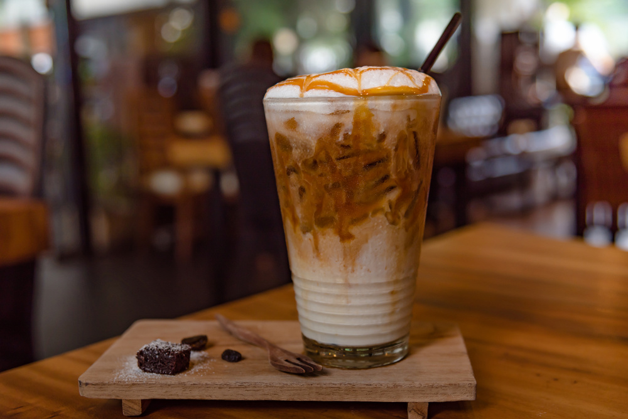
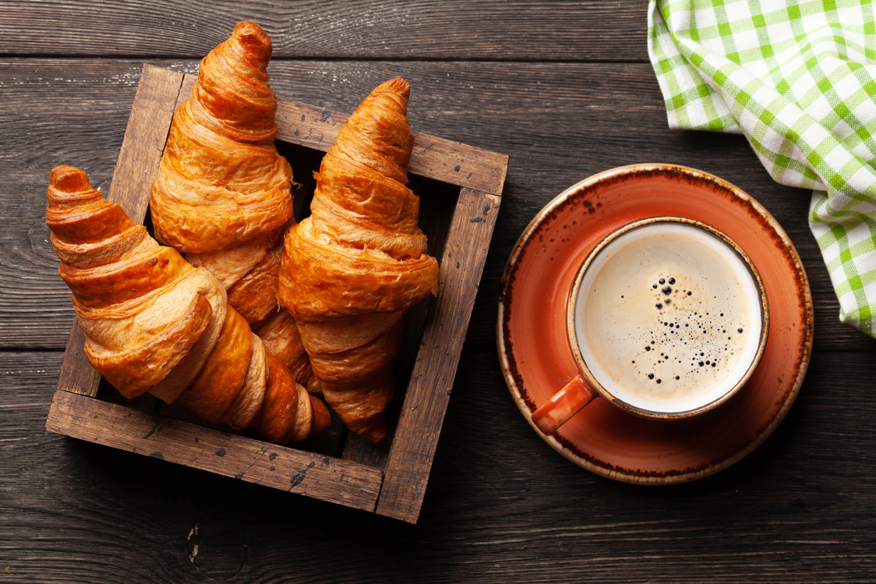
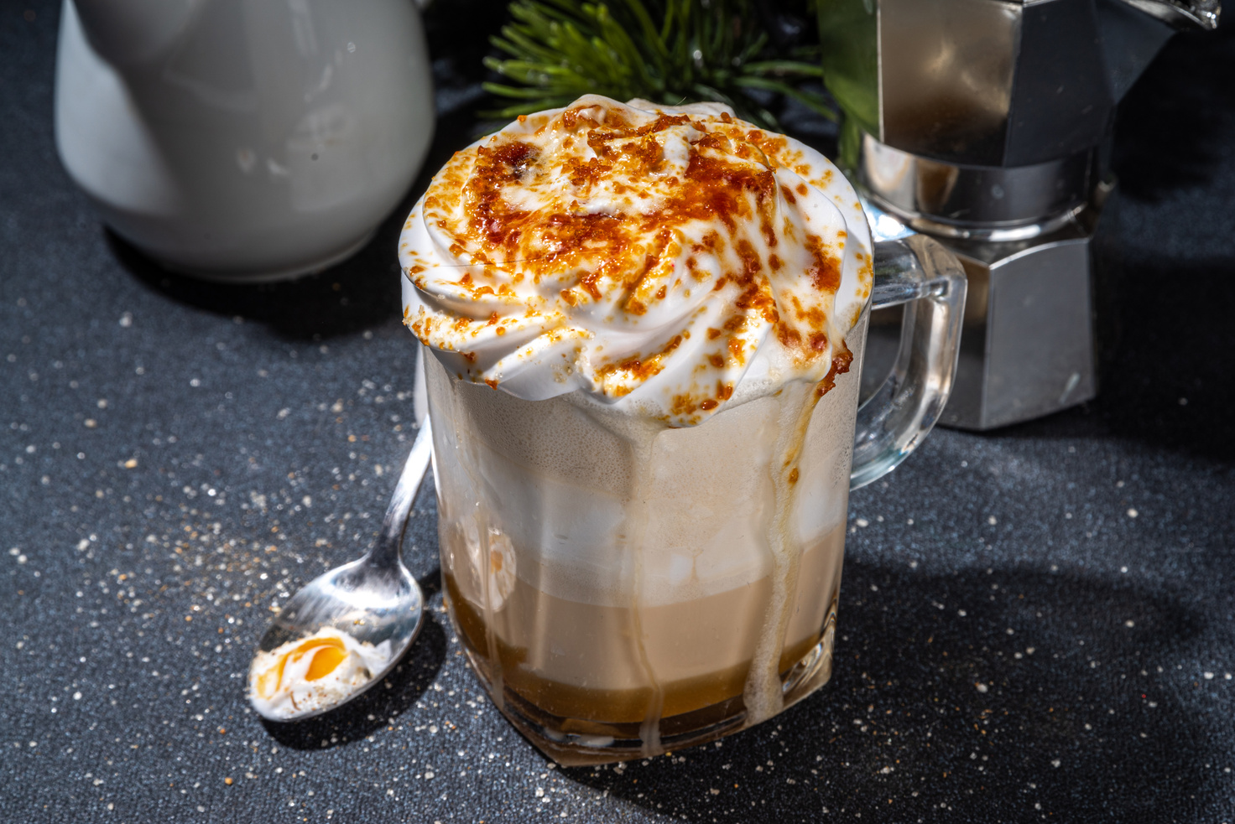
Brand Performance: Product Quality & Menu
Key insight
Quality Table Stakes, Innovation Differentiates
Coffee quality is now table stakes – all major chains score 78%+.
Differentiation comes from:
Food program quality increasingly important as chains compete for all-day occasions.
#1
#2
#3
Consistency at scale (Starbucks, Highlands lead)
Menu innovation
(Starbucks, Katinat win)
Heritage authenticity
(Trung Nguyên)
InsightAsia Vietnam | December 2025 | Base: Users of each brand who visited in past 3 months

Slide 20
Brand Performance: Store Experience & Ambience
In-Store Experience Ratings (% rating 4-5 out of 5)
Brand |  | Store Ambience | Comfort for Work/Study | Noise Control | Cleanliness
 | Starbucks | 88% | 85% | 80% | 90%
 | Highlands Coffee | 82% | 72% | 70% | 83%
 | Katinat | 79% | 70% | 68% | 78%
 | Phúc Long | 77% | 64% | 63% | 79%
 | Trung Nguyên Legend | 76% | 68% | 66% | 80%
 | The Coffee House | 71% | 75% | 69% | 81%
InsightAsia Vietnam | December 2025 | Q: "Please rate each brand on these in-store experience factors" (5-point scale: 1=Very Poor, 5=Excellent)
Base: Users who visited each brand in past 3 months

Slide 21







Brand Performance: Store Experience & Ambience
Ambience Strengths by Brand
Premium Experience Leaders
 | Sophisticated, consistent global aesthetic Premium materials, comfortable seating Best-in-class noise control (80%) "Third place" execution
 | Modern, trendy Vietnamese aesthetic Balance of social & work-friendly spaces Good overall ambience (82%) Variable by location/age of store
Experience Challengers
 | "Saigon Retro" design appeals to Gen Z (79%) Instagram-worthy, artistic interiors Can be noisy during peak (68%) Social experience > work environment
 | Flagship stores excel (85%+) Smaller outlets more cramped Noise issues in busy locations (63%) Inconsistent experience across formats
Work/Study Friendliness
Starbucks (85%) and The Coffee House (75%) lead in work-friendliness due to:
Reliable power outlets and fast WiFi
Comfortable seating for extended stays
Better noise control than competitors
Tolerance for laptop users during non-peak hours
InsightAsia Vietnam | December 2025 | Base: Users of each brand who visited in past 3 months

Slide 22



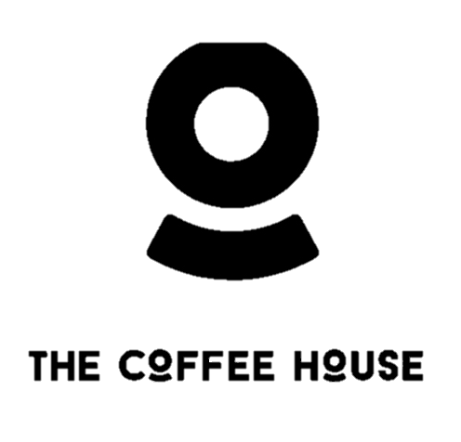

Brand Performance: Store Experience & Ambience
Space Design Preferences by Demographics
18-24 years old
25-34 years old
35-45 years old
Space Preference
Space Preference
Space Preference
"Katinat has the best vibe for hanging out with friends – the decor is so unique and photogenic. But for working, I prefer Starbucks or Highlands where I can stay 3-4 hours without feeling rushed.“
— Female, 24,
Hanoi university student
Instagrammable, vibrant, social
Work-friendly, minimalist, comfortable
Quiet, classic, spacious
Preferred chain
Preferred chain
Preferred chain
InsightAsia Vietnam | December 2025 | Base: Users of each brand who visited in past 3 months

Slide 23
Brand Performance: Store Experience & Ambience
Key insight
Experience Economy Wins
Ambience now equally important as coffee quality for many consumers.
Chains must invest in regular store refreshes to maintain appeal.
Store ambiance rating
(% rating 4-5 out of 5)
Starbucks commands premium pricing partly due to superior space
Katinat compensates for smaller network with distinctive design.
The Coffee House's declining ambience scores, correlating with reduced investment post-acquisition.
88%
79%
71%
InsightAsia Vietnam | December 2025 | Base: Users of each brand who visited in past 3 months

Slide 24
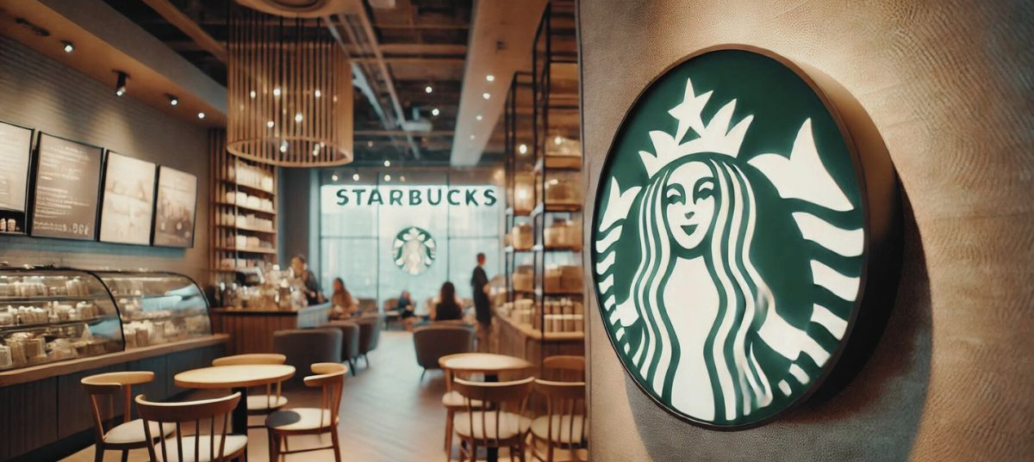
Brand Performance: Service & Convenience
In-Store Experience Ratings (% rating 4-5 out of 5)
Brand |  | Staff Friendliness | Service Speed | Order Accuracy | App/Loyalty Experience
 | Starbucks | 88% | 76% | 85% | 82%
 | Highlands Coffee | 80% | 78% | 82% | 75%
 | The Coffee House | 78% | 73% | 79% | 80%
 | Trung Nguyên Legend | 76% | 74% | 80% | 62%
 | Katinat | 75% | 72% | 78% | 66%
 | Phúc Long | 73% | 70% | 77% | 68%
Service
Excellence Drivers
Starbucks leads on staff friendliness (88%) due to:
Intensive training programs and service culture
Better compensation vs. local chains
Empowerment to resolve customer issues
Consistent service standards across locations
Highlands balances speed (78%) with good accuracy (82%) through operational excellence
at scale.
InsightAsia Vietnam | December 2025 | Q: "Please rate each brand on these service factors" (5-point scale: 1=Very Poor, 5=Excellent)
Base: Users who visited each brand in past 3 months

Slide 25
Brand Performance: Service & Convenience
Location Convenience
Wide franchise network
Major cities, declining
Selective, premium positioning
Ubiquitous presence
Premium locations only
Delivery App Integration
% satisfaction
35% of revenue from digital channels
Premium positioning limits delivery demand
Strong GrabFood/
ShopeeFood presence
Good integration but volume declining
Loyalty Program Effectiveness
Limited digital focus
Growing adoption
Established program
High enrollment but UX issues
Strong local app
Improving rapidly
Wide adoption but app performance complaints
Gamified challenges, digital stamps, optimized for Vietnamese users
Global Starbucks Rewards framework, though some users report app performance issues in Vietnam
InsightAsia Vietnam | December 2025 Q: "This brand's stores are conveniently located near my home/office" (5-point agreement scale)
Base: Users who visited each brand in past 3 months

Slide 26
Brand Performance: Service & Convenience
Key insight
Convenience Multiplier Effect
Highlands' massive network (88% location convenience) creates a "default choice" advantage that outweighs moderate service scores.
However, digital leaders (Phúc Long 35% digital revenue, The Coffee House strong app) show that convenience extends beyond physical stores. 133% YoY digital growth signals that app/delivery excellence will become increasingly critical.
"Phúc Long's delivery is excellent – always packed well, arrives quickly. Their app is getting better too. Highlands is everywhere which is convenient, but sometimes the app is glitchy."
— Male, 29, HCMC office worker
InsightAsia Vietnam | December 2025 | Base: Users of each brand who visited in past 3 months

Slide 27
Brand Image & Positioning Map
Brand Perception Attributes (% agree with statement)
Trendy/ Stylish
Friendly/ Approachable
Premium/ High-end
Vietnamese Identity
Good for Dating
Quich Grab-and-Go
InsightAsia Vietnam | December 2025 | Q: "Please indicate which of the following words/phrases describe each brand" (% agree, based on users familiar with each brand)

Slide 28
Brand Image & Positioning Map
Brand Positioning Map: Correspondence Analysis
Key Positioning Insights
Starbucks: Dominates premium-modern quadrant, closest to "Premium," "Quality," and "Trendy" attributes
Trung Nguyên: Owns traditional-premium space, strongly associated with "Vietnamese Identity"
Highlands/Katinat/The Coffee House: Cluster in accessible-modern space, competing for similar positioning
Phúc Long: Most accessible positioning, associated with "Convenient" and "Friendly"
White space: Limited differentiation among Vietnamese mid-market chains (Highlands, Katinat, The Coffee House)
InsightAsia Vietnam | December 2025 | Q: "Please indicate which of the following words/phrases describe each brand" (% agree, based on users familiar with each brand)

Slide 29
Key Choice Drivers
Importance of Choice Factors
(% rating "very important")
Generational Differences in Choice Drivers
Taste & drink quality
Value for money
Store location convenience
Consistent quality across outlets
Fast service
Staff friendliness
Seating availability & comfort
Attractive promotions/discounts
Air conditioning & ambience
Free & stable Wi-Fi
Ability to order via delivery apps
Quiet enough for working/studying
Vietnamese coffee taste authenticity
Loyalty points & membership benefits
Brand image / "cool" factor
Availability of non-coffee options
Parking availability
Late operating hours
Gen Z (18-24)
Millennials (25-34)
Gen X (35-45)
Taste & quality
Value for money
Brand image/"cool" factor
Instagram-worthy space
Wi-Fi quality
Delivery app integration
Vietnamese authenticity
Parking availability
"Taste is number one, but if the place isn't convenient or the price is too high, I'll just go to a different chain. There are so many options now."
— Female, 27, HCMC banking professional
InsightAsia Vietnam | December 2025 | Base: All respondents (n=1,200), not brand-specific | Q: "When choosing which coffee chain to visit, how important are the following factors?" (5-point scale: 1=Not at all important, 5=Very important. % shown rated 5/5) Base: Gen Z n=348, Millennials n=540, Gen X n=312. Q: "How important is each factor?" (% rating 5/5 "Very Important")

Slide 30
Key Choice Drivers
Key Strategic Implications
Quality is table stakes (88%) but convenience (82%) nearly equals taste in importance. This explains Highlands' dominance – their ~900 stores create unmatched convenience. | Price sensitivity intensifying "Value for money" ranks #2 (84%), up from #4 in 2022. Promotions (71%) and loyalty programs (60%) growing in importance.
Gen Z drives experience economy 72% rate "cool factor" as very important vs. 42% of Gen X. Katinat and Starbucks capitalize on this; traditional chains risk aging out. | Digital hygiene factors Wi-Fi (68%), delivery apps (66%), and loyalty programs (60%) now expected, not differentiators.
InsightAsia Vietnam | December 2025 | Base: All respondents (n=1,200), not brand-specific

Slide 31


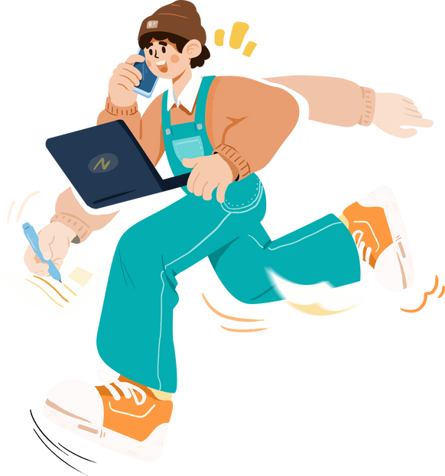


Consumer Segmentation
32%
28%
25%
15%
Premium Connoisseurs
Social Butterflies
Convenience Seekers
Value Optimizers
Demographics | 28-45 years, professionals, high income (>VND 20M/month) | 18-30 years, students & young professionals | 25-40 years, busy office workers, families | 18-45 years, price-conscious across income levels
Behavior | Visit 2-3x weekly, spend VND 70-120k per visit | Visit 1-2x weekly, often in groups, spend VND 40-70k | Visit 3-4x monthly, grab-and-go or delivery, spend VND 30-50k | Visit 1-2x monthly, strategic about promotions, spend VND 25-40k
Priorities | Coffee quality (94%), ambience (88%), service excellence (85%) | Ambience (92%), Instagram-worthy (85%), location (82%) | Location (90%), speed (85%), delivery options (78%) | Value/price (95%), promotions (88%), loyalty rewards (82%)
Preferred brands
Occasions | Business meetings, dating, quiet work sessions | Meeting friends, dating, group study sessions | Morning coffee runs, quick breaks during errands | Treat occasions, redeeming loyalty points
Price sensitivity | Low – willing to pay premium for quality | Moderate – value-conscious but splurge for special occasions | Moderate-high – seek value combos and promotions | Very high – actively hunt for deals
(premium locations)
(selective)
(ubiquity)
InsightAsia Vietnam | December 2025 | Based on primary research with 1,200 Vietnamese coffee chain users

Slide 32
Consumer Segmentation
32%
28%
25%
15%
Premium Connoisseurs
Social Butterflies
Convenience Seekers
Value Optimizers
Distribution by city
STRATEGIC RECOMMENDATION
Starbucks
Katinat
Phúc Long
Double down on Premium Connoisseurs (70% of their base) – expand Reserve stores, premium product innovation
Own Social Butterflies (65% of base) – invest in experiential design, influencer partnerships, limited-edition drinks
Serve Convenience Seekers + Value Optimizers with strong delivery and combo meal programs.
Highlands
Multi-segment appeal is strength – maintain breadth while segmenting offers by location (premium HCMC vs. value Da Nang)
The Coffee House
Rebuild positioning – currently spread too thin across segments post-restructuring
"I follow The Coffee House on their app because they have the best promotions. I'll time my visits around their happy hour deals or when I have enough points for a free drink.“
— Male, 23, Hanoi student (Value Optimizer)
InsightAsia Vietnam | December 2025 | Based on primary research with 1,200 Vietnamese coffee chain users

Slide 33
Strategic Implications & Market Outlook
Market Dynamics 2025-2026
$710M
25,000+
42%
Projected market size by 2030
(6.47% CAGR)
Source: Mordor Intelligence, Vietnam Coffee Market Report 2025
Total café outlets projected by end-2025
Source: Invest Vietnam, Vietnamese Coffee Cafe Market 2025
Top 5 chains' combined market share (up from 33% in 2021)
Source: Vietdata Coffee Shop Chains Market Report 2023
"The coffee chain market in Vietnam is maturing. Quality and convenience are expected. What wins now is the total experience – from app to store design to post-visit engagement. Chains that nail this digital-physical integration will dominate the next decade."
— Expert Interview: Senior F&B Industry Consultant
InsightAsia Vietnam | December 2025 | Based on primary research with 1,200 Vietnamese coffee chain users

Slide 34
Strategic Implications & Market Outlook
1. Scale + Convenience Win
2. Digital Acceleration Required
3. Experience Economy Differentiates
Highlands' ~900 stores create "default choice" advantage
Location convenience (82% importance) nearly equals taste (88%)
Implication: Aggressive expansion critical for market leadership
133% YoY online sales growth in H1 2025
Phúc Long: 35% revenue from digital channels
Implication: Invest in app, loyalty, delivery integration
Ambience (72%) and "cool factor" (58% overall, 72% Gen Z) rising
Starbucks commands premium through superior experience (88% ambience)
Implication: Regular store refreshes, Instagrammable design essential
4. Value Equation Tightens
5. Sustainability Emerging
6. Segment-Specific Strategies
VND 21-40k segment grew from 28.5% to 40% since 2022
Ultra-premium (>VND 100k) collapsed from 6% to 1.7%
Implication: Combo meals, loyalty discounts, happy hours critical
57% willing to choose eco-friendly at equal prices
41% willing to pay 5-10% premium for sustainable
Implication: Green packaging, traceable sourcing becoming table stakes
Premium Connoisseurs (32%): Quality, service, Reserve models
Social Butterflies (28%): Experiential design, influencer partnerships
Convenience Seekers (25%): Density, delivery, speed
Value Optimizers (15%): Promotions, loyalty programs
InsightAsia Vietnam | December 2025 | Based on primary research with 1,200 Vietnamese coffee chain users

Slide 35
Strategic Implications & Market Outlook
Competitive Winners & Losers
Brand | Outlook | Key Strengths to Leverage | Critical Challenges
Highlands | Strong Growth | Scale, brand equity, profitability | App UX, sustaining quality at scale
Phúc Long | Strong Growth | Digital revenue (35%), value positioning | Brand health declining, consistency issues
Starbucks | Steady Growth | Premium experience, service excellence | Limited reach, price barrier for mass market
Katinat | High Growth | Gen Z loyalty, experiential differentiation | Small scale, need operational excellence
Trung Nguyên | Stable/International | Heritage, quality, global expansion | Aging demographics, limited domestic youth appeal
The Coffee House | Restructuring | App/loyalty strong, brand awareness | Massive footprint reduction, declining innovation

Slide 36
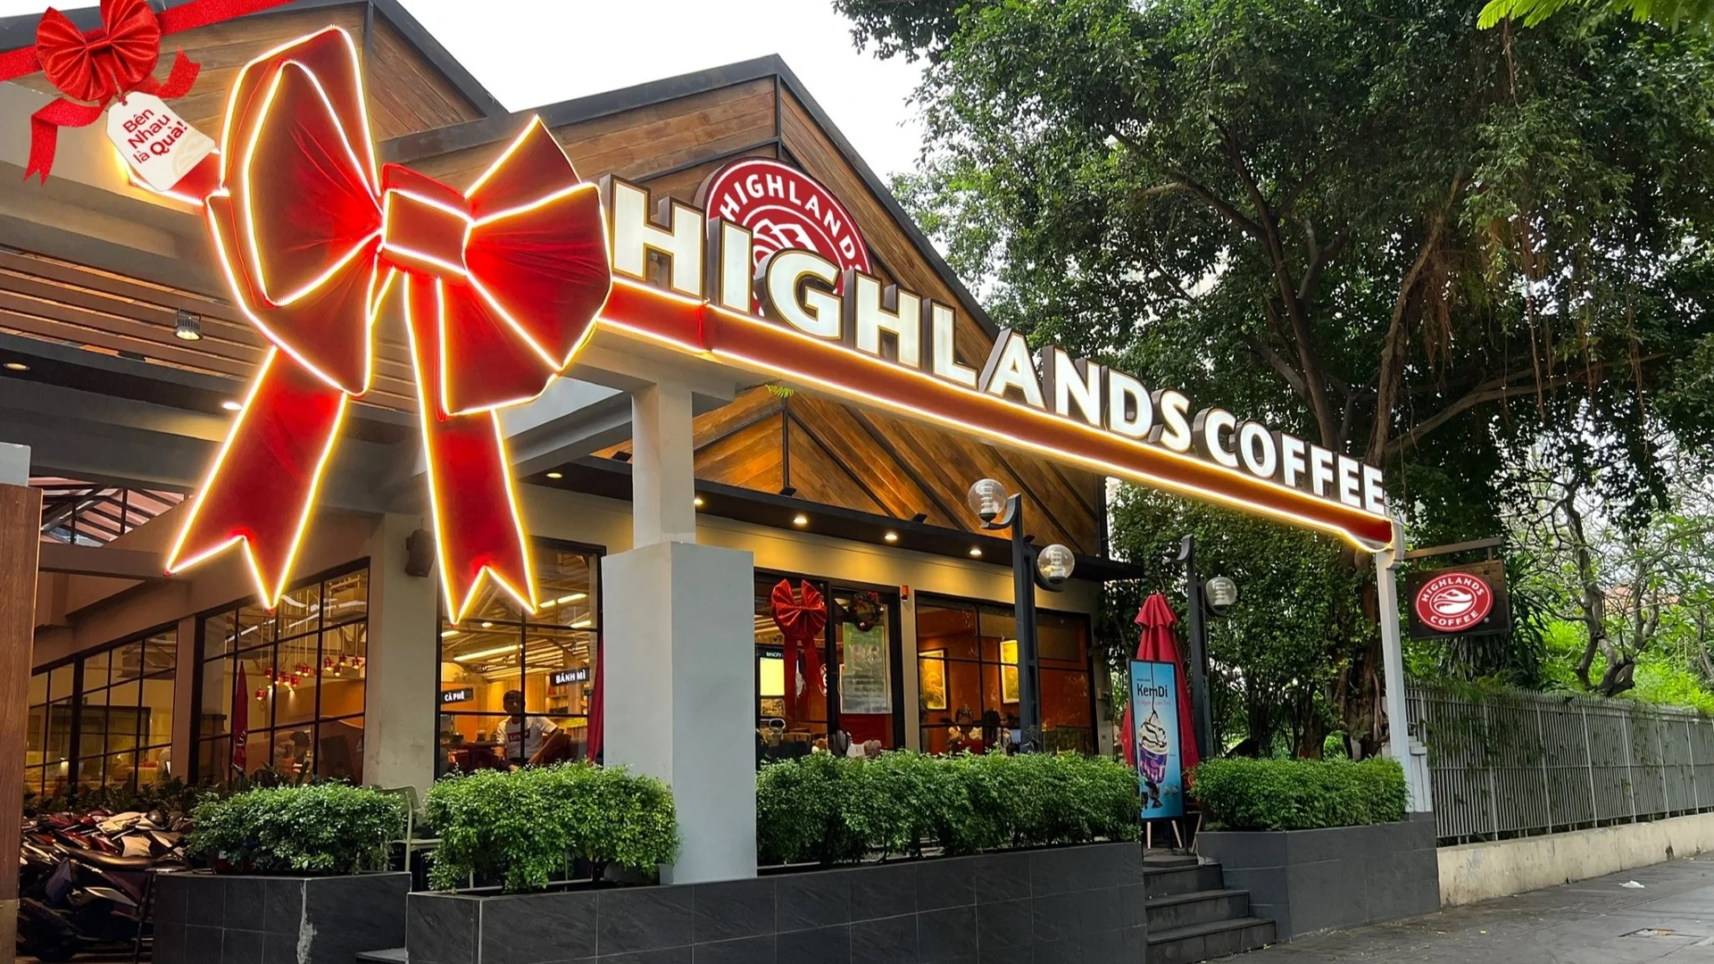
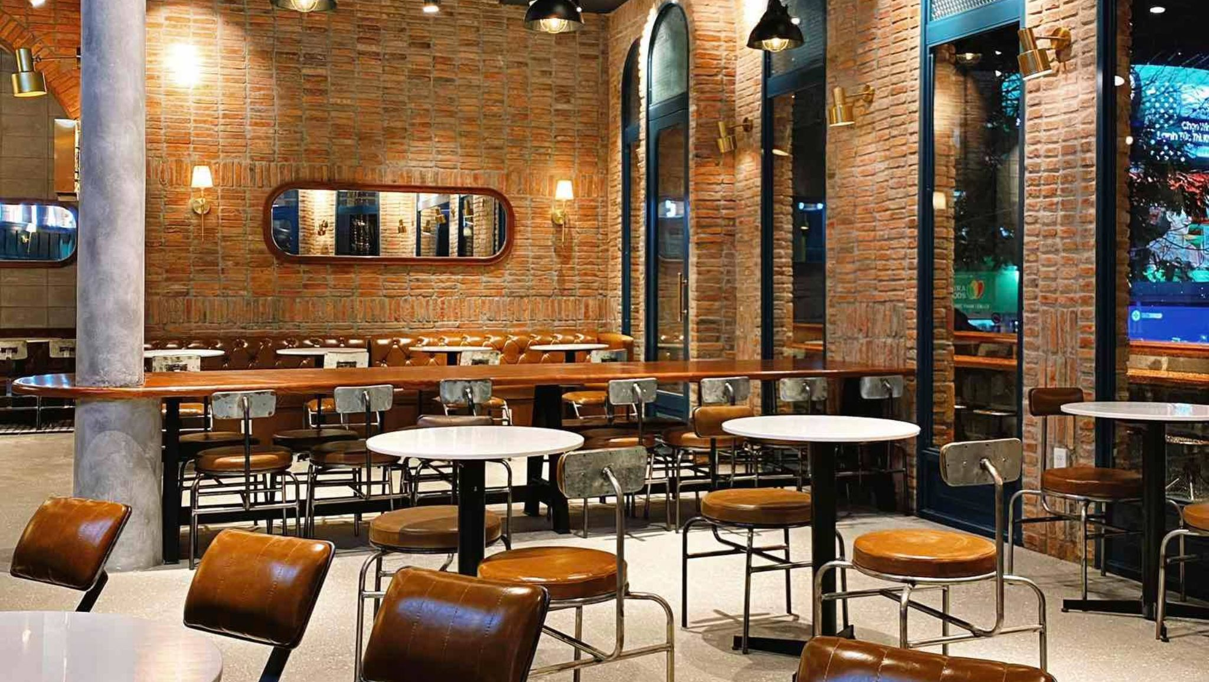


Strategic Implications & Market Outlook
2025-2026 Outlook
Market will continue premiumization despite economic pressure. Winners will balance:
Consolidation likely: Weak brands (like The Coffee House) will continue downsizing or exit. International expansion (Trung Nguyên, potentially Highlands) accelerates as domestic market saturates in Tier 1 cities.
Scale
Experience
Value
Digital
Dense networks for convenience (Highlands model)
Distinctive spaces worth visiting (Starbucks, Katinat model)
Smart pricing, promotions, loyalty (Phúc Long model)
Seamless ordering, delivery, engagement (all must excel)

Slide 37
About Us

Slide 38

We Are
SMALL enough to care &
BIG enough to trust
38
We champion innovative research
Technical rigor and quality control, combined with research passion, creativity and smarter thinking
We bring real local knowledge
To provide ‘up to the minute’ understanding of the evolving competitive & consumer context

Slide 39

Our Clients Trust Us
Because We Understand
Asia.
Efficient and effective research design.
The need for practical and actionable solutions.
39
We Are your
THINKING
PARTNERS

Slide 40
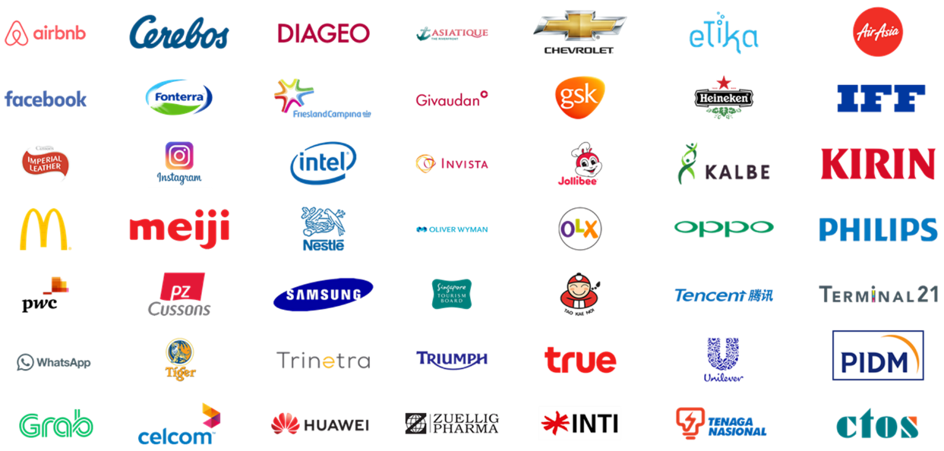




























Local & Regional Clients
Across Industries
...and more

Slide 41








(B2C) What we do
Survey: F2F/ Online
Focus Group
Home Usage Test
Central Location Test
Along shopping
Retail check/ audit
Ethnography
Mystery shopping

Slide 42

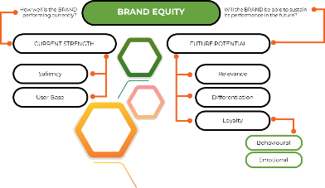
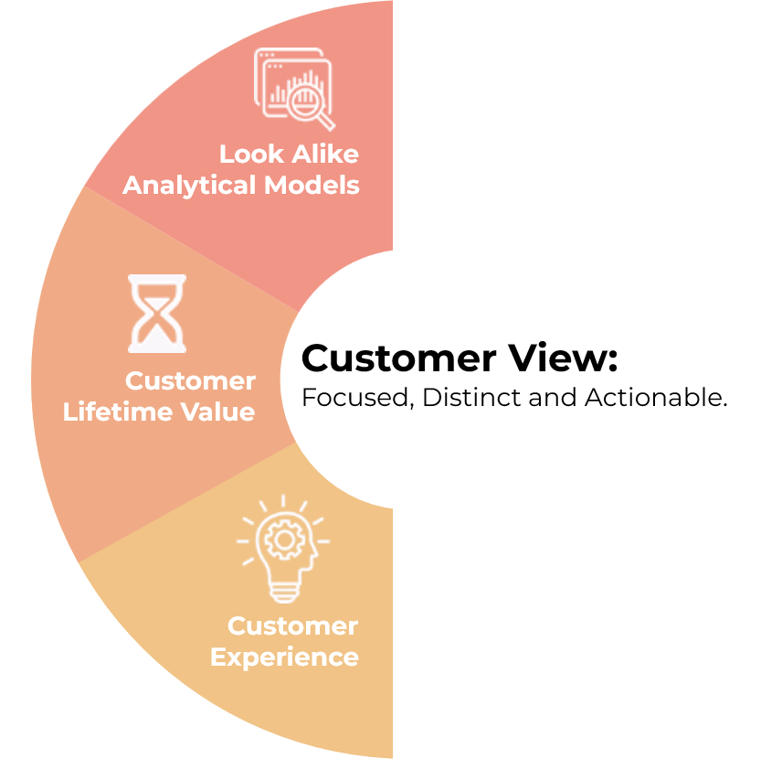
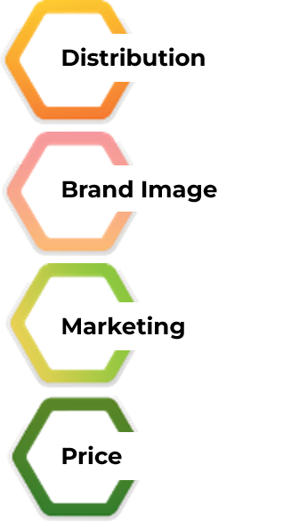
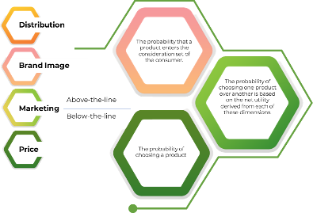

(B2B) What we do
Survey: F2F/ Online
In-depth Interview
Competitor Analysis
Market Analysis
ROMI Analysis
Ideation Workshop

Slide 43





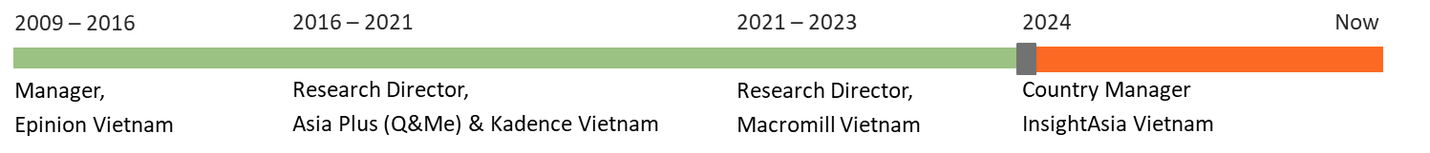
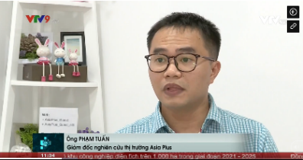
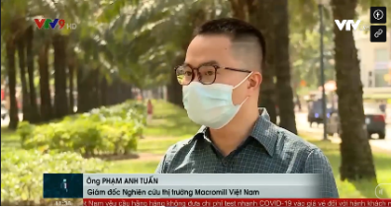
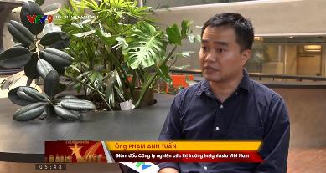
Mr. Pham Anh Tuan
Research Director, Country Manager || VIETNAM
Tuan is a seasoned senior marketing research with over 15 years of expertise, specializing in B2B marketing research. His focus is on market exploration and penetration studies within various sectors, both locally and regionally. With a unique blend of IT and market research experience, Tuan leverages his technical skills to enhance data analysis and market insights, offering a comprehensive understanding of market dynamics.
Renowned for his sharp analytical skills and consultative approach, Tuan has made significant contributions to the understanding of consumer trends and market behaviors.
Tuan’s expert insights are occasionally featured in local newspapers such as Dan Tri , Tuoi Tre Online aaaaaa , and on Vietnam primary TV channels , where he shares his perspectives on evolving market landscapes.

