Slide 1


Vietnam Fast Food & QSR Market
Vietnam Fast Food Market and Consumer Trends
2026 January

Slide 2

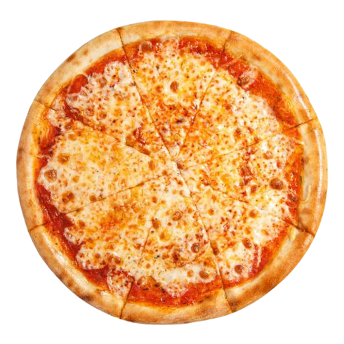
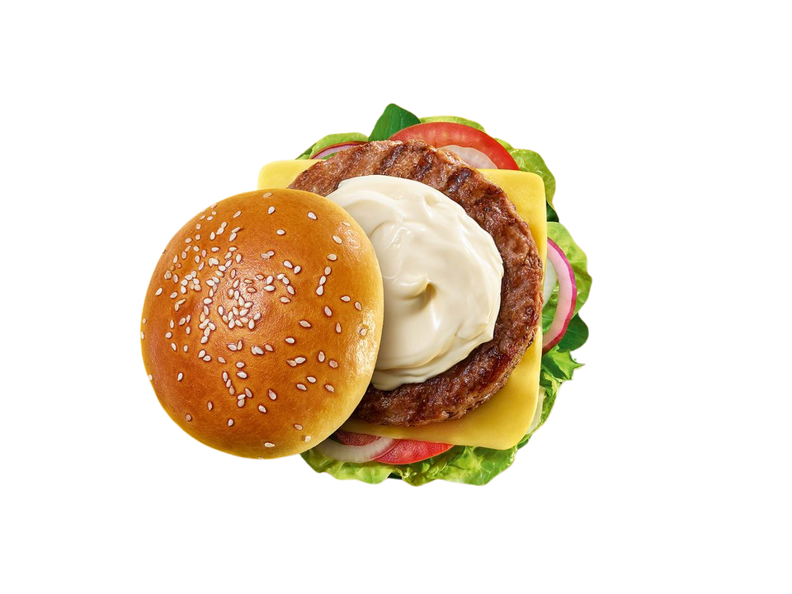
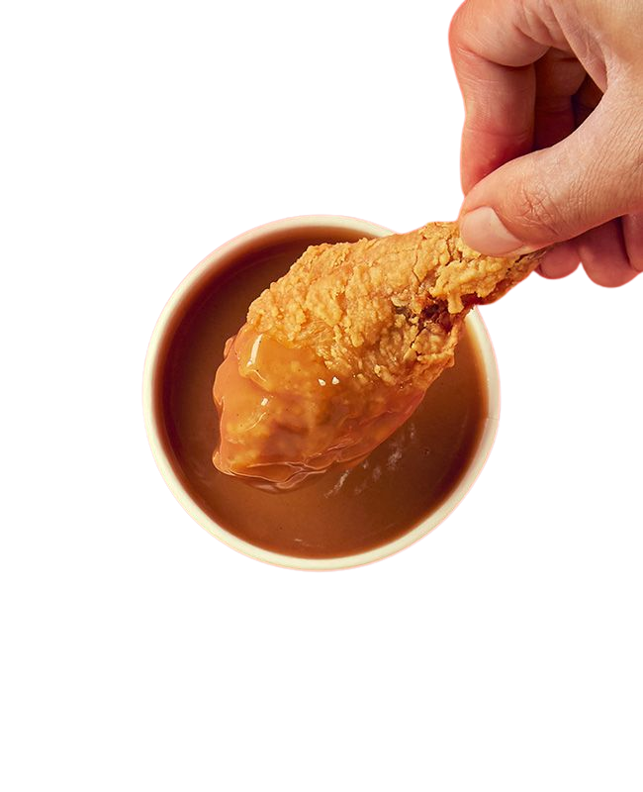
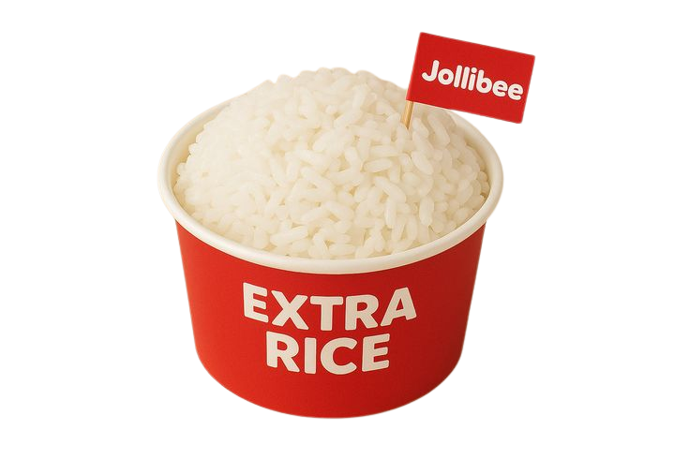
Executive Summary
Key findings from InsightAsia Vietnam's comprehensive fast food consumer study
Average Spending
135K
VND per visit across all occasions, with families spending 2.8x more (212K) than solo diners (76K) due to larger group sizes and upselling.
Localization Impact
28%
Of consumers specifically choose rice-based fast food options, demonstrating strong demand for culturally adapted menu items beyond Western staples.
Digital Integration
47%
Of all fast-food orders now come through
delivery platforms (Shopee Food 26%, Grab Food 21%), fundamentally changing brand discovery
and loyalty dynamics.
Chicken Dominance
82%
Of fast-food consumers ordered
chicken-based meals in their most recent visits
significantly outperforming beef burgers (11%)
and pizza (7%).
Vietnam Fast Food & QSR Market and Consumer Trends | InsightAsia Vietnam Primary Research | January 2026

Slide 3
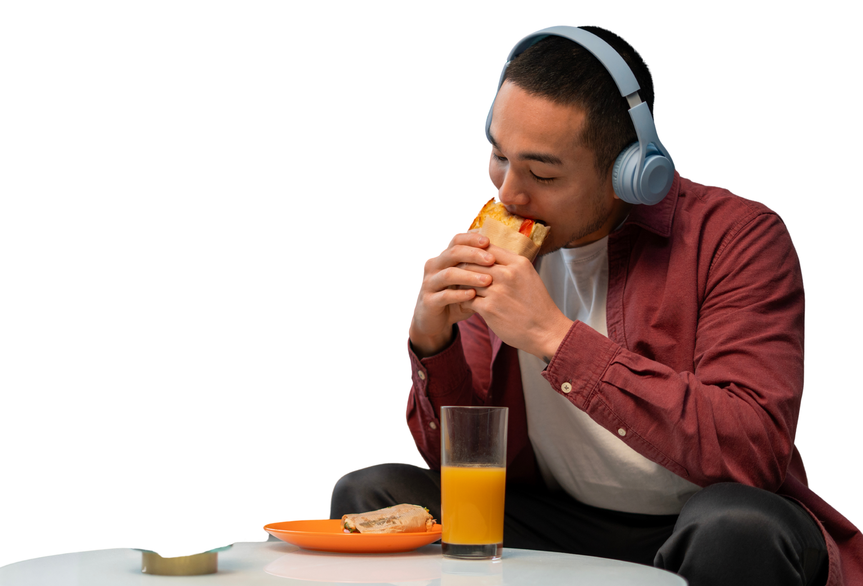
Executive Summary
Key findings from InsightAsia Vietnam's comprehensive fast food consumer study
Vietnam's fast-food market has evolved into a highly competitive, digitally-driven arena where taste leads all purchase decisions (cited by 74% of consumers), followed by convenience (48%) and value for money (43%).
The market is bifurcating between value-oriented Asian brands (Jollibee, Lotteria) that emphasize combo pricing and localized menus, versus premium positioning players (KFC, McDonald's) that command higher spending through quality perception.
The integration of delivery platforms has disrupted traditional foot-traffic advantages—brands now compete on app rankings, promotional mechanics, and viral social media campaigns as much as physical location.
Provincial expansion represents untapped growth as tier-1 cities approach saturation, but success requires understanding regional taste preferences and adjusting value propositions accordingly.
Strategic Implications
68%
Ordered Combo Meals (vs à la carte)
2.4
Average Dining Group Size
51%
Visit Fast Food Weekly or More
Vietnam Fast Food & QSR Market and Consumer Trends | InsightAsia Vietnam Primary Research | January 2026

Slide 4
Research Overview & Methodology
Comprehensive Investigation into Vietnam Fast Food Market
Market Context
This report examines the fast-food market in 2026, focusing on consumer behavior, brand performance & competitive dynamics
Across fried chicken, burger, pizza & Asian QSR segments
Research Objectives
Assess overall consumption behaviors and usage occasions within the fast food & QSR category
Segment consumers based on needs, behaviors, and consumption motivations
Evaluate brand preferences, usage, and brand perceptions across key fast food & QSR players by consumer segment
Understand key purchase decision drivers across different consumer segments
Map behavioral differences across fast food & QSR consumer segments
Fieldwork Period & Timeline
Fieldwork: November to December 2025
Analysis & Reporting: December 2025
Vietnam Fast Food & QSR Market and Consumer Trends | InsightAsia Vietnam Primary Research | January 2026

Slide 5
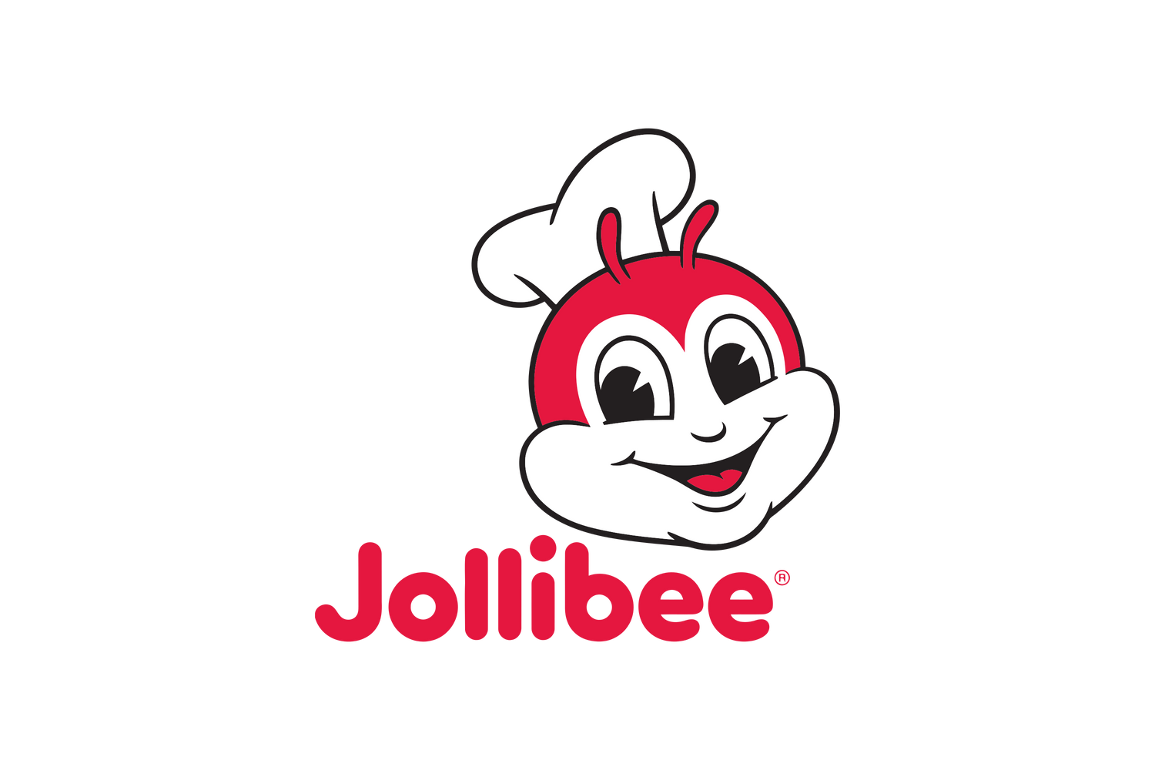


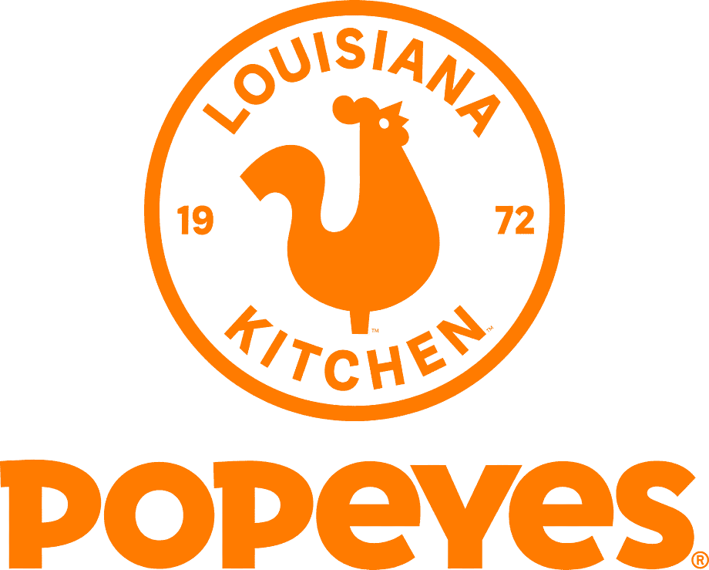
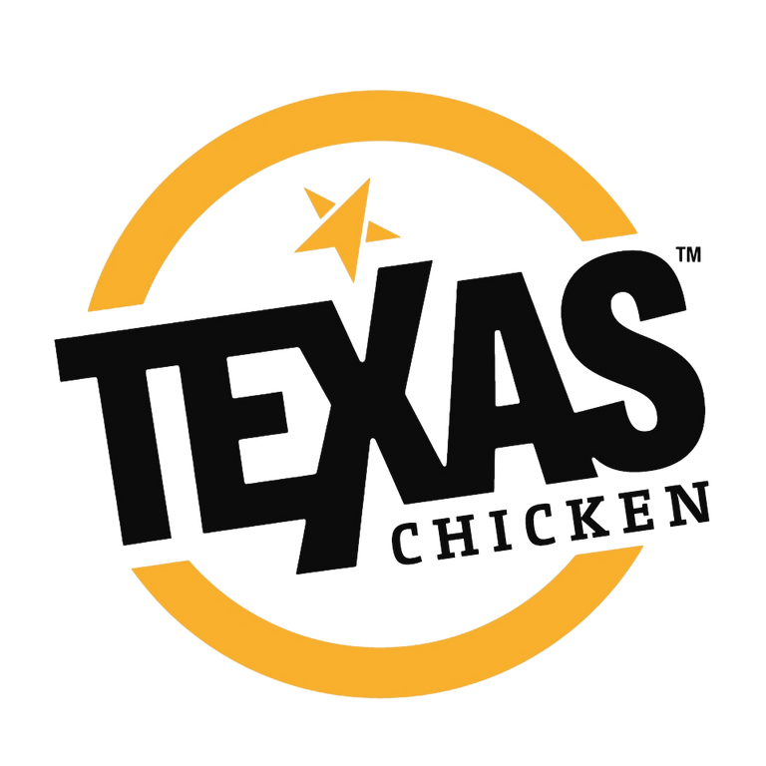
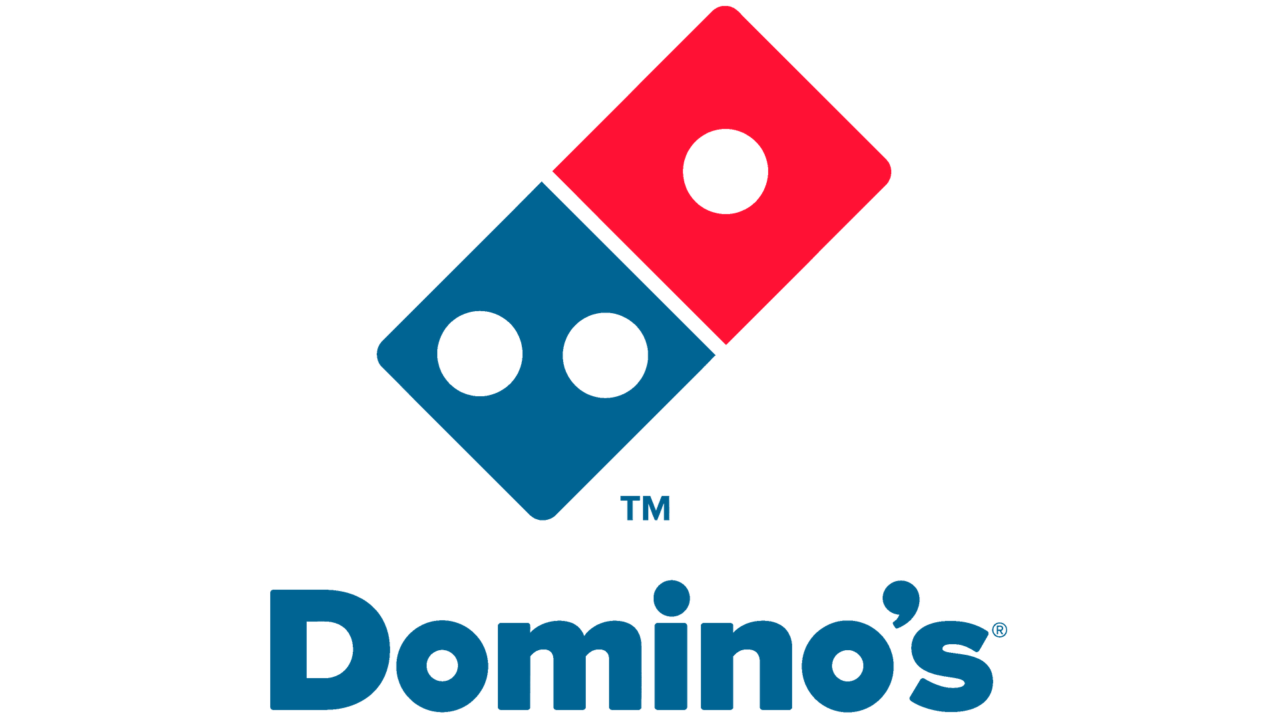
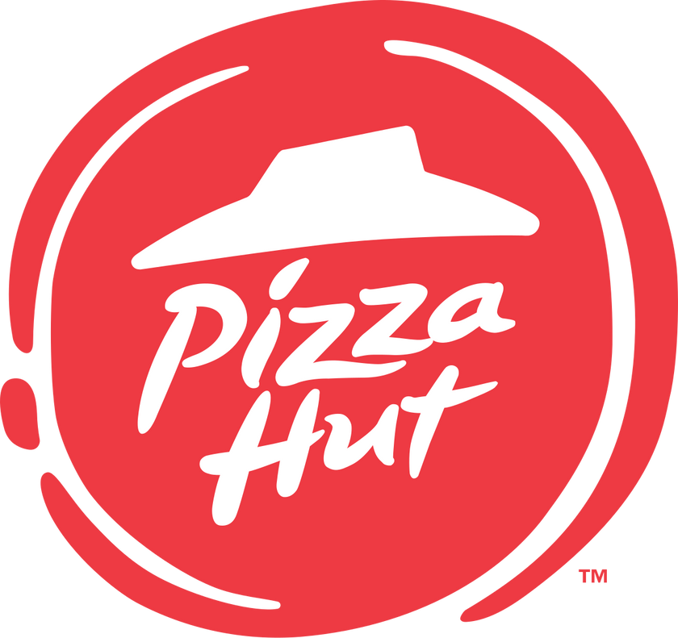
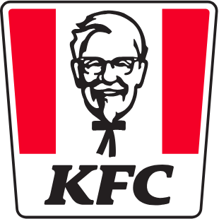
Research Overview & Methodology
Research Methodology
 | Quantitative survey | Qualitative survey
Sample Size | 1,323 respondents (Representative of urban fast food consumers) | 8 consumers
Target Demographic | 18-45 years old (Core fast food consumption age group) Monthly fast food users (at least one in past 30 days) | 22-38 years old Heavy users (3+ visits/month)
Geographic Coverage | 4 major cities: HCMC (42%), Hanoi (36%), Da Nang (13%), Can Tho (9%) | HCMC (4), Hanoi (4)
Data Collection | Online surveys Mobile-optimized, 12-minute average completion | Consumer In-Depth Interviews (IDIs) 40-45 minutes each
Focus | Consumer behavior, brand performance | Deep motivations, brand perceptions, decision journeys
Key Brands Analyzed
Vietnam Fast Food & QSR Market and Consumer Trends | InsightAsia Vietnam Primary Research | January 2026

Slide 6
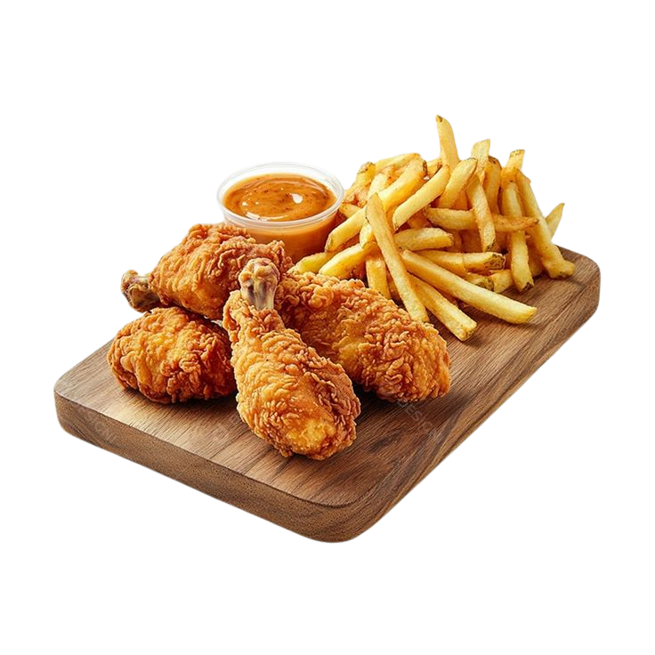
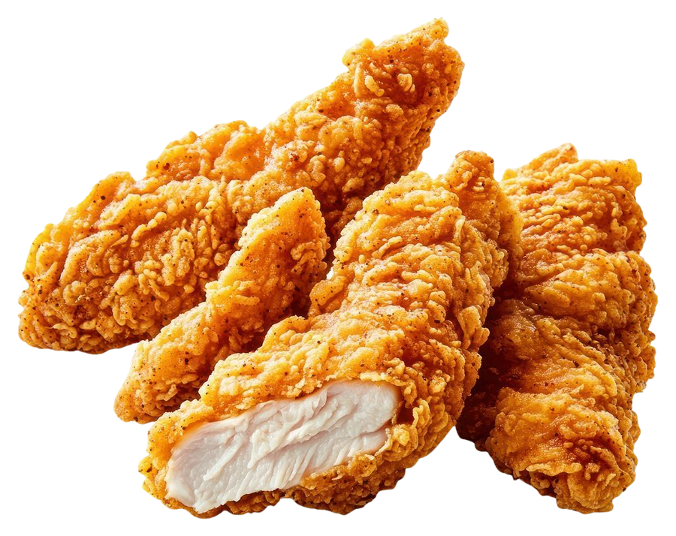
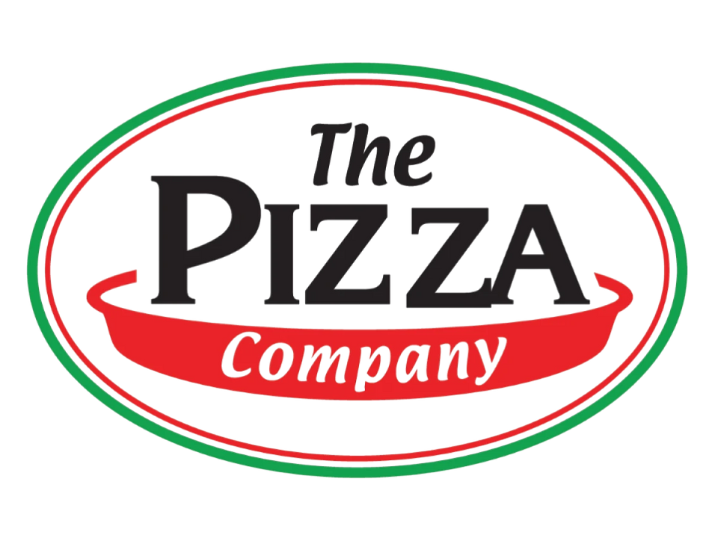

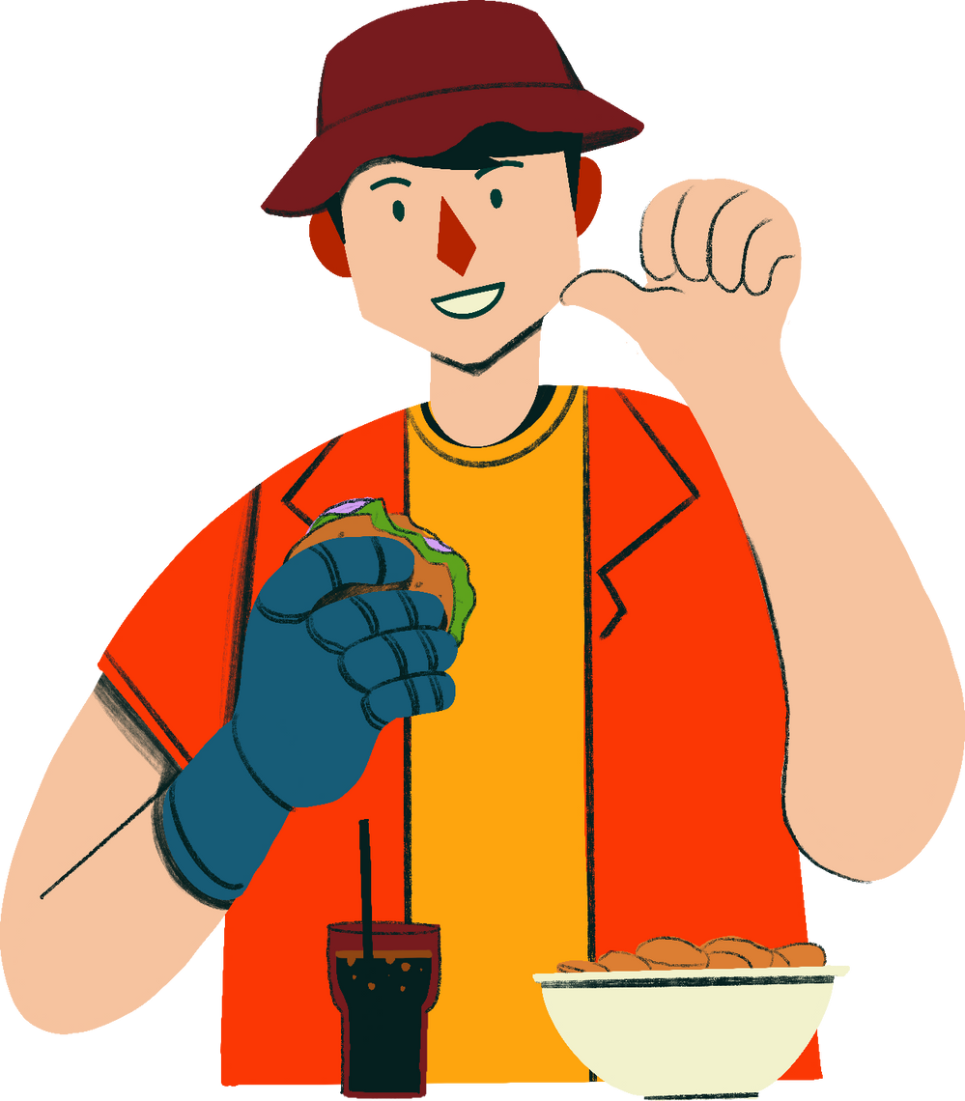
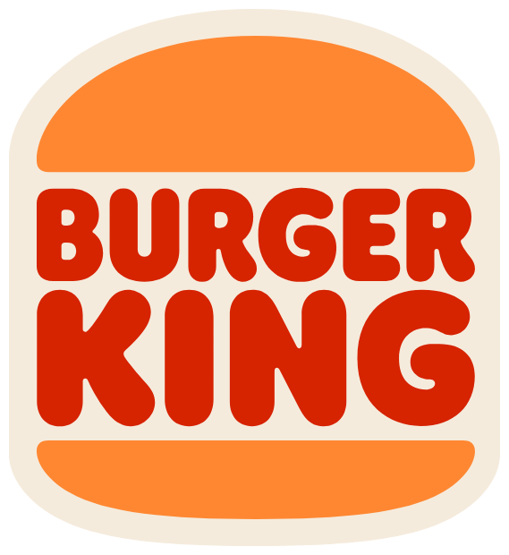
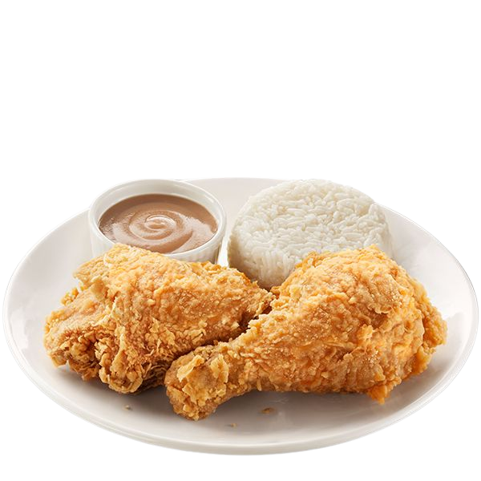
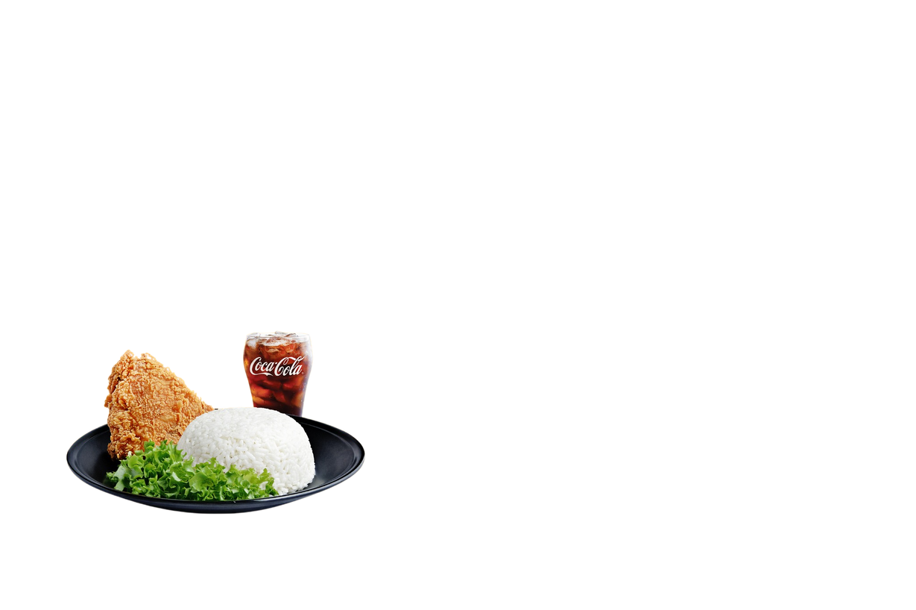
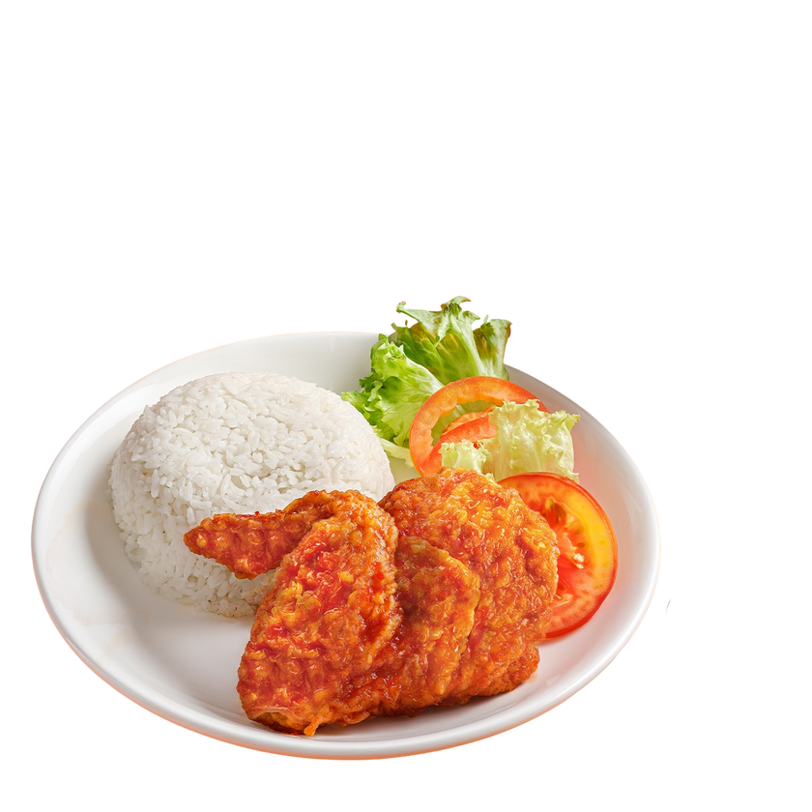
Fast Food Category Usage Behavior
Penetration and preference patterns across major QSR segments
Past 30-Day Category Consumption
Fried Chicken QSR
Pizza Chains
Burger-focused Chains
Asian/Localized QSR
Fried Chicken Category Lead
81%
84%
48%
Multi-Category Users
56%
Avg Categories
per Consumer
2.2
40%
35%
Q: In the past 30 days, which of the following fast food categories have you consumed? Select all that apply.
Base: All respondents (n=1,323) | Vietnam Fast Food & QSR Market and Consumer Trends | InsightAsia Vietnam Primary Research | January 2026

Slide 7
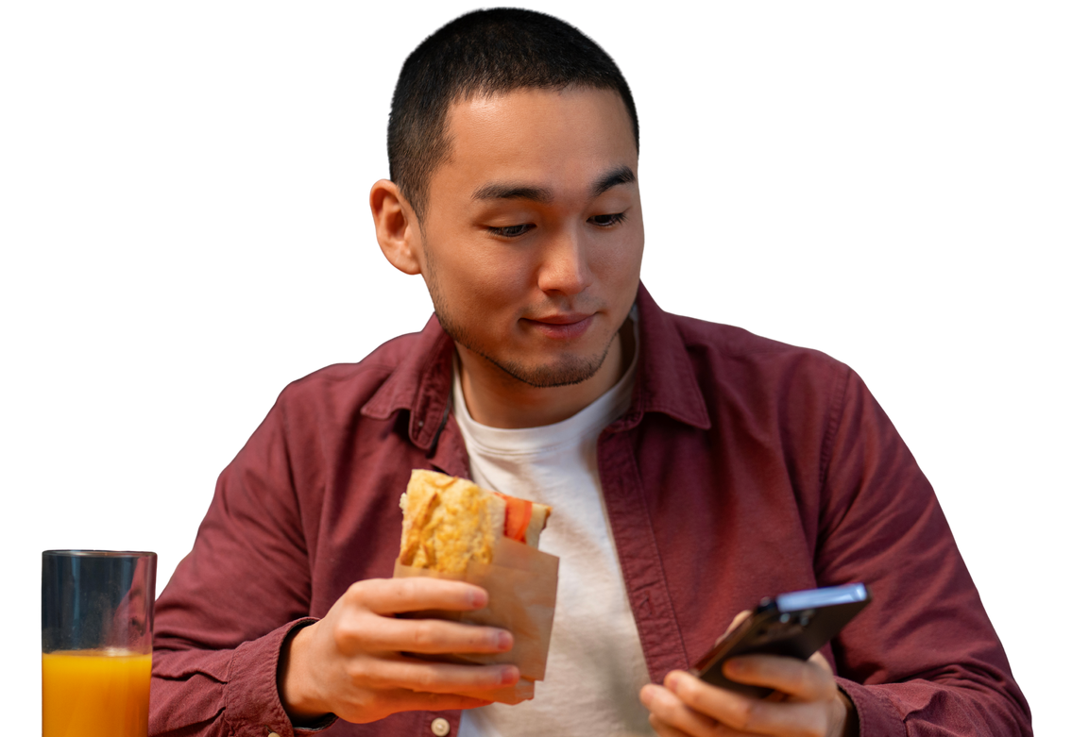
Fast Food Category Usage Behavior
Penetration and preference patterns across major QSR segments
Menu Item Preferences Within Chicken QSR Visits
Chicken Combo Sets (with drink & side)
84%
Combo is the default choice, driven by value perception
Desserts
14%
Occasional indulgence
Chicken Pieces/Nuggets
(à la carte)
41%
Secondary add-on for larger groups or snacking occasions
Beverages (Soft drinks, Iced tea)
69%
Combo-driven; standalone drink purchases rare (8%)
Sides (Fries, Coleslaw, Corn)
45%
Often included in combos; à la carte for sharing
Rice-based Chicken Meals
28%
Localization success, appeals to lunch crowd seeking "proper meal"
Burgers (Chicken or Beef)
16%
Lower penetration
When I eat fast food for lunch, I need rice to feel full. Chicken with fries is good for snacking with friends, but for a proper midday meal, I always choose rice combos. It's more satisfying and feels healthier somehow. The portion sizes are also better for Vietnamese appetite—not too small like some Western meals. Plus, my parents approve more when I tell them I had rice! — Male, 28, Marketing Executive, HCMC
Q: When you visit fried chicken QSR chains, what do you typically order?
Base: Chicken users (n=1,077) | Vietnam Fast Food & QSR Market and Consumer Trends | InsightAsia Vietnam Primary Research | January 2026

Slide 8
Visit Frequency & Occasion Dynamics
Understanding when and how often Vietnamese consumers engage with fast food
Fast Food Consumption Frequency
About once per week | 34%
2-3 times per month | 30%
About once per month | 18%
Multiple times per week (3+ times) | 17%
Primary Visit Occasions
Convenient lunch (office/school) | 61%
Hanging out with friends | 54%
Casual dinner option | 47%
Family outing with kids | 29%
Snacking between meals | 25%
Celebrations/Special treats | 18%
Late-night food option | 13%
Visit Companion Profile
Friends/Colleagues | 36% | 168K
Solo | 26% | 76K
Couple (no kids) | 20% | 152K
Family with kids | 18% | 212K
Family Segment Premium
Families with children represent only 18% of visits but contribute 29% of revenue due to highest spend per occasion (212K VND avg, ordering 4.2 items). For this segment, child's preference becomes the primary brand selection driver (cited by 59% of family respondents).
Q: How often do you eat or order fast food? on what occasions? and with whom?
Base: All respondents (n=1,323) | Vietnam Fast Food & QSR Market and Consumer Trends | InsightAsia Vietnam Primary Research | January 2026

Slide 9
Weekday vs Weekend Behavior Patterns
Understanding when and how often Vietnamese consumers engage with fast food
Weekday
Weekend
Mon | Tue | Wed | Thus | Fri | Sat | Sun
Peak time: Lunch (11:30am-1:30pm) - 49% of daily visits
Primary audience: Office workers, solo & small groups (2-3 people)
Avg spend: 118K VND (lower, value-driven decisions)
Delivery ratio: 44% (convenience-driven, office delivery)
Popular items: Rice combos, quick chicken sets, value meals
Peak time: Dinner (6:00pm-8:30pm) - 54% of daily visits
Primary audience: Families, friend groups (3-5 people)
Avg spend: 174K VND (higher, experiential dining)
Dine-in ratio: 67% (social experience priority, ambience valued)
Popular items: Family buckets, pizza, premium combos, desserts
Q: How often do you eat or order fast food? on what occasions? and with whom?
Base: All respondents (n=1,323) | Vietnam Fast Food & QSR Market and Consumer Trends | InsightAsia Vietnam Primary Research | January 2026

Slide 10
Consumer Spending Analysis
Spending patterns across demographics and occasion types
135K
(Average Spending)
Spending by Companion Type
Family with kids | 212K
Friends/Colleagues | 168K
Couple without kids | 152K
Solo dining | 76K
Spending by Age Group Spending rises with age as income and family needs grow. Gen X (35–45) spend 47% more per visit than Gen Z.
18-24 years (Gen Z) | 108K
25-34 years (Millennials) | 143K
35-45 years (Gen X) | 159K
Spending by Order Type Combo meals boost value perception and satisfaction. Mixed orders (combo + à la carte) drive the highest spend, often from larger groups seeking variety.
Combo meals only | 128K
Mix of combo + à la carte | 187K
À la carte items only | 114K
135K
Overall Average Spend per Visit (VND)
Average Items per Transaction
3.2
Choose Combo Meals (vs à la carte)
68%
Q: How much did you spend in your most recent fast food visit?, Who did you eat with?
Base: All respondents (n=1,323) | Vietnam Fast Food & QSR Market and Consumer Trends | InsightAsia Vietnam Primary Research | January 2026

Slide 11


Factors Influencing Spending Levels
Factors Influencing Spending Levels and Strategic Implications
Eating with larger group/family
67%
Group size is strongest predictor
of transaction value
Special occasion
44%
Birthdays, achievements unlock premium menu exploration.
Strategic Pricing Insight
Our analysis reveals that combo meals are the cornerstone of fast-food economics in Vietnam. While 68% of consumers choose combos, they represent 72% of total revenue due to higher perceived value driving purchase confidence.
The "combo + à la carte mix" segment (16% of orders but 23% of revenue) represents sophisticated consumers who use combos as base anchors then add premium items.
Brands maximizing combo variety while creating compelling add-on
opportunities capture disproportionate wallet share. Solo diners present opportunity for smaller, affordable
combo formats (currently underserved)
to drive frequency over
transaction size.
#1
#2
Promotional combo offers
42%
Value deals paradoxically drive higher basket size through bundling
Trying new menus
35%
Menu innovation creates incremental purchases (add-ons)
#3
#4
Weekend/leisure mood
29%
Experiential dining mindset vs functional weekday meals
Very hungry
26%
Hunger state drives larger portion selection
Ordering delivery
18%
Minimum order thresholds drive ~15% higher delivery spend
#5
#6
#7
Q: What factors typically make you spend more at fast food restaurants?
Base: All respondents (n=1,323) | Vietnam Fast Food & QSR Market and Consumer Trends | InsightAsia Vietnam Primary Research | January 2026

Slide 12
Brand Awareness & Trial Funnel
Consumer journey from awareness to regular patronage across major brands
Pizza Chains
Pizza 4P's: Premium Niche Player
Despite lowest awareness (64%) and smallest footprint (26 stores), Pizza 4P's maintains 33% conversion—respectable given premium positioning and artisanal focus. Appeals to affluent, food-conscious urbanites seeking authentic Neapolitan pizza vs mass-market chains.
Store Count | 118 | 59 | 74 | 26
Top of mind
Total awareness
Ever tried
Past 6mo usage
Regular user
87%
65%
41%
72%
60%
40%
72%
58%
35%
61%
55%
31%
Burger Chains
McDonald's: The Accessibility Gap
Despite 94% awareness and strong brand equity, McDonald's converts only 45% of aware consumers to P6M usage—weakest among major brands. With merely 37 stores vs Jollibee's 213 or Lotteria's 222, physical accessibility creates a fundamental barrier limiting market penetration
Store Count | 37 | 28 | 222
Top of mind
Total awareness
Ever tried
Past 6mo usage
Regular user
78%
58%
36%
65%
52%
31%
84%
62%
41%
Base: All respondents (n=1,323) | Vietnam Fast Food & QSR Market and Consumer Trends | InsightAsia Vietnam Primary Research | January 2026

Slide 13
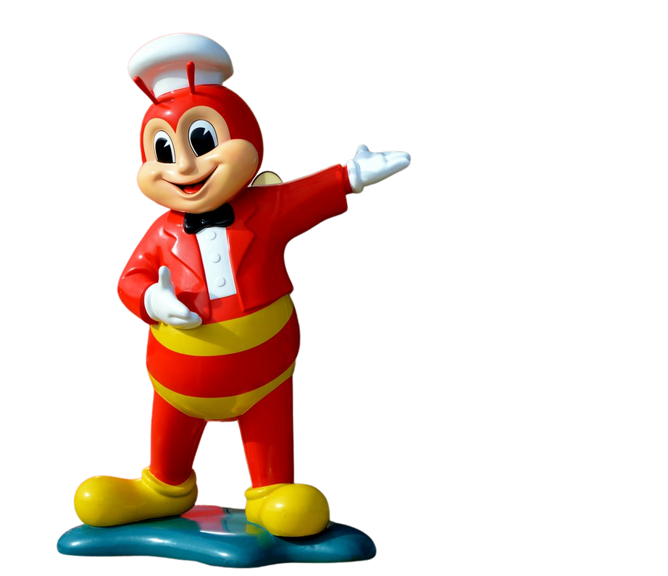
Brand Awareness & Trial Funnel
Brand (Store Count) | Top of Mind | Total Awareness | Ever Tried | Past 6mo Usage | Regular User | Conversion (P6M/Aware)
Pizza Hut 118 stores | 4.8% | 93.7% | 81.2% | 52.4% | 21.6% | 56%
Domino's Pizza 59 stores | 1.8% | 86.4% | 62.3% | 37.1% | 14.8% | 43%
The Pizza Company 74 stores | 1.2% | 78.3% | 56.7% | 32.8% | 11.4% | 42%
Pizza 4P's 26 stores | 0.8% | 64.2% | 38.9% | 21.3% | 6.7% | 33%
Fried Chicken Chains
Consumer journey from awareness to regular patronage across major brands
Store Count | 213 | 172 | 222 | 59 | 42
Top of mind
Total awareness
Ever tried
Past 6mo usage
Regular user
92%
81%
58%
94%
74%
50%
91%
75%
51%
66%
59%
37%
58%
47%
31%
Jollibee: Highest Conversion Efficiency
Jollibee demonstrates the strongest awareness-to-usage conversion at 75%, surpassing even KFC (69%)
despite having similar awareness levels. With 213 stores (2nd largest network),
Jollibee's combination of aggressive pricing, localized menu, and viral marketing drives
superior trial-to-loyalty conversion.
Base: All respondents (n=1,323) | Vietnam Fast Food & QSR Market and Consumer Trends | InsightAsia Vietnam Primary Research | January 2026

Slide 14
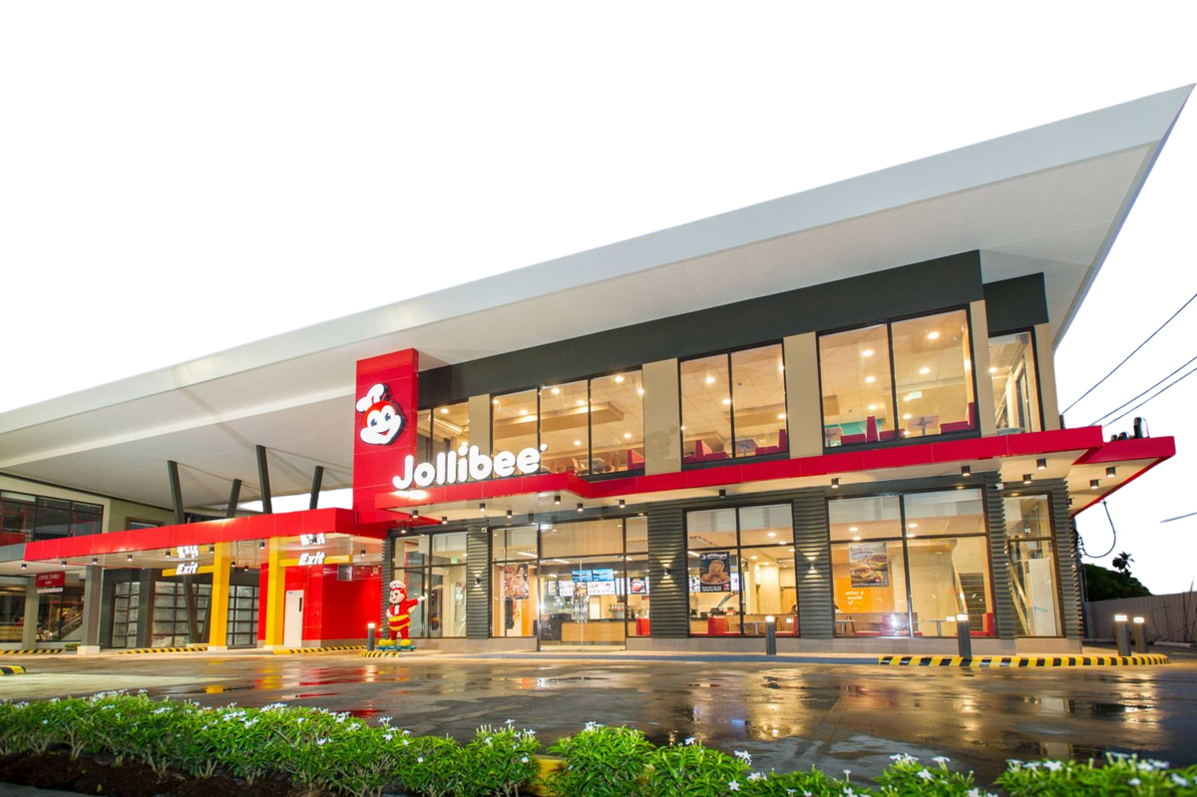
Brand Awareness & Trial Funnel
Brand (Store Count) | Top of Mind | Total Awareness | Ever Tried | Past 6mo Usage | Regular User | Conversion (P6M/Aware)
Pizza Hut 118 stores | 4.8% | 93.7% | 81.2% | 52.4% | 21.6% | 56%
Domino's Pizza 59 stores | 1.8% | 86.4% | 62.3% | 37.1% | 14.8% | 43%
The Pizza Company 74 stores | 1.2% | 78.3% | 56.7% | 32.8% | 11.4% | 42%
Pizza 4P's 26 stores | 0.8% | 64.2% | 38.9% | 21.3% | 6.7% | 33%
Consumer journey from awareness to regular patronage across major brands
Top-of-Mind Brand Recall Breakdown
5%
37%
8%
19%
Store Count Correlation
Strong positive correlation (r=0.78) between store count and P6M usage penetration. Lotteria (222 stores, 64.7% P6M), Jollibee (213 stores, 72.1% P6M), KFC (172 stores, 68.3% P6M) demonstrate that physical presence drives accessibility and trial opportunities.
27%
Q: When you think of fast food in Vietnam, what is the FIRST brand that comes to mind?
Base: All respondents (n=1,323) | Vietnam Fast Food & QSR Market and Consumer Trends | InsightAsia Vietnam Primary Research | January 2026

Slide 15

Category Sentiment & Satisfaction Comparison
Consumer attitudes and satisfaction levels across fast food categories
Fried Chicken QSR
Satisfaction Level – 84%
Pizza Chains
Satisfaction Level – 80%
Burger Chains
Satisfaction Level – 76%
Convenient locations | 91% | Good for group sharing | 93% | International standard | 89%
Good for families | 88% | Wide menu variety | 84% | Consistent quality | 84%
Quick service | 87% | Tastes great | 81% | Tastes great | 77%
Tastes great | 85% | Consistent quality | 76% | Convenient locations | 61%
Good value for money | 83% | Convenient locations | 64% | Good value for money | 58%
Consistent quality | 82% | Good value for money | 61% | Wide menu variety | 52%
Q: How satisfied are you overall with your experiences in each fast food category? (% Top 2 Boxes)
Base: All respondents (n=1,323) | Vietnam Fast Food & QSR Market and Consumer Trends | InsightAsia Vietnam Primary Research | January 2026

Slide 16
Category Preference by Occasion Type
Consumer usage across fast food categories
Quick weekday lunch | Hanging out with friends | Family weekend dinner | Kids' birthday parties (under 12) | Office team meals | Solo dining | Date/ romantic meal
Category Insights & Strategic Positioning
Fried Chicken
Leads overall satisfaction (84.2%), driven by unmatched accessibility (91%), strong value perception (83%), and fast service (87%). Dominates kids’ parties (74%)—KFC and
Jollibee packages are Vietnamese childhood staples. The category’s strength is versatility across all occasions without trade-offs.
Pizza
Excels in group/sharing contexts (93% rate as good for sharing) and offers widest menu variety (84% agree), but weaker on value (61%) and accessibility vs chicken. This creates an “occasion tax”—pizza is saved for special gatherings, limiting visit frequency despite high satisfaction.
Burgers
Face Lowest satisfaction (76.3%) and an identity crisis, seen as international/premium (89%) but weakly differentiated on taste vs fried chicken and inferior on value. Limited store access worsens the issue. Burgers lose the
value fight to chicken and the premium fight
to artisanal pizza.
Q: Which category do you prefer for each occasion type?
Base: All respondents (n=1,323) | Vietnam Fast Food & QSR Market and Consumer Trends | InsightAsia Vietnam Primary Research | January 2026

Slide 17
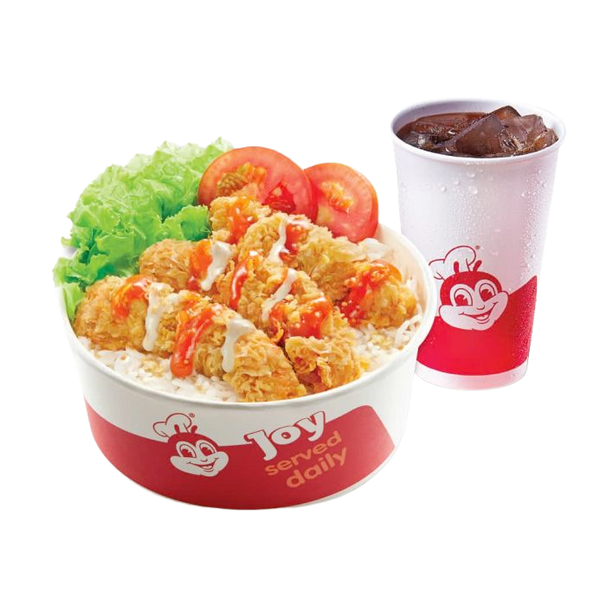
Brand Performance: Product Quality & Menu
Fried Chicken Chains
Consumer ratings on food quality, taste, consistency, and menu variety
Taste & Flavor | 79% | 82% | 73% | 84% | 69%
Quality Consistency | 76% | 87% | 71% | 78% | 64%
Portion Size | 81% | 74% | 76% | 72% | 68%
Menu Variety | 84% | 71% | 79% | 58% | 54%
Freshness | 73% | 79% | 69% | 76% | 67%
Unique Taste | 72% | 68% | 64% | 81% | 58%
Localized Taste | 89% | 76% | 78% | 52% | 61%
Fried Chicken Insights: Localization vs Authenticity
Jollibee dominates localized taste (89%), rice meals, Filipino-Vietnamese fusion, sweeter flavor profiles resonate strongly.
KFC balances both consistency (87%, highest) and localization (76%) effectively. Popeyes leads on unique taste (81%) with
bold Cajun spices but scores lowest on localization (52%), maintaining Louisiana authenticity limits Vietnamese adaptation.
Menu variety is Jollibee's weapon (84%) vs Popeyes' focused offering (58%).
Q: Please rate each brand on the following attributes.
Base: Users in past 6 months | Vietnam Fast Food & QSR Market and Consumer Trends | InsightAsia Vietnam Primary Research | January 2026

Slide 18
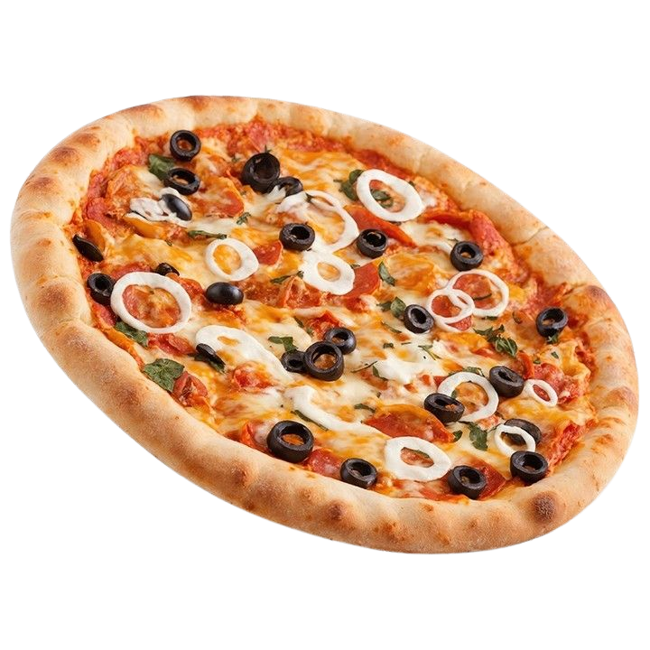
Brand Performance: Product Quality & Menu
Pizza Chains
Consumer ratings on food quality, taste, consistency, and menu variety
Burger Chains
Taste & Flavor | 76% | 74% | 72% | 88% | Taste & Flavor | 85% | 78% | 71%
Quality Consistency | 74% | 76% | 71% | 84% | Quality Consistency | 89% | 74% | 69%
Portion Size | 83% | 76% | 78% | 71% | Portion Size | 68% | 76% | 73%
Menu Variety | 81% | 73% | 76% | 68% | Menu Variety | 62% | 71% | 74%
Freshness | 72% | 73% | 69% | 91% | Freshness | 84% | 72% | 68%
Unique Taste | 69% | 67% | 71% | 86% | International Standard | 91% | 82% | 64%
Pizza 4P's: Premium Quality Champion
Despite smallest footprint (26 stores), Pizza 4P's achieves highest ratings across taste (88%), freshness (91%), unique taste (86%),
and consistency (84%). Artisanal Neapolitan approach, homemade cheese, and farm-to-table sourcing
create differentiated premium experience. However, lower menu variety (68%) and portion size ratings (71%) reflect focused,
authentic offering vs mass-market variety of Pizza Hut/Domino's.
Q: Please rate each brand on the following attributes.
Base: Users in past 6 months | Vietnam Fast Food & QSR Market and Consumer Trends | InsightAsia Vietnam Primary Research | January 2026

Slide 19
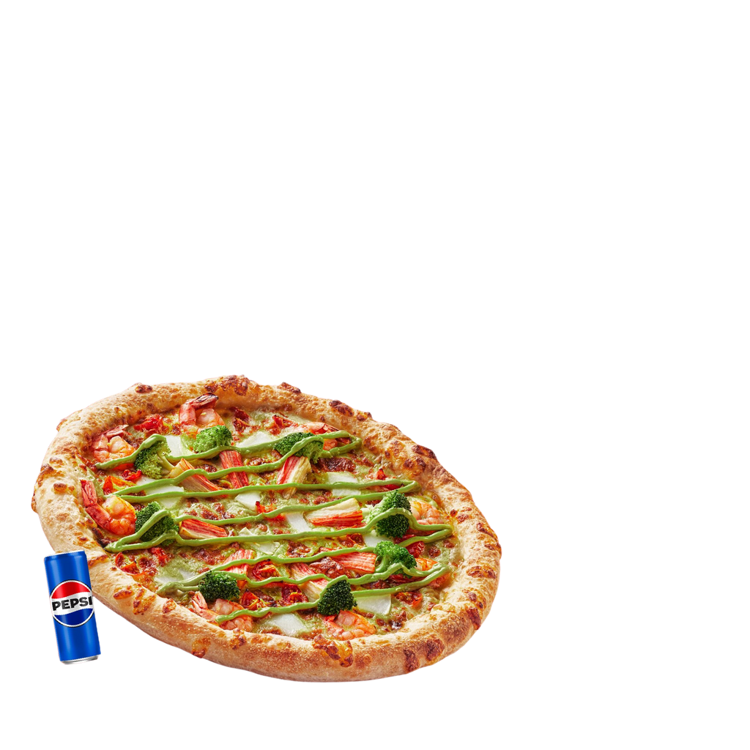
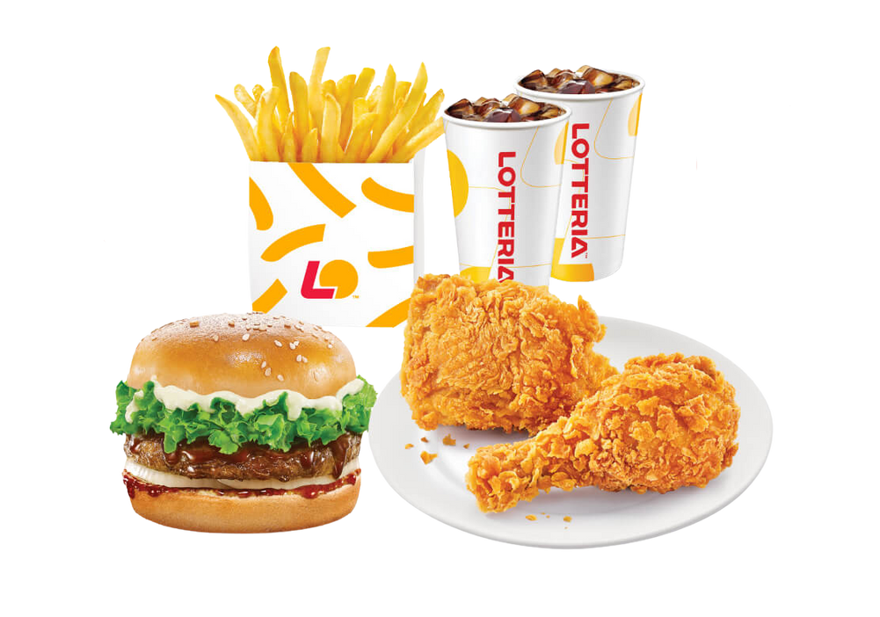
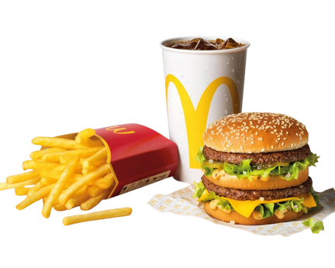
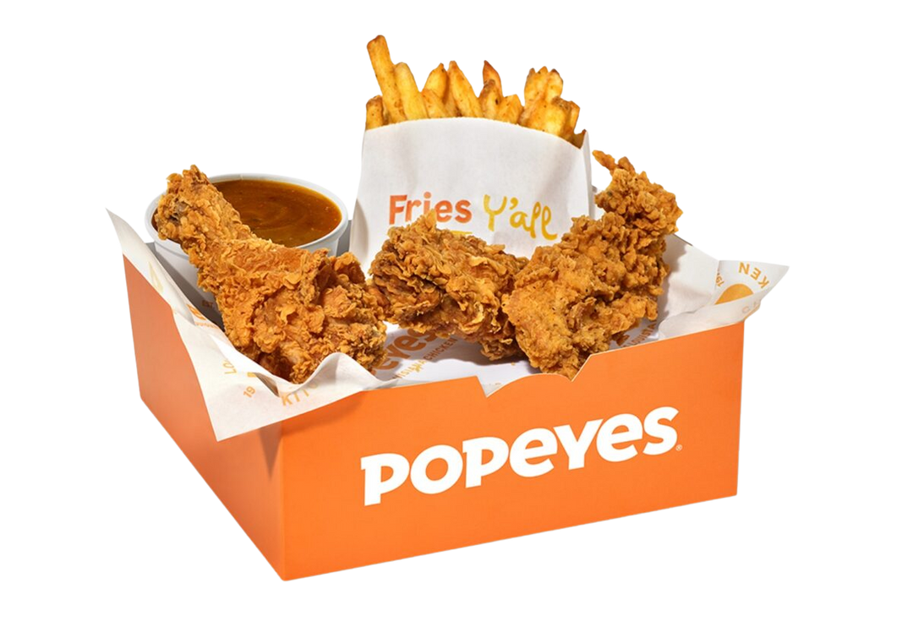
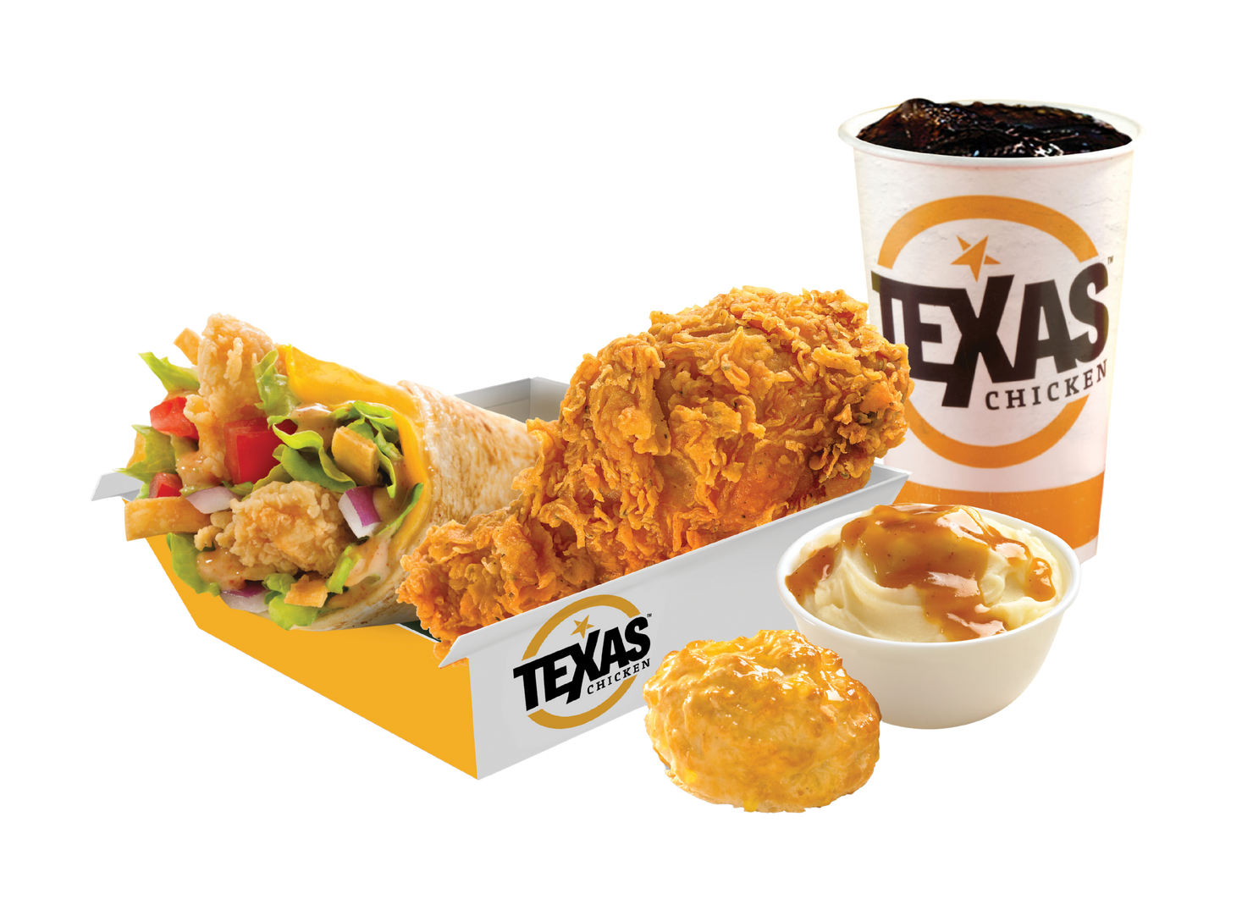
Brand Performance: Value for Money & Pricing
Perceived value, affordability, and promotional effectiveness
Attractive Promotions | 86% | 81% | 74% | 79% | 68% | 61%
Combo Meal Value | 84% | 80% | 76% | 72% | 73% | 64%
Affordable Pricing | 81% | 79% | 61% | 58% | 64% | 42%
Value for Money | 78% | 76% | 69% | 67% | 71% | 58%
Overall Value Index | 82 | 79 | 70 | 69 | 69 | 56
Q: Please rate each brand on the following attributes.
Base: Users in past 6 months | Vietnam Fast Food & QSR Market and Consumer Trends | InsightAsia Vietnam Primary Research | January 2026

Slide 20
Brand Performance: Value for Money & Pricing
Perceived value, affordability, and promotional effectiveness
Price Positioning Perception
% Rating as "Affordable" or "Very Affordable"
Promotional Impact on
Visit Decision
The Value Leadership Battle
Jollibee and Lotteria compete head-to-head on value positioning, both scoring 79-82 on our Value Index. The key difference lies in promotional frequency and visibility: Jollibee's aggressive social media campaigns (86% rating promotions as attractive) create stronger top-of-mind recall when consumers seek deals. Our IDIs reveal that Gen Z consumers (18-24) actively check Jollibee's app/social before deciding, treating promotions as expected rather than bonus value.
Meanwhile, McDonald's premium positioning (Value Index: 56) creates a perception-reality gap,while quality justifies pricing for some (42% say "worth the premium"), 58% cite affordability as barrier to more frequent visits. This bifurcation explains McDonald's challenge in scaling beyond affluent urbanites.
Vs.
12%
Rarely/
Never
35%
Always/
Almost
always
24%
Sometimes
29%
Often
Key Finding
63.6% of consumers are promotion-driven in brand selection, deals are now table stakes, not differentiators.
Q: How does this brand’s pricing compare to other fast food options? (% Top 2 Boxes) | How often do promotions influence your brand choice?
Base: Users in past 6 months | Vietnam Fast Food & QSR Market and Consumer Trends | InsightAsia Vietnam Primary Research | January 2026

Slide 21
Brand Performance: Value
Value perception, restaurant ambience, and fit-for-occasion ratings
% ‘Very Suitable’, ‘Suitable’ | Value for Money | Value for Money | Affordable Pricing | Attractive Promotions | Combo Value
Fried chicken QSR
Jollibee | 78% |  | 81% | 86% | 84%
Lotteria | 76% |  | 79% | 81% | 80%
KFC | 69% |  | 61% | 74% | 76%
Popeyes | 71% |  | 64% | 68% | 73%
Texas chicken | 77% |  | 82% | 65% | 74%
Burger & pizza chains
McDonald's | 58% |  | 42% | 61% | 64%
Burger King | 66% |  | 63% | 72% | 71%
Pizza Hut | 67% |  | 58% | 79% | 72%
Domino's | 69% |  | 62% | 76% | 73%
Pizza 4P's | 64% |  | 38% | 52% | 61%
Q: Rate each brand on value-related attributes
Base: Users in past 6 months | Vietnam Fast Food & QSR Market and Consumer Trends | InsightAsia Vietnam Primary Research | January 2026

Slide 22
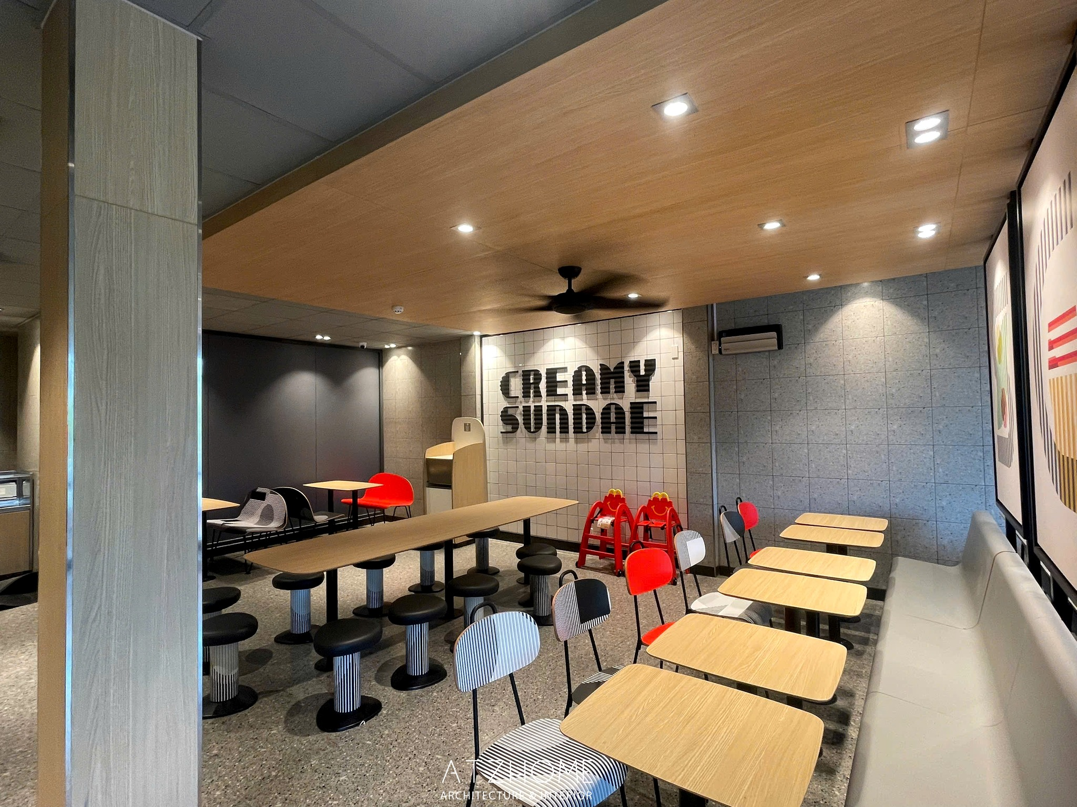
Brand Performance: Space
Consumer ratings on food quality, taste, consistency, and menu variety
% ‘Very Suitable’, ‘Suitable’ | Interior Design | Cleanliness | Comfortable Seating | Overall Ambience
Pizza 4P's | 92% | 94% | 89% | 91%
McDonald's | 86% | 89% | 84% | 87%
Jollibee | 78% | 83% | 76% | 79%
KFC | 74% | 81% | 72% | 76%
Pizza Hut | 76% | 79% | 78% | 77%
Popeyes | 71% | 76% | 69% | 72%
Lotteria | 64% | 74% | 67% | 68%
Q: How would you rate the physical restaurant environment? (Top 2 boxes)
Base: Users in past 6 months | Vietnam Fast Food & QSR Market and Consumer Trends | InsightAsia Vietnam Primary Research | January 2026

Slide 23
Brand Performance: Occasion Suitability
Consumer ratings on food quality, taste, consistency, and menu variety
% ‘Very Suitable’, ‘Suitable’ | Kids’ Parties | Friends Gathering | Young Families | Office Workers | Dating/ Couples
Jollibee | 86% | 82% | 84% | 79% | 58%
KFC | 81% | 76% | 82% | 74% | 54%
Pizza Hut | 89% | 84% | 83% | 68% | 64%
Pizza 4P's | 62% | 87% | 76% | 64% | 88%
McDonald's | 74% | 71% | 76% | 73% | 69%
Lotteria | 72% | 68% | 71% | 81% | 49%
Jollibee owns family occasions, leads kids' parties (86%), young families (84%), and friends' gatherings (82%). Child-friendly brand identity, mascot appeal, and fun atmosphere drive this dominance. Pizza 4P's excels in romantic/social dining, highest for dating/couples (88%) due to premium ambience (91% overall ambience rating). However, lowest for kids' parties (62%), deliberately avoids family chaos positioning. Lotteria captures office worker lunches (81%) through ubiquitous locations (222 stores) and weekday combo efficiency, but fails premium occasions like dating (49%, lowest).
Q: How suitable is each brand for these occasions? (Top 2 boxes)
Base: Users in past 6 months | Vietnam Fast Food & QSR Market and Consumer Trends | InsightAsia Vietnam Primary Research | January 2026

Slide 24
Brand Image & Positioning Map
Perceptual mapping of brand associations across value and quality dimensions
High Quality/Premium
Premium Quality Zone (Top Right)
Pizza 4P's and McDonald's occupy ultra-premium space but face severe accessibility limitations, McDonald's 37 stores vs Jollibee's 213 creates fundamental reach gap. Mid-Premium Sweet Spot
KFC and Popeyes balance quality perception with broader pricing acceptance. KFC's 172-store network enables scale Popeyes (59 stores) cannot yet match. Value Leader Zone (Left Center)
Jollibee and Lotteria dominate mass market. Jollibee's superior trendiness/innovation perception (vs Lotteria) drives conversion advantage despite similar value positioning. Pizza Cluster (Middle Right)
Burger King, Pizza Hut, Domino's, The Pizza Company cluster in moderate-premium zone, competing on occasion-based differentiation rather than everyday frequency.
Budget Friendly
Premium Pricing
Standard Quality/Mainstream
Methodology: Correspondence analysis of brand attribute ratings (n=1,323) mapping brands on two key purchase dimensions
Base: Users in past 6 months | Vietnam Fast Food & QSR Market and Consumer Trends | InsightAsia Vietnam Primary Research | January 2026

Slide 25
Brand Image & Positioning
Top brand associations
Fried Chicken QSR
Pizza Chains
Burger Chains
Jollibee (213 stores) | Fun, Value for Money, Variety & Localized Menu
KFC (172 stores) | Reliable, Family-Friendly, Consistent Taste
Lotteria (222 stores) | Affordable, Convenient Locations, Reliable Choice
Popeyes (59 stores) | Bold Flavors, Distinctive Taste, Quality Chicken
Texas (42 stores) | Budget Option, Basic Quality, Limited Presence
McDonald’s (37 stores) | Premium, Consistent Quality, International Standard
Burger King (28 stores) | Flame-Grilled, Hearty Portions, American Style
Pizza Hut (118 stores) | Sharing Food, Group Dining, Varied Pizza Options
Pizza 4P’s (26 stores) | Artisanal, Premium Ingredients, Authentic, Trendy
The Pizza Company (74 stores) | Thai Brand, Affordable Pizza, Good Delivery
Domino’s (59 stores) | Fast Delivery, Convenient, Modern Brand
Methodology: Correspondence analysis of brand attribute ratings (n=1,323) mapping brands on two key purchase dimensions
Base: Users in past 6 months | Vietnam Fast Food & QSR Market and Consumer Trends | InsightAsia Vietnam Primary Research | January 2026

Slide 26
Key Choice Drivers
What actually drives fast food brand selection decisions among Vietnamese consumers
Primary Decision Factors
At the end of the day, I eat fast food because I want it to taste good. Location and price matter when I'm deciding between two options, but if the food doesn't taste great, I won't go back no matter how cheap or convenient it is. That's why I keep returning to KFC and Jollibee,
they never disappoint on flavor.
— Minh Le, 26, Software Engineer, Hanoi
#1 | Taste & flavor quality | 74%
#2 | Location convenience / proximity | 48%
#3 | Value for money / pricing | 43%
#4 | Promotions & deals available | 39%
#5 | Menu variety & options | 31%
#6 | Service speed / quick | 29%
Q: What are the most important factors when choosing which fast food brand to visit? (Rank top 3)
Base: Users in past 6 months | Vietnam Fast Food & QSR Market and Consumer Trends | InsightAsia Vietnam Primary Research | January 2026

Slide 27



Consumer Segmentation: Three Core Segments
Three distinct fast food consumer segments with unique needs and behaviors
Value-Driven
Regulars
42%
Social Enthusiasts
35%
Family Occasionals
23%
Profile | 18-35 years old, office workers and students | 18-32 years old, digitally native | 30-45 years old with children (ages 4-14)
Fast-food Perception | Fast food is functional daily solution, prioritize convenience and affordability over experience | View fast food as social activity and lifestyle expression | Fast food is family treat and convenient dining option when cooking is not feasible
Primary Influence Factor | Highly promotion-sensitive Brand-switching based on deals. | Heavily influenced by social media trends, viral campaigns Peer recommendations. Willing to pay premium for "Instagram-worthy" experiences. | Child's preference is the primary brand selector (71% cite as main factor).
Decision Priorities | Value/pricing (78%) Location convenience (69%) Speed of service (61%) Promotions (58%) | Taste quality (81%) Trendy/modern brand (73%) Fun atmosphere (68%) Social media buzz (54%) | Child's preference (71%) Family-friendly environment (64%) Portion sizes/value (57%) Safe food quality (52%)
Based on cluster analysis of purchase behaviors, brand preferences, spending levels, and stated priorities
Base: All respondents (n=1,323) | Vietnam Fast Food & QSR Market and Consumer Trends | InsightAsia Vietnam Primary Research | January 2026

Slide 28
Consumer Segmentation: Three Core Segments
Segment Comparison Matrix
Value-Driven Regulars
42% of market
Social Enthusiasts
35% of market
Family Occasional
23% of market
Visit Frequency | 3-4x/week Mostly weekday lunch and solo dining | 2-3x/week Evenings and weekends with friends | 1-2x/month Weekends and special occasions
Average spend (Per visit) | 89K VND | 171K VND Group dining, sharing mentality | 224K VND Ordering for 3-5 people
Brand Loyalty | Low Rotate based on location and deals | N/A | High Driven by kids' mascot attachment
Key Behavior | Heavy delivery users (71% of orders) Actively seek promotions before ordering (67%) | Follow brands on social media (82%) Seek limited-edition promos and collectibles Create UGC—photos, check-ins, reviews | Strong dine-in preference (78%)—value restaurant experience Seek family-friendly amenities: play areas, party hosting
Brand Affinity | Jollibee (42%), Lotteria (38%), any brand with active promotions | Jollibee (46%), Pizza 4P's (34%), KFC (31%), any brand with viral campaigns | Jollibee (51%), KFC (39%), Pizza Hut (28%)
 | Largest segment but lowest margins. Brands compete fiercely for frequency through aggressive combo pricing and delivery partnerships. Critical to maintain top-of-mind through constant promotional cadence. | Most valuable for brand building—drives organic UGC and trial via FOMO. Jollibee’s Christmas reindeer campaign nailed this, turning queues into social currency. Premium brands (Pizza 4P’s, McDonald’s) attract an affluent subset seeking elevated experiences. | Despite smallest segment, contributes 31% of total revenue due to highest transaction value. Win the kids, win the family—mascot appeal, party packages, and play spaces create durable loyalty that persists across childhood years.
Based on cluster analysis of purchase behaviors, brand preferences, spending levels, and stated priorities
Base: All respondents (n=1,323) | Vietnam Fast Food & QSR Market and Consumer Trends | InsightAsia Vietnam Primary Research | January 2026

Slide 29
Segment Size & Revenue Contribution Analysis
Segment sizing based on behavioral clustering and revenue modeling
Why 3 Segments, Not 4?
Our analysis tested 4-segment and 5-segment solutions, but 3 segments provide optimal balance of distinctiveness and actionability.
The "premium quality seekers" that appeared in 4-segment modeling (8% of sample) lacked sufficient size and had overlapping behaviors with Social Enthusiasts' affluent subset. In Vietnam's value-conscious market, premium positioning is more about occasion and brand than permanent consumer mindset. Even affluent consumers toggle between value and premium based on context—same person orders Lotteria delivery for office lunch (Value-Driven behavior) and takes family to Pizza 4P's for celebration (Social Enthusiast behavior).
Avg Monthly Visits 14.4
Avg Spend per Visit 89K
Est. Revenue Contribution 54%
Strategic Value Volume driver, low margin
Avg Monthly Visits 10.4
Avg Spend per Visit 171K
Est. Revenue Contribution 15%
Strategic Value Brand building, viral marketing
Avg Monthly Visits 1.4
Avg Spend per Visit 224K
Est. Revenue Contribution 31%
Strategic Value Highest $ per transaction
Segment sizing based on behavioral clustering and revenue modeling
Base: All respondents (n=1,323) | Vietnam Fast Food & QSR Market and Consumer Trends | InsightAsia Vietnam Primary Research | January 2026

Slide 30

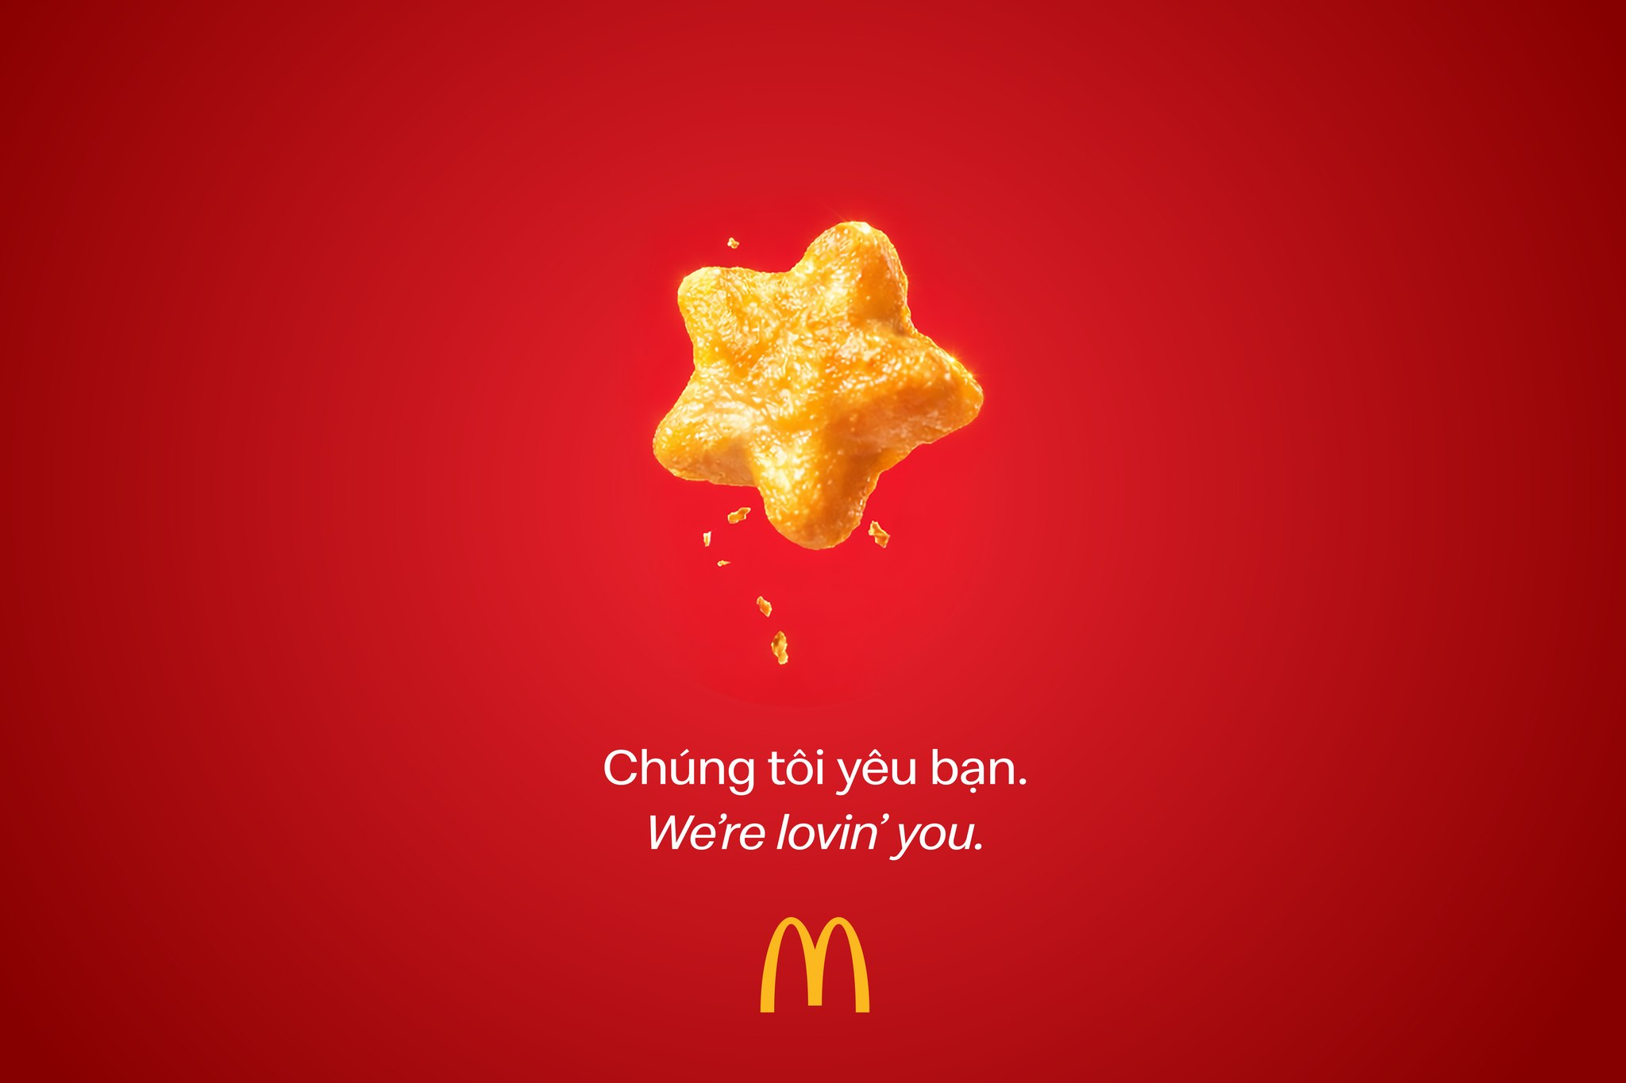
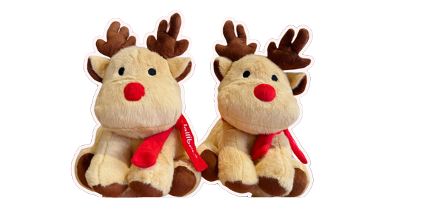
Strategic Implications & 2026-2028 Market Outlook
Vietnam's fast-food market stands at an inflection point. The next three years will separate winners from losers based on three critical capabilities:
Speed-to-Scale in Provinces
As HCMC and Hanoi approach saturation, brands must rapidly establish presence in tier-2 cities. First-mover advantage creates 5–7-year competitive moats.
Digital-First Brand Building
TikTok virality, app-based loyalty, and social commerce are the new playbook. Jollibee's Christmas 2025 campaign generated more visits than 6 months of TV advertising.
1
2
Operational Excellence at Scale
Only operators with superior unit economics will survive the margin squeeze as delivery dominance grows and promotions intensify.
3
Vietnam Fast Food & QSR Market and Consumer Trends | InsightAsia Vietnam Primary Research | January 2026

Slide 31
About Us

Slide 32

We Are
SMALL enough to care &
BIG enough to trust
32
We champion innovative research
Technical rigor and quality control, combined with research passion, creativity and smarter thinking
We bring real local knowledge
To provide ‘up to the minute’ understanding of the evolving competitive & consumer context

Slide 33

Our Clients Trust Us
Because We Understand
Asia.
Efficient and effective research design.
The need for practical and actionable solutions.
33
We Are your
THINKING
PARTNERS

Slide 34
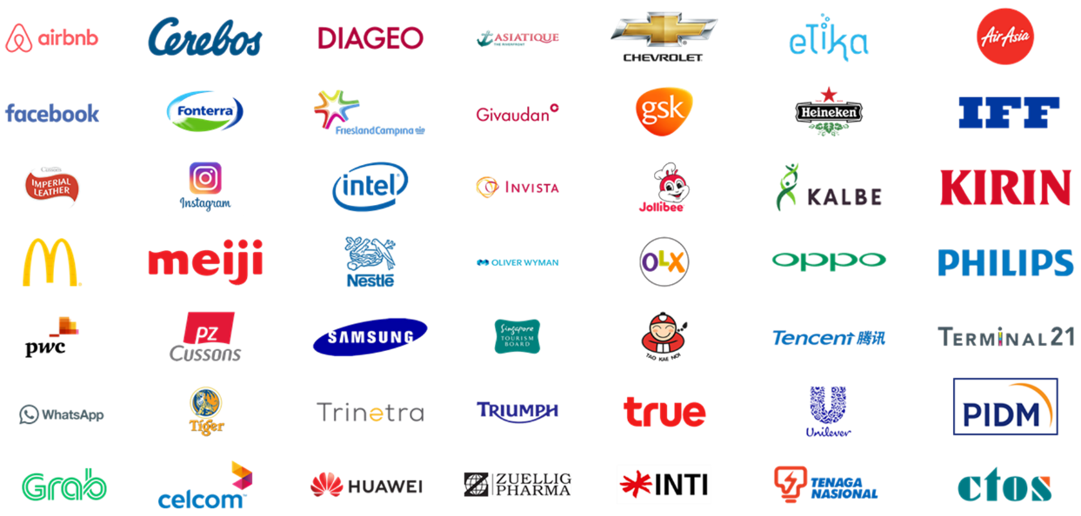




























Local & Regional Clients
Across Industries
...and more

Slide 35








(B2C) What we do
Survey: F2F/ Online
Focus Group
Home Usage Test
Central Location Test
Along shopping
Retail check/ audit
Ethnography
Mystery shopping

Slide 36

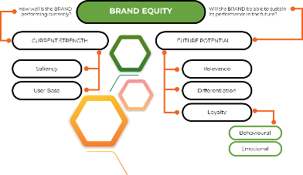
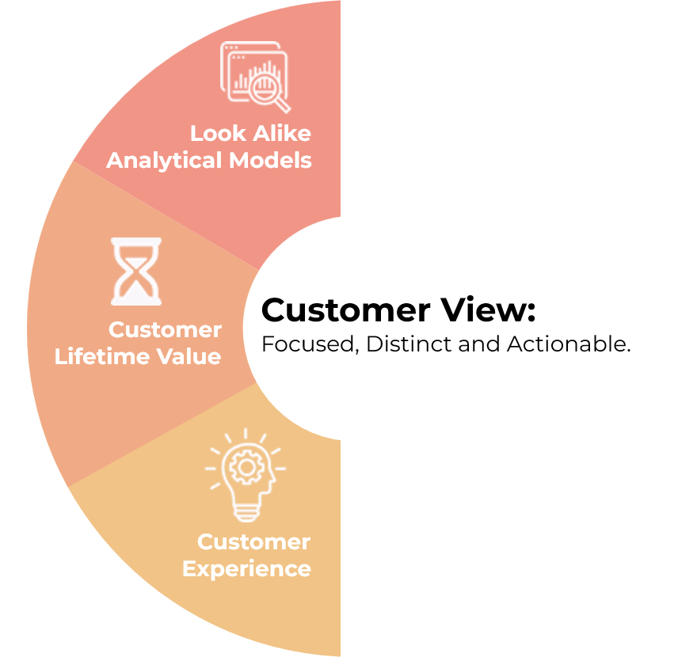

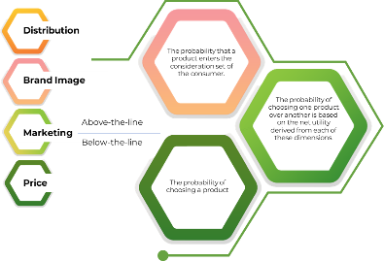

(B2B) What we do
Survey: F2F/ Online
In-depth Interview
Competitor Analysis
Market Analysis
ROMI Analysis
Ideation Workshop

Slide 37





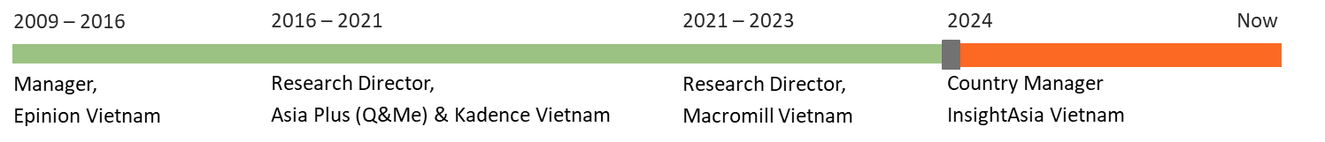
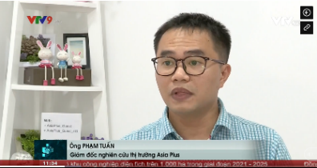
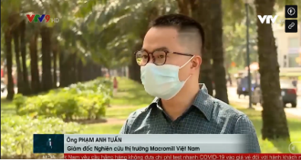

Mr. Pham Anh Tuan
Research Director, Country Manager || VIETNAM
Tuan is a seasoned senior marketing research with over 15 years of expertise, specializing in B2B marketing research. His focus is on market exploration and penetration studies within various sectors, both locally and regionally. With a unique blend of IT and market research experience, Tuan leverages his technical skills to enhance data analysis and market insights, offering a comprehensive understanding of market dynamics.
Renowned for his sharp analytical skills and consultative approach, Tuan has made significant contributions to the understanding of consumer trends and market behaviors.
Tuan’s expert insights are occasionally featured in local newspapers such as Dan Tri , Tuoi Tre Online aaaaaa , and on Vietnam primary TV channels , where he shares his perspectives on evolving market landscapes.

