Slide 1



Vietnam Kids' English Learning Market
Parental Perceptions, Consumer Behaviors & Brand Performance
Age 5-15
2026 March

Slide 2


Executive Summary
87% of Vietnamese parents
view English proficiency as "absolutely essential“
for their children's future,
not optional enrichment
Quality-Promise Gap:
53% of parents at premium centers (VUS, ILA, Apollo) report that courses are "not customized" and progress
is "slower than advertised." Parents whose
children already speak English at home
feel centers actually
"pull back their child's progress."
Critical Market Realities
The Online Learning Paradox
72% of parents reject online-only English programs, citing concentration issues, lack of discipline, and perceived ineffectiveness despite pandemic-era exposure.
The "Backpacker Teacher" Problem
60% of parents express concern about unqualified native English speakers working as teachers, with actual observations confirming minimal teaching involvement.
InsightAsia Vietnam | Market Research Report

Slide 3








Executive Summary
Market Snapshot
Brand Leaders:
Average Monthly Spending:
2.1-4.5 million VND per child
(varies by brand tier)
Highest awareness: 89%
Highest satisfaction: 82 points
EdTech Emergence:
Key Pain Points:
High fees, variable teacher quality, unclear learning outcomes, overselling in marketing
gaining traction as supplementary tools (31% usage rate)
InsightAsia Vietnam | Market Research Report

Slide 4
Research Overview & Methodology
Research Objectives
To understand Vietnamese parents' perceptions, behaviors, and decision-making patterns regarding English learning for children aged 5-15, with particular focus on format preferences (online vs. offline), teacher quality concerns (native vs. local), spending patterns, brand performance, and satisfaction levels.
Research Methodology
Quantitative survey
Qualitative Research
Sample | N=1,219 parents of children aged 5-15
Profiles | Ages 23-50 years old (69% mothers, 31% fathers)
Geographic Coverage | Tier-1 cities: 67% (HCMC, Hanoi) Tier-2 cities: 33% (Da Nang, Can Tho, Hai Phong)
Method | Online survey
Fieldwork | January-February 2026
In-Depth Interviews (IDIs) | Total: 10 interviews (45-60 minutes each) 5 parent interviews - Mix of satisfied and dissatisfied customers across multiple brands 3 teaching assistant interviews - Vietnamese assistants at major centers (ILA, Apollo, VUS) 2 native teacher interviews - Foreign teachers with 1-3 years experience in Vietnam
Focus Group Discussions (FGDs) | 2 FGDs with parents (90 minutes each) FGD 1: HCMC (4 parents) FGD 2: Hanoi (4 parents) Mix of center users, EdTech users, and those considering enrollment
InsightAsia Vietnam | Market Research Report

Slide 5


English Learning
Perceived Necessity & Expected Benefits
English as Necessity, Not Enrichment
87% of parents view English proficiency as "absolutely essential" for their children's future success.
13% of parents view English as optional "enrichment."
The overwhelming majority see it as a
fundamental skill comparable to
literacy and numeracy.
"I don't care if my son becomes fluent immediately. What matters is that by the time he's 15, he can confidently interview for international universities. English opens doors that Vietnamese alone cannot."
— Mother, 38, HCMC,
child enrolled at ILA
InsightAsia Vietnam | Market Research Report | Base: All respondents (n=1,219)

Slide 6


English Learning
Perceived Necessity & Expected Benefits
Expected Benefits (Multiple Responses Allowed)
Question: "What benefits do you expect your child to gain from learning English? Please select all that apply."
Benefit | % of Parents | Importance Level
Better academic performance & university admission | 77% | Very Important
Access to international career opportunities | 72% | Very Important
Global competitiveness & mobility | 69% | Very Important
Confidence in communication | 64% | Important
Study abroad readiness | 59% | Important
Access to international schools/programs | 44% | Somewhat Important
Social mobility & status | 38% | Somewhat Important
InsightAsia Vietnam | Market Research Report | Base: All respondents (n=1,219)

Slide 7


English Learning
Perceived Necessity & Expected Benefits
Long-Term Promise Evaluation
Questions: "Do you have plans for your child to study abroad in the future?";
"How confident are you that your child's current English program will prepare them for [study abroad/international school]?"
Study Abroad Aspirations:
51% of parents explicitly link English learning to future study abroad plans, with preference for English-speaking countries (US, UK, Australia, Canada).
Skepticism About Promises:
However, 48% of parents are skeptical about centers' promises of "international school readiness" or "study abroad preparation," citing lack of measurable outcomes and vague curriculum descriptions.
InsightAsia Vietnam | Market Research Report | Base: All respondents (n=1,219)

Slide 8


Learning Format Preferences
The Online Learning Reality Check
Finding
Despite widespread digital adoption in Vietnam and pandemic-era normalization of online learning, parents overwhelmingly reject online-only English programs for their children.
Format Preferences
Question: "What format does your child currently use for English learning?“,
"What format would you prefer for your child's English learning in the future?"
Learning Format | Current Usage | Future Preference
Offline/In-person only | 62% | 59%
Hybrid (offline primary + online supplement) | 26% | 34%
Online-only live classes | 8% | 5%
EdTech apps (self-paced) | 4% | 2%
InsightAsia Vietnam | Market Research Report | Base: All respondents (n=1,219)

Slide 9
Learning Format Preferences
The Online Learning Reality Check
Why Parents Reject Online Classes
Question: "What are your main concerns about online-only English classes for your child? Please select all that apply.“
Base: Parents who reject online-only format (n=878)
Top Concerns (% Citing)
Poor concentration & attention span | 72%
Lack of discipline without physical classroom | 69%
Ineffective for young children (ages 5-10) | 65%
Technical issues & connectivity problems | 62%
Limited interaction with teacher & peers | 59%
Screen time & health concerns | 51%
Cannot monitor child's actual learning | 48%
"During COVID, my daughter had online English classes. I could see her on the screen but she was playing with toys half the time. The teacher couldn't control 15 kids through Zoom. After 6 months, I felt she learned almost nothing."
— Mother, 35, Hanoi, Parent FGD
"Online is okay for practicing vocabulary or pronunciation with an app. But for real learning? No. Children need to feel embarrassed when they make mistakes in front of their friends. That's how they improve."
— Father, 42, HCMC, Parent FGD
InsightAsia Vietnam | Market Research Report | Base: All respondents (n=1,219)

Slide 10

Learning Format Preferences
The Online Learning Reality Check
Geographic Comparison: Tier-1 vs. Tier-2 Cities
Format Preference | Tier-1 Cities (HCMC, Hanoi) (n=812) | Tier-2 Cities (Da Nang, Can Tho, Hai Phong) (n=402) | Difference
Reject online-only programs | 70% | 78% | +8pp stronger rejection in Tier-2
Prefer offline-only | 59% | 68% | +9pp higher in Tier-2
Open to hybrid models | 32% | 22% | -10pp lower in Tier-2
EdTech app usage (supplementary) | 34% | 26% | -8pp lower in Tier-2
31% of parents use EdTech apps (Monkey Junior, Edupia, ELSA Speak Kids) as supplementary practice tools at home, but NOT as the primary learning method. Parents appreciate gamification and AI pronunciation features for at-home practice, but do not trust these platforms for comprehensive English education.
InsightAsia Vietnam | Market Research Report | Base: All respondents (n=1,219)

Slide 11
Teacher Quality Debate
Native vs. Local—The "Backpacker" Problem
Stated Preferences
Question: "What is your preference for your child's English teachers? Please indicate your level of preference for each option."
Teacher Type | Strongly Prefer | Accept | Reject
Native English speaker (qualified) | 55% | 37% | 8%
Vietnamese teacher (highly qualified) | 23% | 68% | 9%
Mix of both | 72% | 25% | 3%
Critical Finding
60% of parents express concern about unqualified native English speakers ("backpackers," "travelers") working as English teachers in Vietnam, particularly at mid-tier and local centers.
The "Backpacker Teacher" Problem: Parent Perceptions
1
Short-term commitment:
Minimal qualifications:
Inconsistent quality:
Cultural disconnect:
Many native teachers are perceived as temporary travelers with no long-term investment in teaching
Parents question whether native speakers have actual teaching credentials beyond "speaking English"
High turnover means children cannot build relationships with teachers
Some native teachers lack understanding of Vietnamese education culture and parent expectations
2
3
4
InsightAsia Vietnam | Market Research Report | Base: All respondents (n=1,219)

Slide 12




Teacher Quality Debate
Native vs. Local—The "Backpacker" Problem
The "Backpacker Teacher" Problem:
Parent Perceptions
Some native teachers lack understanding of Vietnamese education culture and parent expectations
High turnover means children cannot build relationships with teachers
Parents question whether native speakers have actual teaching credentials beyond "speaking English"
Cultural disconnect
Many native teachers are perceived as temporary travelers with no long-term investment in teaching
Inconsistent quality
Minimal qualifications
Short-term commitment
InsightAsia Vietnam | Market Research Report | Base: All respondents (n=1,219)

Slide 13
Teacher Quality Debate
Native vs. Local—The "Backpacker" Problem
Vietnamese Teaching Assistants:
Native Teachers:
"At our center, classes for young children under 6 are honestly more like babysitting than structured learning. The native teacher comes in for maybe 15-20 minutes—sings songs, does flashcards—then leaves. We assistants handle the rest of the 90-minute session: games, coloring, bathroom breaks, managing behavior. Parents see the foreigner and assume their child is getting full English immersion. But the reality? Maybe 20 minutes of actual English instruction per class."
— Teaching Assistant,
major premium center HCMC, 2 years experience
"Teacher turnover is a huge problem that parents don’t see. In the past year at our center, we've had 4 different native teachers for the same class of 6-year-olds. Each teacher stays 2-3 months, then moves to Thailand or goes home. The kids get confused, they have to adjust to new teaching styles every few months. How can they build relationships or consistent learning when teachers keep changing?"
— Teaching Assistant,
national brand center Hanoi, 3 years experience
"I came to Vietnam right after university with a TEFL certificate—just a 4-week online course, no real teaching experience. My center hired me in one interview because I'm a native speaker. I try my best, but honestly I don't know what I'm doing half the time. There's no training, no mentorship. They just give me a textbook and say 'teach.' I'm leaving next month because I feel like I'm failing these kids."
— Native Teacher, American, 24 years old,
local center Da Nang, 6 months experience
"The quality expectations in Vietnam are very different from back home. In Australia, I'd never have a class of 18 young children by myself—that's impossible to manage. Here, centers want to maximize profits so they pack in as many kids as possible. Even with an assistant, I can only give each child maybe 2-3 minutes of individual attention per class. It's not real learning—it's crowd control."
— Native Teacher, Australian, 28 years old,
national brand center HCMC, 1.5 years experience
InsightAsia Vietnam | Market Research Report | Base: All respondents (n=1,219)

Slide 14
Teacher Quality Debate
Native vs. Local—The "Backpacker" Problem
What Parents Value in Teachers
Question: "How important is each of these qualities in your child's English teacher?" Rated on 5-point scale.
Quality Factor | Native Teacher Strength | Local Teacher Strength
Pronunciation & accent | ✓ Strong | Moderate
Cultural exposure | ✓ Strong | Limited
Grammar & structure | Moderate | ✓ Strong
Exam preparation (Cambridge, IELTS) | Moderate | ✓ Strong
Understanding Vietnamese learner challenges | Weak | ✓ Strong
Commitment & consistency | Weak | ✓ Strong
Ideal model is qualified native teachers for speaking/pronunciation + experienced Vietnamese teachers for grammar/exam prep. But qualification verification is key - not just "native speaker" status.
Parent Conclusion:
InsightAsia Vietnam | Market Research Report | Base: All respondents (n=1,219)

Slide 15

English Center Usage & Spending Patterns
Current English Learning Enrollment
Question: "Is your child currently enrolled in any English learning program? If yes, which type?"
67% of surveyed parents
have their children enrolled in at least one formal English learning program.
Enrollment Type
%
of Parents
Enrolled in major English center (VUS, ILA, Apollo, British Council, etc.) | 41%
Enrolled in local/smaller center | 14%
Using EdTech app/online program as primary method | 5%
Private tutor only | 7%
Total with formal English learning | 67%
Not currently enrolled (relying on school English only) | 33%
Note: An additional 19% supplement formal programs with EdTech apps for at-home practice, bringing total EdTech usage to 24%.
InsightAsia Vietnam | Market Research Report | Base: All respondents (n=1,219)

Slide 16





English Center Usage & Spending Patterns
Monthly Spending Patterns
Question: "Approximately how much do you spend per month on your child's English learning at [center/program name]?. Open-ended, coded into ranges.
Base: Parents with children currently enrolled in English programs (n=816)
Among parents currently enrolled in English programs, monthly spending varies significantly by center choice:
Million VND
0.3-1.0 million VND/month
0.8-1.8 million VND/month
1.5-4.0 million VND/month
4.0-6.5 million VND/month
EdTech Apps
Local/Regional Center
Major National Brands
British Council
budget tier
competitive mid-tier, similar price ranges
clearly premium tier
supplementary, subscription-based
VUS, ILA, Apollo, and YOLA compete directly in the 1.5-4.0M VND range, with pricing overlaps.
The distinction is NOT price tier but rather brand positioning (facilities, teacher mix, curriculum approach).
British Council stands alone as the premium option at nearly 2x the price of competitors.
InsightAsia Vietnam | Market Research Report | Base: All respondents (n=1,219)

Slide 17
English Center Usage & Spending Patterns
Class Frequency Patterns
Question: "How many times per week does your child attend English classes at the center/program?"
Base: Parents with children enrolled in centers (n=670, excludes EdTech-only and private tutor-only)
attend classes
2 times per week
(most common schedule)
attend classes
3 times per week
attend classes
1 time per week
intensive programs
(4+ times per week)
64%
23%
9%
4%
Price Sensitivity & Trade-offs
"I know British Council is the best, but it's 5 million per month. That's my entire salary! So I chose VUS—it's still good quality but half the price. I can afford to keep my son enrolled for years, not just a few terms."
— Mother, 34, Hanoi, household income ~25 million VND/month, Parent IDI
Key Insight: Price is the #2 decision factor (after teacher quality), but parents are willing to pay premiums IF they see tangible results. Problem: 53% feel they're not getting value for money at their current center.
InsightAsia Vietnam | Market Research Report | Base: All respondents (n=1,219)

Slide 18


Brand Awareness & Trial Funnel
Brand Awareness & Usage (Tier-1 Cities Focus)
Questions: "Which English learning centers or programs have you heard of?" (unaided then aided); "Which have you ever tried?"; "Which are you currently using?"
Base: All respondents (n=1,219)
Brand | Total Awareness (%) | Unaided Awareness (%) | Ever Tried (%) | Currently Using (%)
 | 89% | 71% | 44% | 25%
 | 83% | 62% | 38% | 19%
 | 75% | 49% | 30% | 14%
 | 69% | 53% | 22% | 8%
 | 28% | 12% | 8% | 3%
 | 52% | 29% | 17% | 6%
 | 48% | 23% | 29% | 16%
 | 44% | 20% | 33% | 18%
 | 39% | 16% | 25% | 12%
Local centers | - | - | 42% | 16%
Note: Language Link's lower awareness/trial figures (28%/8%) reflect their limited geographic presence—primarily operating in northern Vietnam with 3 centers in Hanoi and 1 in Da Nang, with no HCMC presence.

Slide 19
Brand Awareness & Trial Funnel
Geographic Brand Performance: Tier-1 vs. Tier-2
Question: "Which English learning center/program is your child currently using?"
Base: All enrolled parents. Tier-1 n=547, Tier-2 n=269
Strong urban dominance
Very limited Tier-2 presence
Tier-2 market dominated by local players
Higher Tier-2 usage for accessibility
Major National Brands | Premium Brand | Local/Regional Centers | EdTech Apps
InsightAsia Vietnam | Market Research Report | Base: All respondents (n=1,219)

Slide 20

Brand Awareness & Trial Funnel
VUS dominates awareness and trial, benefiting from extensive network and accessible pricing across both tiers
British Council maintains premium aspiration—21% trial rate represents healthy conversion given high barriers
1
2
3
4
EdTech brands show strong trial-to-usage conversion and surprisingly high Tier-2 penetration due to limited physical center options
Local centers hold majority share in Tier-2/3 markets where national brands have limited presence
Key
insights:
InsightAsia Vietnam | Market Research Report | Base: All respondents (n=1,219)

Slide 21
Brand Performance: Teaching Quality & Curriculum
Overall Satisfaction Score (0-100 Scale)
Questions: "Please rate your satisfaction with [brand] on the following aspects" using 5-point scale (Very Dissatisfied to Very Satisfied), converted to 0-100 scale.
Base: Users of each respective brand (varies by brand: British Council n=97, ILA n=232, Apollo n=171, VUS n=305, etc.)
Brand | Overall Satisfaction | Teacher Quality | Curriculum Quality | Learning Outcomes
 | 82 | 88 | 86 | 84
 | 76 | 79 | 77 | 71
 | 74 | 76 | 78 | 69
 | 72 | 73 | 75 | 68
 | 71 | 68 | 74 | 70
 | 69 | 70 | 72 | 65
 | 65 | 66 | 67 | 62
Local centers (Avg) | 58 | 59 | 61 | 55

Slide 22


Brand Performance: Teaching Quality & Curriculum
Critical Quality Issues
53% of parents at premium/ mid-tier centers (VUS, ILA, Apollo) report that:
Courses are
NOT
customized to
individual
learning pace
Progress is
SLOWER
than advertised
in marketing
materials
For children who already speak
English at home,
centers "pull back their progress"
to fit standardized curriculum.
"My daughter speaks English at home with me—I lived in the US for 5 years. I enrolled her at a premium center thinking they'd advance her skills. But they put her in a beginner class because 'that's her age group.' After 6 months, her English actually got worse because she was bored and stopped trying."
— Mother, 36, HCMC, withdrew from premium center after 8 months, Parent IDI
InsightAsia Vietnam | Market Research Report | Base: All respondents (n=1,219)

Slide 23
Brand Awareness & Trial Funnel
Satisfaction by City Tier
Question: "Overall, how satisfied are you with [brand]?" 5-point scale, converted to 0-100.
Base: Current users of each brand, split by city tier
-6 points
(lower quality in smaller cities)
-9 points
(limited Tier-2 presence)
-6 points
+7 points
(stronger in home markets)
+1 point
(consistent quality)
 |  |  | Local Centers | EdTech Apps
Note: National brands struggle to maintain quality standards in Tier-2 cities due to teacher recruitment challenges. Local centers and EdTech show more consistent performance.
InsightAsia Vietnam | Market Research Report | Base: All respondents (n=1,219)

Slide 24
Brand Performance: Facilities, Value & Service
Brand | Facilities & Environment | Value for Money | Parent Communication | Progress Tracking
 | 91 | 62 | 85 | 88
 | 84 | 68 | 79 | 76
 | 78 | 66 | 74 | 71
 | 76 | 79 | 73 | 74
 | 65 | 88 | 71 | 77
 | 62 | 84 | 68 | 73
 | 71 | 72 | 65 | 68
Local centers (Avg) | 58 | 75 | 61 | 59
Key insights:
1
Value Paradox:
British Council scores lowest on value despite highest satisfaction—parents accept premium pricing for quality. VUS and EdTech apps score highest on value.
2
Facilities Gap:
Major investment differentiator—ILA and British Council's modern environments appeal to upper-income families
3
Progress Tracking:
British Council excels with detailed assessments. 56% of parents at other centers feel feedback is vague or irregular.
InsightAsia Vietnam | Market Research Report | Base: All respondents (n=1,219)
Questions: "Please rate your satisfaction with [brand] on the following aspects" using 5-point scale, converted to 0-100.
Base: Current users of each respective brand

Slide 25
Brand Performance: Facilities, Value & Service
Top Parent Complaints
Question: "What issues or problems have you experienced with your child's English learning center? Please select all that apply."
Base: All enrolled parents (n=816)
Issue
High fees vs. unclear results
Marketing oversells reality
Inconsistent teacher quality
Large class sizes (15-20+ students)
Aggressive sales tactics
Unclear progress tracking
% Reporting
Most Affected Brands
62%
"They promise 'international curriculum' and 'study abroad readiness' but after 2 years and 100 million VND spent, my son can barely hold a simple conversation. When I complained, they said 'every child learns at their own pace.' That's code for 'we didn't deliver.'"
53%
48%
Local Centers
43%
39%
— Father, 41, Da Nang,
former premium center parent,
Parent FGD
37%
Local Centers
InsightAsia Vietnam | Market Research Report | Base: All respondents (n=1,219)

Slide 26


Key Decision Drivers & Pain Points
Top Decision Factors When Choosing an English Center
Question: "How important are each of the following factors when choosing an English learning center for your child?" 5-point scale from "Not Important" to "Critical".
Base: All respondents (n=1,219)
Factor | % Rated "Critical" or "Very Important"
Teacher quality & qualifications | 86%
Tuition fees & value for money | 82%
Curriculum quality & international alignment | 77%
Location & convenience | 72%
Class size (prefer small groups) | 69%
Progress tracking & reporting | 65%
Facilities & learning environment | 60%
Brand reputation & recommendations | 57%
Certification pathways (Cambridge, IELTS) | 52%
Native English speakers on staff | 48%
Teacher quality & qualifications
86%
Tuition fees & value for money
82%
InsightAsia Vietnam | Market Research Report | Base: All respondents (n=1,219)

Slide 27
Key Decision Drivers & Pain Points
Critical Pain Points
Top 5 Complaints
What Would Increase Satisfaction
Marketing vs. Reality Gap (62%)
Centers oversell capabilities; promises don't match delivery
1
2
3
4
5
Transparent progress reporting (72%)
Regular assessments with clear benchmarks
Slow/Unclear Progress (57%)
After months or years, unclear if child is actually improving
Customized learning paths (69%)
Adjust pace and content to child's level
Non-Customized Approach (53%)
One-size-fits-all curriculum ignores individual pace/level
Smaller class sizes (65%)
Maximum 10-12 students per class
High Costs with Unclear ROI (51%)
Spending millions yearly but can't see tangible results
Better teacher vetting (63%)
Verify qualifications, ongoing training
Teacher Inconsistency (48%)
Some teachers excellent, others clearly unqualified
Honest marketing (60%)
Set realistic expectations about timelines
"I want to see DATA. Show me my child's vocabulary growth. Show me pronunciation scores. Show me where she struggles. Don't just tell me 'she's doing well' every 3 months. I'm paying 4 million VND per month—I deserve transparency."
— Father, 39, HCMC, premium center parent considering switching, Parent IDI

Slide 28
Key Decision Drivers & Pain Points
Information Sources for Decision-Making
Questions: "Which sources of information did you use when choosing an English center?" (multiple select); "How much do you trust each source?" (5-point scale).
Base: Parents who have ever enrolled or considered enrolling (n=1,076)
Source | % Who Use | Trust Level (High)
Word-of-mouth from friends/family | 83% | 79%
Facebook groups & parent forums | 71% | 66%
Trial classes | 69% | 81%
Center website & marketing materials | 62% | 42%
Google/Facebook reviews | 59% | 54%
YouTube reviews/testimonials | 45% | 49%

Slide 29




Consumer Segmentation: Four Distinct Parent Groups
Key Insight: These segments require different value propositions. Premium brands (British Council, ILA) effectively serve Segment 1. VUS successfully captures Segment 2. Local centers and EdTech platforms serve Segments 3 and 4.
The challenge: Segment 2 (43% of market) is most dissatisfied with current offerings—they want premium quality but can't afford it, creating opportunity for innovative mid-tier players.
Premium Quality Seekers
Value-Conscious Balancers
Budget-Constrained Pragmatists
Digital-First Convenience Seekers
22%
43%
20%
15%
Defining Behaviors:
Monthly spending: 4-6.5 million VND+
Choose British Council (52%) or ILA Premium (48%)
Strongly prefer native teachers (89%)
Reject online-only programs (94%)
International school aspirations (78%)
Profile: Household income 50M+ VND/month. Often have international exposure or overseas education history. Study abroad plans for children.
Defining Behaviors:
Monthly spending: 1.5-3.5 million VND
Choose VUS (58%), Apollo (25%), mid-tier ILA (17%)
Accept mix of native/local teachers
Price is #1 or #2 decision factor
Compare multiple centers before enrollment
Profile: Household income 20-40M VND/month. Largest segment. Seek "good enough" quality at sustainable price. Most affected by marketing-reality gap.
Defining Behaviors:
Monthly spending: 0.8-1.8 million VND
Choose local centers (78%) or budget EdTech (22%)
Strongly rely on word-of-mouth (91%)
Concentrated in Tier-2/3 cities (68%)
Often combine low-cost center with free resources
Profile: Household income 10-20M VND/month. Affordability paramount. Concerned children falling behind wealthier peers but cannot access premium options.
Defining Behaviors:
Monthly spending: 0.3-2.0 million VND
Primary or heavy EdTech users (Monkey Junior, Edupia)
Younger parents: 87% aged 25-35
Comfortable with online learning (76%)
Often subscribe to multiple apps
Profile: Tech-savvy parents across income levels. Value flexibility and convenience. May combine apps with occasional offline classes but prefer digital-primary approach.
"Money is not the issue. Quality is. I'll pay 10 million per month if it means my daughter gets into a top university abroad."
"VUS isn't the best, but it's what I can afford long-term. Better consistent learning for 5 years than British Council for 1 year."
"Our local center costs 800,000 per month. The teacher is Vietnamese but she's good. My son is learning. That's all that matters."
"My daughter uses Monkey Junior daily—like a game. But I know apps alone aren't enough for conversation. We're adding group classes once a week
Methodology: Through clustering analysis of survey responses on spending levels, brand choices, format preferences, and decision priorities, we identified four distinct parent segments with markedly different behaviors and needs.

Slide 30
Key Takeaways
Market Realities
Geographic Patterns
English viewed as essential skill, not enrichment by 87% of parents | 72% reject online-only programs despite digital adoption—offline discipline matters | 60% concerned about unqualified "backpacker" native teachers | 53% report quality-promise gap at their current center
Tier-1 cities: National brands dominate (VUS, ILA, Apollo) with 62% combined share | Tier-2 cities: Local centers hold 51% share; EdTech adoption 7pp higher than Tier-1 | Quality challenges: National brands show 6-9 point satisfaction drops in Tier-2 markets
Brand Performance Hierarchy
Tier | Brands | Satisfaction | Key Strength | Key Weakness
Premium | British Council | 82 | Quality, outcomes | High cost, limited access
Upper-Mid | ILA, Apollo | 74-76 | Facilities, native teachers | Marketing-reality gap
Mid-Tier | VUS | 72 | Value, accessibility | Variable quality, large classes
EdTech | Monkey Jr, Edupia | 69-71 | Affordable, flexible | Limited speaking practice
Consumer Segments
Premium Quality Seekers
Value-Conscious Balancers
Budget-Constrained Pragmatists
Digital-First Convenience Seekers
22%
43%
20%
15%
Will pay for British Council/ILA Premium quality
Largest segment, most dissatisfied—want quality but can't afford premium
Local centers dominate; concentrated in Tier-2 markets
EdTech primary users, younger parents, convenience-focused

Slide 31

We Are
SMALL enough to care &
BIG enough to trust
31
We champion innovative research
Technical rigor and quality control, combined with research passion, creativity and smarter thinking
We bring real local knowledge
To provide ‘up to the minute’ understanding of the evolving competitive & consumer context

Slide 32

Our Clients Trust Us
Because We Understand
Asia.
Efficient and effective research design.
The need for practical and actionable solutions.
32
We Are your
THINKING
PARTNERS

Slide 33
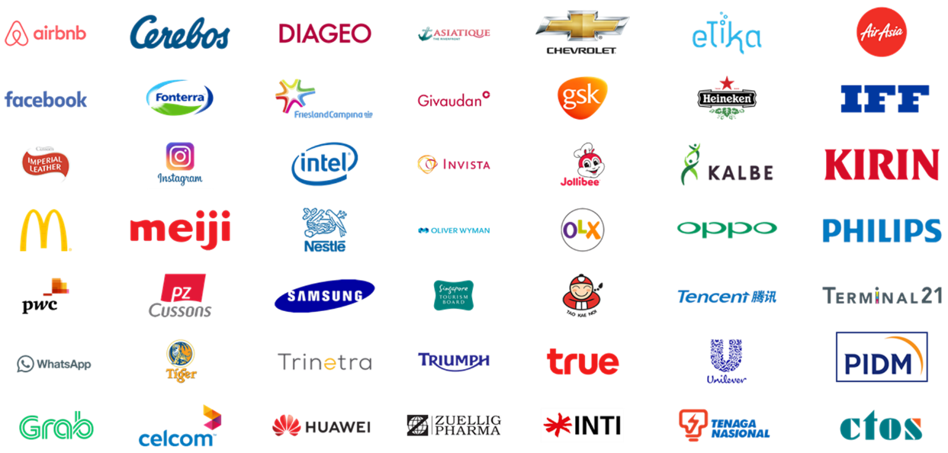




























Local & Regional Clients
Across Industries
...and more

Slide 34








(B2C) What we do
Survey: F2F/ Online
Focus Group
Home Usage Test
Central Location Test
Along shopping
Retail check/ audit
Ethnography
Mystery shopping

Slide 35

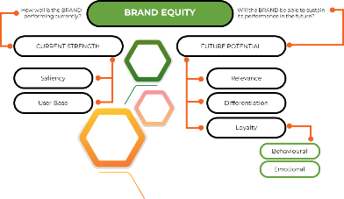
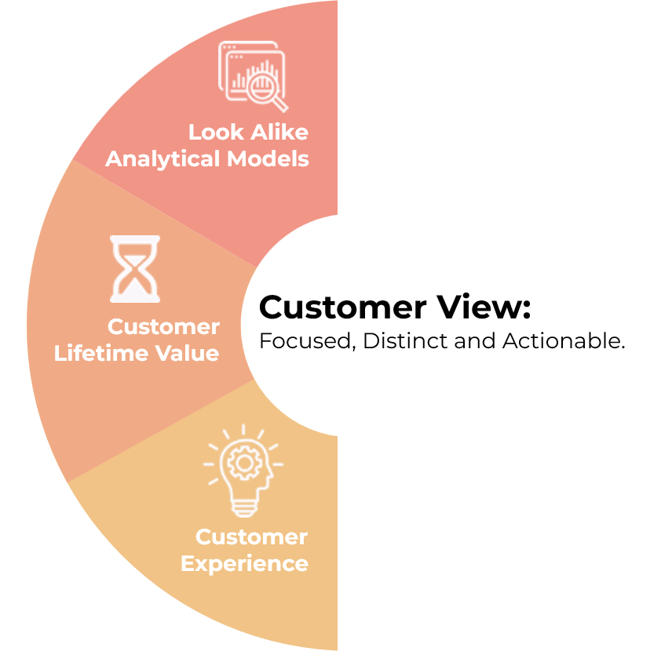

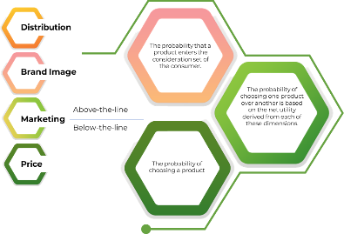

(B2B) What we do
Survey: F2F/ Online
In-depth Interview
Competitor Analysis
Market Analysis
ROMI Analysis
Ideation Workshop

Slide 36





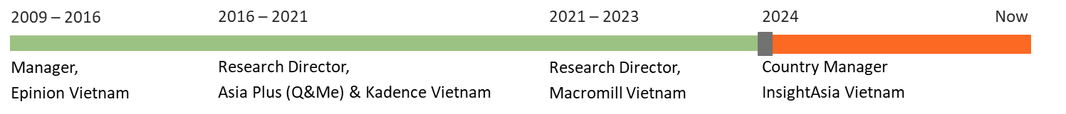
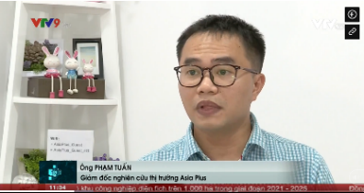
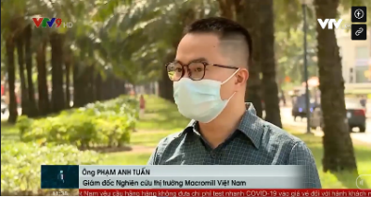
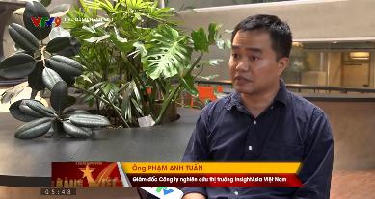
Mr. Pham Anh Tuan
Research Director, Country Manager || VIETNAM
Tuan is a seasoned senior marketing research with over 15 years of expertise, specializing in B2B marketing research. His focus is on market exploration and penetration studies within various sectors, both locally and regionally. With a unique blend of IT and market research experience, Tuan leverages his technical skills to enhance data analysis and market insights, offering a comprehensive understanding of market dynamics.
Renowned for his sharp analytical skills and consultative approach, Tuan has made significant contributions to the understanding of consumer trends and market behaviors.
Tuan’s expert insights are occasionally featured in local newspapers such as Dan Tri , Tuoi Tre Online aaaaaa , and on Vietnam primary TV channels , where he shares his perspectives on evolving market landscapes.

