Slide 1




Vietnamese Travel Trends Summer 2026
Navigating Economic Headwinds: The Shift to Domestic & Regional Destinations
2026 March

Slide 2
Research Overview & Methodology
Vietnamese Travel Trends Summer 2026
Market Context
This report was initiated to understand how Vietnamese consumers are planning Summer 2026 travel amid a shifting economic backdrop, changing budget priorities, and evolving destination and booking preferences.
Research Objectives
Understand travel planning behaviors & budget constraints
Map destination preferences (domestic vs. outbound)
Evaluate Online Travel Agency (OTA) platform performance & satisfaction
Identify key conversion drivers & barriers
Assess hospitality brand perceptions
Project Summer 2026 travel trends
Fieldwork Period & Timeline
Fieldwork: January - February 2025
Analysis & Reporting: March 2025
Vietnamese Travel Trends Summer 2026 | InsightAsia Vietnam Primary Research | March 2026

Slide 3
Research Overview & Methodology
Research Methodology
Quantitative survey
Qualitative Research
Sample | 1,389 respondents
Age | 18-45 years
Criteria | Have decided to travel or are planning to travel during Summer 2026 (May–August)
Method | Online survey
Consumer IDIs | 8 in-depth interviews
Expert Interviews | 3 industry experts (OTA executives, travel agents)
Focus | Travel motivations, booking behaviors, budget considerations, platform preferences
Duration | 45-60 minutes per interview
Geographic Coverage
Key city coverage
Tier 1 cities (HCMC, Hanoi - 60%)
Tier 2 cities (Da Nang, Can Tho, Hai Phong - 40%)
Vietnamese Travel Trends Summer 2026 | InsightAsia Vietnam Primary Research | March 2026

Slide 4


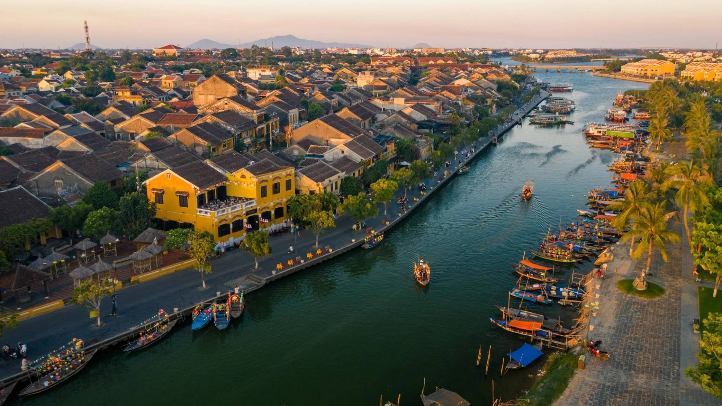

Market Landscape & Context
Vietnamese travelers are pivoting decisively toward domestic and regional Asian destinations for Summer 2026
driven by economic pressures, value-seeking behavior, and improved infrastructure. While GDP growth remains robust (6.5-6.7%), persistent inflation concerns and labor market uncertainties are reshaping travel priorities.
73% | Prioritize Domestic Travel (up from 51% in 2025)
22% | Domestic Search Growth (vs. 7% Outbound)
Vietnamese Travel Trends Summer 2026 | InsightAsia Vietnam Primary Research | March 2026

Slide 5




Key Findings Defining Trends in Summer 2026
Value Over Luxury
92% set accommodation budgets at ≤VND 2.6M ($99)/night, reflecting strong price consciousness
Family-Centric Travel
56% of trips are family-oriented, with multi-generational travel rising 18% YoY
Platform Dynamics Shift
Local OTAs (Vntrip, MyTour) gaining ground with localized promotions and e-wallet integration
Regional Asia Dominance
Thailand, South Korea, Taiwan lead outbound; premium destinations under pressure
Mobile-First Booking
72% of bookings made via mobile; digital wallets account for 46% of travel payments
Shorter Planning Windows
71% of Gen Z/Millennials book within 4 weeks of travel; flexibility is critical
Vietnamese Travel Trends Summer 2026 | InsightAsia Vietnam Primary Research | March 2026

Slide 6
Travel Behavior & Trip Occasions
Planned Travel Type
Base: Total (n=1,389)
Primary motivation
Base: Total (n=1,389)
Family vacation (with children) | 41%
Couples/romantic getaway | 18%
Multi-generational family trip | 15%
Friends group travel | 14%
Solo travel/exploration | 8%
Business + Leisure (Bleisure) | 4%
Relaxation & rest | 47%
Family bonding | 44%
Cultural exploration | 38%
Culinary experiences | 32%
Beach/nature activities | 29%
Value for money | 27%
This summer is about family time without breaking the bank. We're choosing destinations within Vietnam because we can drive there, the kids love the beach, and we don't have to worry about expensive flights.
— Female, 34, HCMC Mother of 2, Planning Vung Tau Trip
Q: Which of the following best describes your planned summer 2026 travel? | Q: What is your primary motivation for summer travel?
Vietnamese Travel Trends Summer 2026 | InsightAsia Vietnam Primary Research | March 2026

Slide 7




Booking Windows & Travel Frequency
Booking lead time
Base: Total (n=1,389)
Trip duration
No. of trips per year
42% | Within 2 weeks | 28%
29% | 2-4 weeks ahead | 31%
21% | 1-2 months ahead | 27%
8% | 3+ months ahead | 14%
Base: Total (n=1,389)
Base: Total (n=1,389)
1-2 nights | 19%
3-4 nights | 42%
5-7 nights | 28%
8-10 nights | 8%
>10 nights | 3%
1 trips | 11%
2-3 trips | 32%
4-6 trips | 36%
7-10 trips | 18%
>10 trips | 3%
Gen Z/Millennials
(18-40 years old)
Gen X
(41-45 years old)
Q: How far in advance do you typically book summer travel? | Q: Typical trip duration for summer travel? | Q: How many leisure trips do you take per year? | Vietnamese Travel Trends Summer 2026 | InsightAsia Vietnam Primary Research | March 2026

Slide 8


Consumer Spending Analysis
92% set accommodation budgets at ≤VND 2.6M ($99)/night, reflecting heightened price sensitivity. The "value-seeker" segment has expanded significantly from 2025, with travelers prioritizing affordable destinations that offer quality experiences without premium pricing.
Typical accommodation budget per night
Base: Total (n=1,389)
We're definitely tightening our belts this year. Instead of going to Thailand like we usually do, we're looking at Da Lat or Nha Trang.
The kids still get their vacation, but we save maybe 40-50% on costs.
— Male, 38, Hanoi Father of 3, IT Manager
< VND 1.3M (< $49) | 56%
VND 1.3M - 2.6M ($49 - $99) | 36%
VND 2.6M - 5.2M ($100 - $199) | 6%
> VND 5.2M (> $200) | 2%
Expected budget for summer trip
Base: Total (n=1,389)
< VND 5M (< $195) | 36%
VND 5M - 10M ($195-$390) | 42%
VND 10M - 20M ($390-$780) | 16%
> VND 20M (> $780) | 6%
Q: What is your typical accommodation budget per night for summer travel? | Q: Expected total budget for summer trip (per person)?
Vietnamese Travel Trends Summer 2026 | InsightAsia Vietnam Primary Research | March 2026

Slide 9











Platform Awareness & Usage Funnel
Consumer journey from awareness to regular patronage across major brands
Base: Total (n=1,389)
Awareness
Past 12M Usage
75%
73%
70%
52%
49%
Base: Total (n=1,389)
Awareness
Past 12M Usage
45%
39%
41%
42%
37%
Platform Landscape
Global OTAs dominate top-of-mind awareness and usage, with Traveloka, Booking.com, and Agoda collectively
capturing ~80% of digital booking volume. However, local OTAs are gaining traction with Vietnam-specific promotions,
e-wallet integration (MoMo, VNPay, ZaloPay), and Vietnamese language support.
Q: Which of the following travel booking platforms are you aware of? / Which have you used in the past 12 months?
Vietnamese Travel Trends Summer 2026 | InsightAsia Vietnam Primary Research | March 2026

Slide 10

Platform Performance: Key Attributes
Detailed Brand Attribute Perceptions
Base: Platform users
Scale: 0-100
Attribute | Price Competitiveness | Ease of Use | Promo Mechanics | Refund Speed | Customer Support | Overall Score
 | 87 | 91 | 90 | 89 | 86 | 89
 | 90 | 88 | 92 | 87 | 83 | 88
 | 85 | 94 | 85 | 88 | 85 | 87
 | 82 | 84 | 81 | 82 | 83 | 82
 | 80 | 83 | 79 | 80 | 84 | 81
 | 84 | 87 | 88 | 84 | 82 | 85
 | 78 | 86 | 75 | 78 | 79 | 79
Q: For each brand, Q: How would you rate each platform on the following attributes?
Vietnamese Travel Trends Summer 2026 | InsightAsia Vietnam Primary Research | March 2026

Slide 11

Platform selection drivers
Platform selection drivers
I always check 3-4 platforms before booking. Traveloka usually has the best deals with MoMo cashback, but Agoda has great loyalty points if you travel often. It's all about timing the flash sales.
— Female, 29, Da Nang,
Marketing Professional,
Frequent Traveler
Loyalty rewards 38%
Competitive pricing
68%
Flash sales/promotions 62%
E-wallet integration 46%
Flexible cancellation 54%
Fast refund processing 49%
App stability/UX 43%
Q: What drives your platform selection?
Vietnamese Travel Trends Summer 2026 | InsightAsia Vietnam Primary Research | March 2026

Slide 12




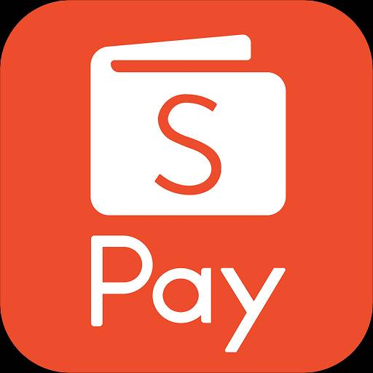
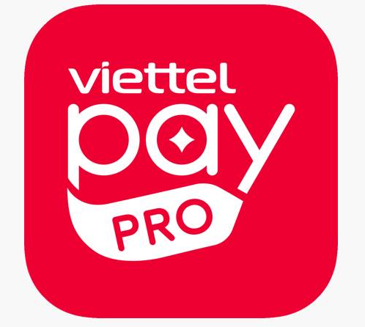

Payment Methods & Digital Wallet Adoption
Preferred payment method
Actively used digital wallets
72%
Base: Total (n=1,389)
Base: Digital wallet users (n=639)
46%
Digital Wallets
(MoMo, VNPay, ZaloPay)
primarily use
mobile phone
for travel bookings
Beside Laptop/Desktop - 23% and Tablet - 5%a
31%
Credit/Debit Cards
Base: Total (n=1,389)
Digital Payments Surge
Digital wallets now account for 46% of online travel payments, up from 32% in 2024. The integration of e-wallets with OTAs has accelerated adoption, driven by instant confirmation, cashback offers, and seamless QR code payments. Mobile-first booking dominates at 72%, particularly among Gen Z/Millennials.
18%
Bank Transfer
5%
Cash on Collection/Counter
Q: What is your preferred payment method when booking travel online? | Q: Which digital wallets do you actively use? | Q: What device do you primarily use for travel bookings? | Vietnamese Travel Trends Summer 2026 | InsightAsia Vietnam Primary Research | March 2026

Slide 13


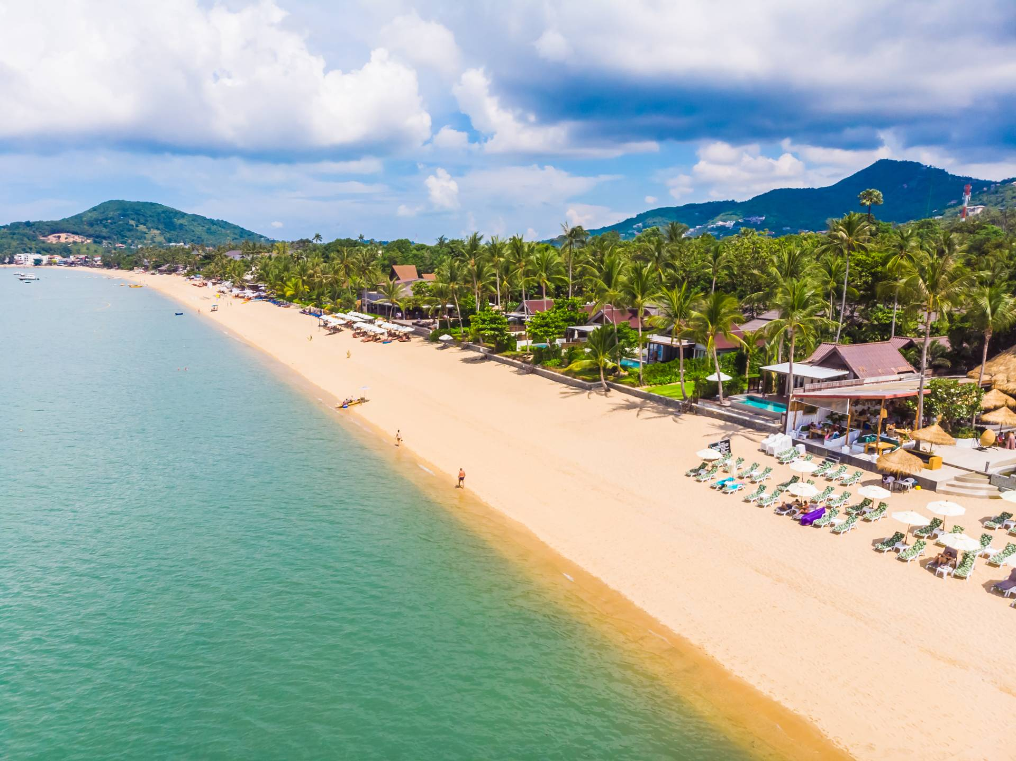


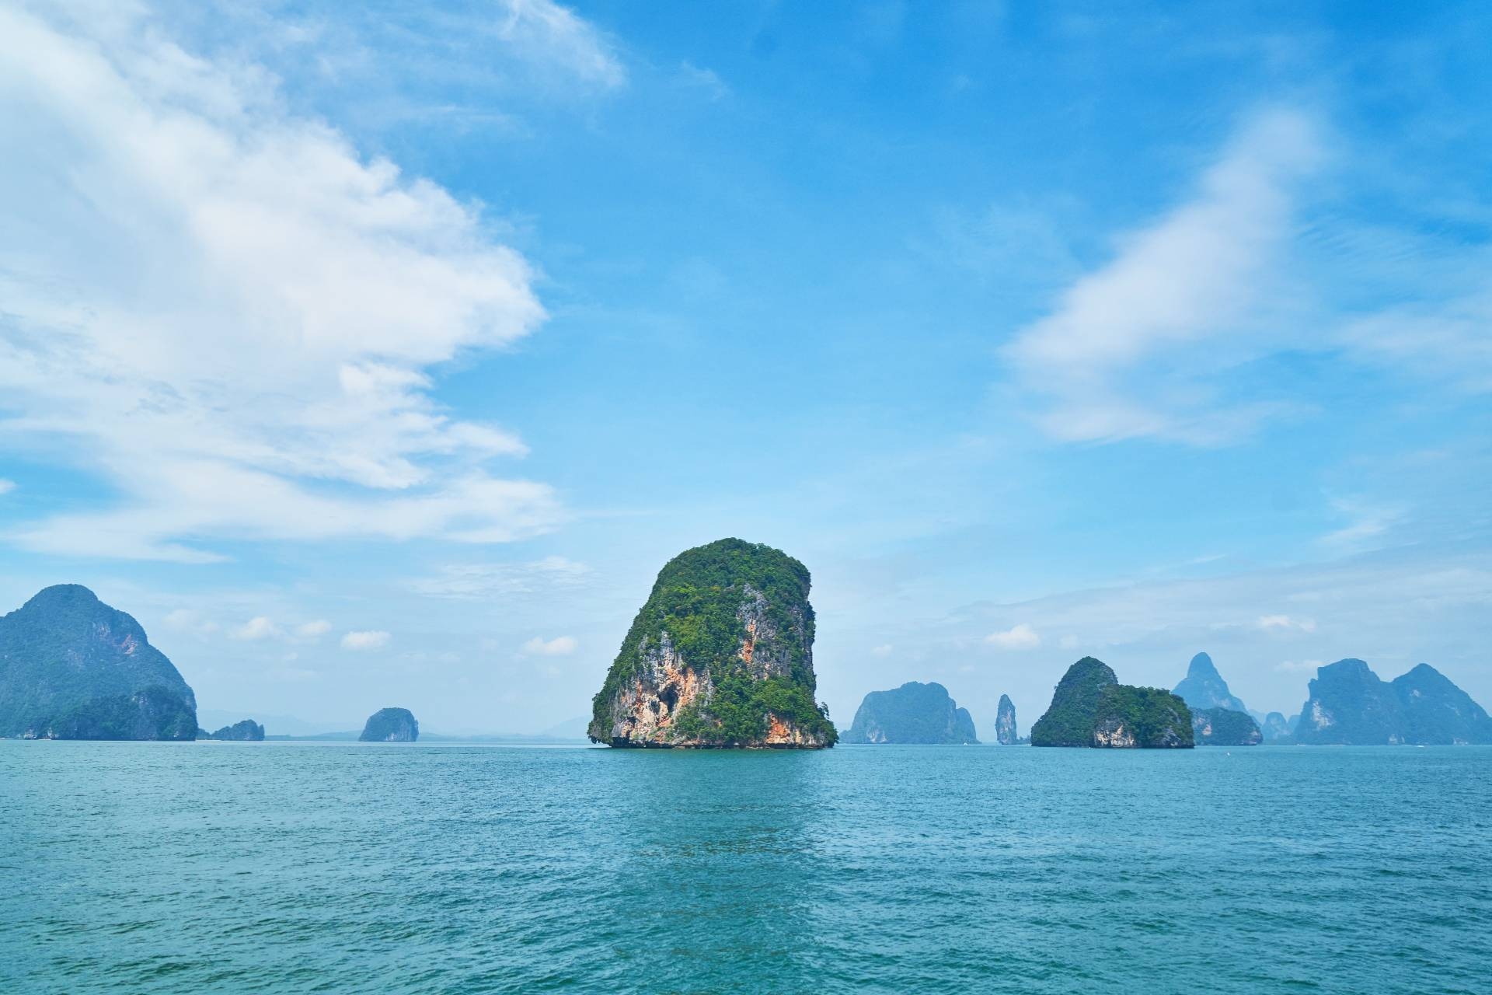



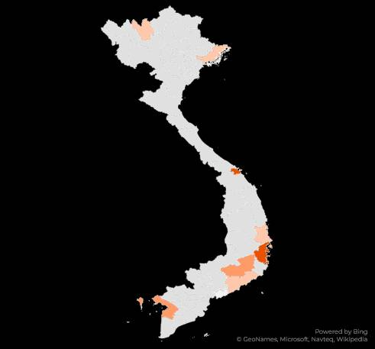
Destination Preferences: Domestic Leading
Considered domestic destinations
Base: Domestic travelers (n=1,014)
Sapa
Danang
Ha Long Bay
Nha Trang
36%
Phu Quoc
28%
Da Lat
24%
36%
41%
28%
24%
73% Choose Domestic only
While 27% Outbound/ Both
Danang
Driver | Affordability, Beach, Activities | Beach, City Amenities, Accessibility | Resorts, Nature, Premium Experience | Cool Climate, Romance, Nature
Segment | Families, Youth | Families, Groups | Couples, Luxury Seekers | Couples, Millennials
Quy
Nhon
Ha Long Bay
Nha
Trang
Quy Nhon
Sapa
Mui Ne
Da Lat
14%
18%
12%
11%
Phu Quoc
Mui Ne
Driver | Emerging, Affordability, Uncrowded | UNESCO Site, Cruises, Culture | Mountains, Culture, Adventure | Beach, Budget-Friendly, Sports
Segment | Value Seekers, Millennials | Families, Explorers | Adventure, Photography | Budget Travelers, Youth
Q: Are you planning to travel domestically or internationally this summer? | Q: Which domestic destinations are you considering for summer 2026?
Vietnamese Travel Trends Summer 2026 | InsightAsia Vietnam Primary Research | March 2026

Slide 14
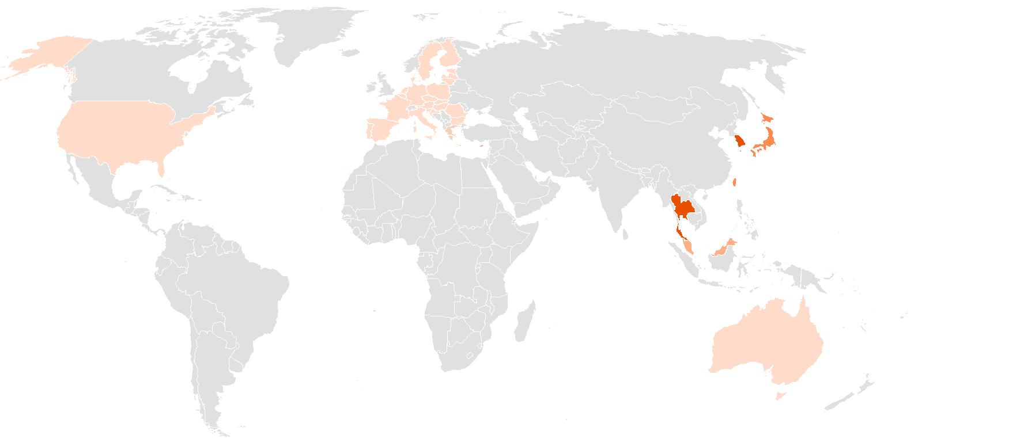














Outbound Destination Preferences
Considered domestic destinations
Base: Outbound travelers (n=375)
21%
Europe
Heritage,
Novelty, Visa Exemptions
Japan
Culture, Events, Premium Experience
7%
8%
18%
(vs 2025)
(vs 2025)
38%
South Korea
K-culture,
Shopping, Short-Haul
5%
4%
(vs 2025)
United States
Family/
Business, Education
9%
(vs 2025)
24%
52%
Taiwan
Food, Culture, Accessibility
Thailand
Affordability,
Proximity, Shopping
6%
8%
(vs 2025)
(vs 2025)
11%
Singapore
Urban, Family-Friendly, Events
Malaysia
Affordability,
Halal Options, Proximity
18%
(vs 2025)
5%
(vs 2025)
Stable
5%
Australia
Family/Study,
Nature
11%
(vs 2025)
Regional Asia Resilience, Premium Destinations Under Pressure
Affordable regional destinations are surging (Thailand +8%, South Korea +5%, Taiwan +6%) while premium and long-haul destinations face declines (Japan -8%, Singapore -5%, Europe -18%, Australia -11%). The shift reflects economic pragmatism and shorter travel times, with families prioritizing value and convenience. Japan remains popular at 21% but has softened from 29% in 2025 as budget-conscious travelers shift to more affordable regional options.
Q: Which international destinations are you considering for summer 2026?
Vietnamese Travel Trends Summer 2026 | InsightAsia Vietnam Primary Research | March 2026

Slide 15


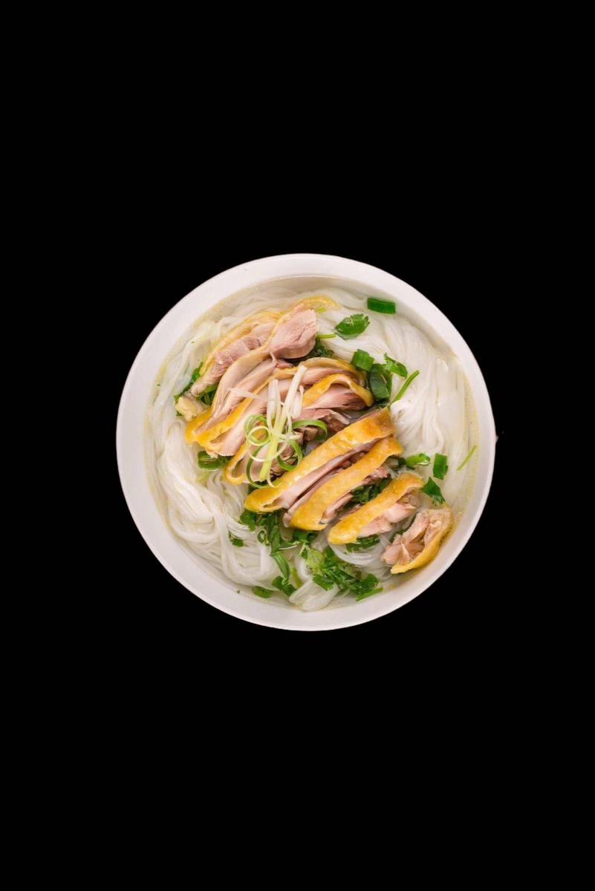
Key Destination & Accommodation Choice Drivers
Summer destination selection criteria
Accommodation selection criteria
Base: Total (n=1,389)
52%
Beach/Nature Activities
Base: Total (n=1,389)
36%
Safety/Security
Price/Value | 74%
Cleanliness | 71%
Location/Accessibility | 66%
Guest Reviews/Ratings | 61%
Family-Friendly Amenities (Pool, Kids Club) | 52%
Breakfast Included | 48%
Free Cancellation | 45%
61%
Family
Friendliness
68%
Affordability
Value for Money
56%
Accessibility (Short Travel Time)
44%
Cultural/Historical Interest
39%
Culinary/Food Experience
Q: What factors are most important when choosing a summer destination? (Select Top 5) | Q: What factors are most important when selecting accommodation? (Select Top 5) | Vietnamese Travel Trends Summer 2026 | InsightAsia Vietnam Primary Research | March 2026

Slide 16
Key Destination & Accommodation Choice Drivers
Accommodation types/brands satisfaction
Base: Past users | Scale: 0-100
Vinpearl is our go-to for family trips. Everything is there - pool, kids club, beach, restaurants. We don't need to leave the resort, which is perfect with young children. Yes, it's more expensive, but worth it for the convenience and quality.
— Female, 36, Hanoi Mother of 2, Bank Manager
By Criteria
Cleanliness
92
90
88
85
81
77
For couples' trips, we prefer boutique hotels or homestays. They're more authentic, often cheaper, and you get a real feel for the local area. Chain hotels are fine but they all feel the same.
— Male, 28, HCMC Graphic Designer
84 83 78
85 84 82
Staff Service
Value
86 88 90
78 79 84
87
87
91
72
77
81
Vinpearl & Fusion Lead, Value Matters
Amenities
Vietnamese brands Vinpearl and Fusion outperform international chains in overall satisfaction, driven by strong family appeal, integrated amenities, and localized service. However, value perception gaps remain, international chains score lower on value (78) despite high service quality, while local 3–4-star hotels and homestays rank highest for affordability (85, 84).
Remark | Overall Score
Remark | Overall Score
89
83
87
81
85
78
Q: How would you rate your satisfaction with the following accommodation types/brands you've experienced?
Vietnamese Travel Trends Summer 2026 | InsightAsia Vietnam Primary Research | March 2026

Slide 17









Consumer Segmentation Framework
Strategic Implication
Budget-Conscious Families dominate (42%), requiring targeted value packages, family-friendly amenities, and domestic destination promotions. Experience-Seeking Millennials (28%) respond to authentic local experiences, boutique accommodations, and regional Asia offerings. Affluent Quality Seekers (18%) are defined by behavior rather than budget alone - they prioritize premium experiences and are willing to pay more for quality, even if their absolute spend varies. This group is downsizing from long-haul to premium domestic/regional options while maintaining quality standards.
Budget-Conscious Families
Experiential Millennials
Affluent Quality Seekers
Regional Explorers
 | Families with children Budget ≤VND 1.3M/night Domestic-only travelers Value-driven decisions
 | Vung Tau, Nha Trang, Quy Nhon
 | Local OTAs, Direct hotel bookings
 | Ages 25-40, couples/solo Budget VND 1.3-2.6M/night Mix domestic & regional Authenticity-driven
 | Da Lat, Sa Pa, Thailand, Taiwan
 | Global OTAs, Airbnb, Klook
 | High-income, professionals Prioritize quality over price Premium choices Outbound preference
 | Da Lat, Sa Pa, Thailand, Taiwan
 | Global OTAs, Airbnb, Klook
 | Flexible travelers favoring short-haul regional destinations (Thailand, Malaysia, Taiwan) on moderate budgets, prioritizing accessibility, cultural experiences, and easy booking platforms.
42%
28%
12%
12%
 | Characteristics | Preferred destinations | Platforms
Vietnamese Travel Trends Summer 2026 | InsightAsia Vietnam Primary Research | March 2026

Slide 18


Strategic Implications
For OTAs & Travel Platforms
UP TO 50%
Enhance Mobile UX &
E-Wallet Integration
72% book via mobile, 46% pay via digital wallets
Seamless MoMo, VNPay, ZaloPay integration is non-negotiable for conversion.
2
Prioritize Domestic Campaigns
73% prioritize domestic travel
Allocate 65-70% of marketing budgets to domestic destination promotions, leveraging family-focused packages and short-haul accessibility messaging.
Local OTA Differentiation
Vntrip, MyTour must leverage Vietnamese language superiority, 24/7 local customer support, and exclusive domestic partnerships to compete with global OTA scale.
1
Flash Sales & Flexible Cancellation
62% cite promotions as key drivers
Implement aggressive flash sale strategies (especially June-July) with transparent refund policies to build trust.
4
3
Vietnamese Travel Trends Summer 2026 | InsightAsia Vietnam Primary Research | March 2026

Slide 19




Strategic Implications
For Hospitality Brands
Vinpearl & Fusion Model
Integrated resort experiences with on-site dining, activities, and convenience resonate strongly; replicate this model at scale.
8
Value-Driven Packages
92% have budgets ≤VND 2.6M/night
Create bundled family packages (accommodation + meals + activities) positioned as "all-inclusive value."
5
Family-Centric Amenities
56% travel as families
Invest in kid clubs, family pools, and multi-generational suite configurations.
Direct Booking Incentives
Offer exclusive perks (free breakfast, early check-in, room upgrades) to reduce OTA commission costs while maintaining competitive pricing.
6
7
Vietnamese Travel Trends Summer 2026 | InsightAsia Vietnam Primary Research | March 2026

Slide 20

We Are
SMALL enough to care &
BIG enough to trust
20
We champion innovative research
Technical rigor and quality control, combined with research passion, creativity and smarter thinking
We bring real local knowledge
To provide ‘up to the minute’ understanding of the evolving competitive & consumer context

Slide 21

Our Clients Trust Us
Because We Understand
Asia.
Efficient and effective research design.
The need for practical and actionable solutions.
21
We Are your
THINKING
PARTNERS

Slide 22
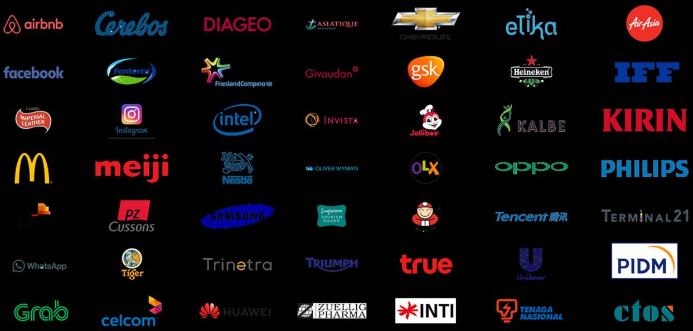




























Local & Regional Clients
Across Industries
...and more

Slide 23








(B2C) What we do
Survey: F2F/ Online
Focus Group
Home Usage Test
Central Location Test
Along shopping
Retail check/ audit
Ethnography
Mystery shopping

Slide 24


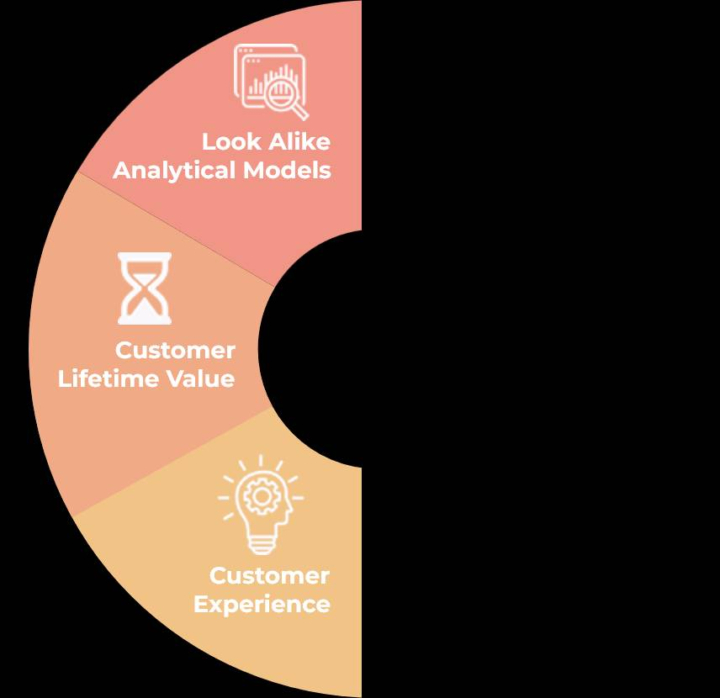
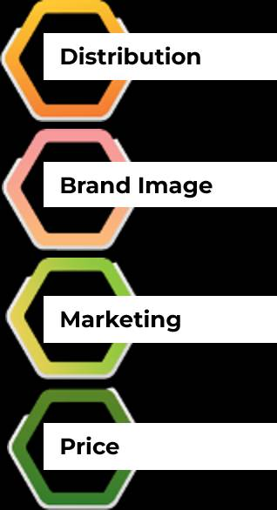


(B2B) What we do
Survey: F2F/ Online
In-depth Interview
Competitor Analysis
Market Analysis
ROMI Analysis
Ideation Workshop

Slide 25





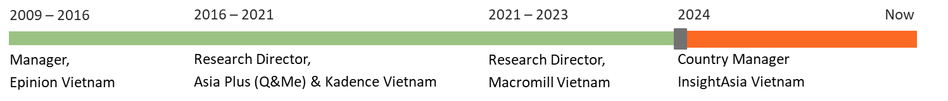

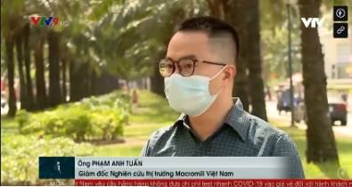
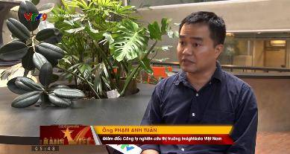
Mr. Pham Anh Tuan
Research Director, Country Manager || VIETNAM
Tuan is a seasoned senior marketing research with over 15 years of expertise, specializing in B2B marketing research. His focus is on market exploration and penetration studies within various sectors, both locally and regionally. With a unique blend of IT and market research experience, Tuan leverages his technical skills to enhance data analysis and market insights, offering a comprehensive understanding of market dynamics.
Renowned for his sharp analytical skills and consultative approach, Tuan has made significant contributions to the understanding of consumer trends and market behaviors.
Tuan’s expert insights are occasionally featured in local newspapers such as Dan Tri , Tuoi Tre Online aaaaaa , and on Vietnam primary TV channels , where he shares his perspectives on evolving market landscapes.

Slide 27
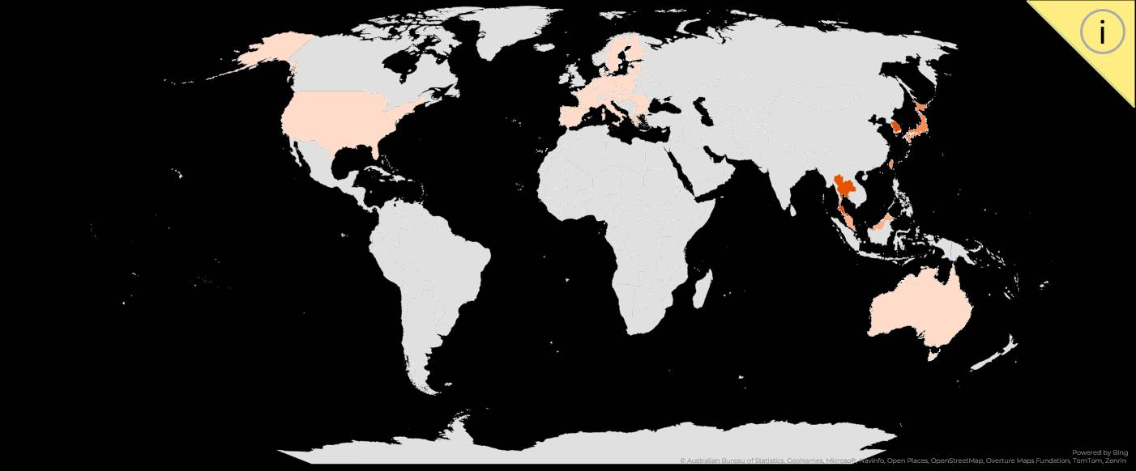
Outbound Destination Preferences
Q: Which of the following best describes your planned summer 2026 travel? | Vietnam Beer Market and Tet 2026 Consumer Trends | InsightAsia Vietnam Primary Research | December 2025

